Slide 1
Human Research Program
The Twins Study:
NASA’s First
Integrated Omics Study
NED
23 April 2015
Craig E. Kundrot, Ph.D.
Deputy Chief Scientist, HRP
SA2/NASA JSC

Slide 2
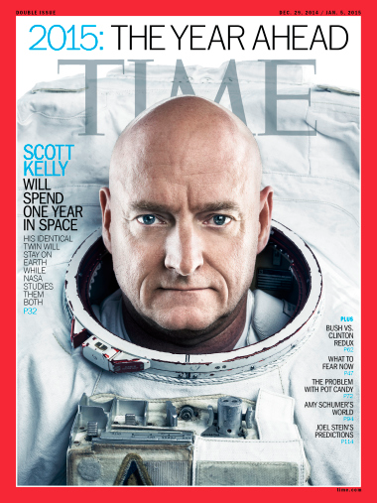
time.com/meet-the-twins-unlocking-the-secrets-of-space/
Notes:
Cover of Time magazine at the end of 2014. Twins Study is featured.

Slide 3
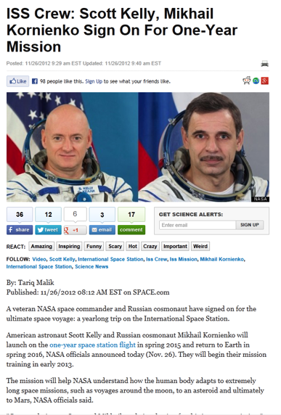
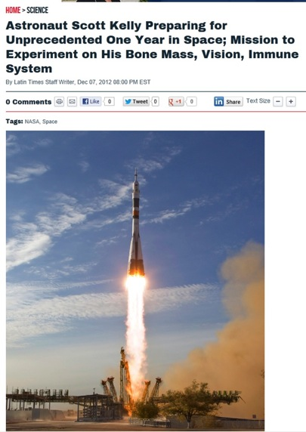
The One-Year Mission
Notes:
Shortly after SK was selected for the 1YM, he was being briefed on the research that would probably be done on the 1YM.
SK asked if any of the research would involve his twin brother, Mark.

Slide 4
1: Too Late
Launch
Solicitation and Award
Flight Preparation
2012
2013
2014
2015
Notes:
First reaction: no, it is too late for new experiments.

Slide 5
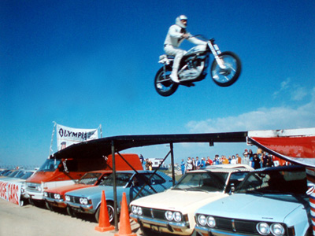
2: A stunt?
Notes:
Second reaction: just one twin pair would be a stunt

Slide 6
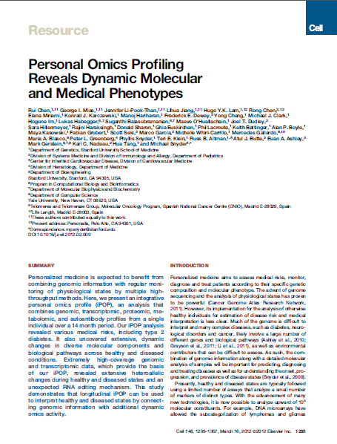
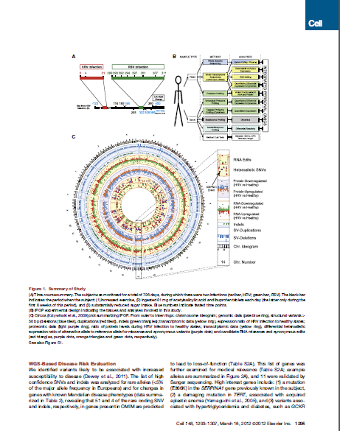
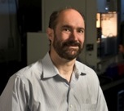
3a: Great Value in n = 1 Omic Study Over Time
Mike Snyder
Celll (2012) 148:1293-1307.
Notes:
Reaction #3: This omics study of just one individual over time was very informative.
So a study of the twins would not be a stunt.

Slide 7
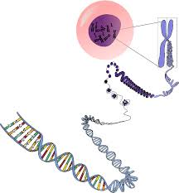
What is Omics?
Omics
Epigenome
Epitranscriptome
Genome
Transcriptome
Proteome
Metabolome
DNA
RNA
Protein
Nucleic Acids
Amino Acids
Carbohydrates
Lipids
Lipids
Lipids
Notes:
Animated slide
Start with a cell and DNA
Here is the the central dogma from high school biology; DNA is used to make RNA (transcription), RNA is used to make protein (translation), protein does most everything in a cell
Here are how the ‘omes’ are related to the central dogma.
The collection of ‘omes’ is omics.

Slide 8
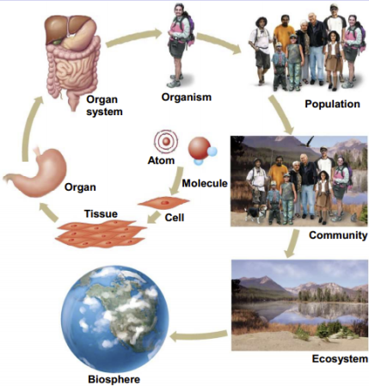
Where Does Omics Fit In?
Notes:
Omics is the study of the molecules in cells or tissues
Cells and tissues are our building blocks.

Slide 9
One Notion
Flight
Subject
Ground
Subject
time
pre-flight
in-flight
post-flight
Notes:
One set of comparisons can be comparing each subject to himself over time.
SK may show a response in some omics parameter when he is in flight and the value may head back to Earth normal values upon his return.
MK will live a ‘free range’ life on Earth, unconstrained by SK’s diet, sleep, exercise, etc. He provides a measure of natural variation.
The changes we see in SK can be compared to the variation seen in MK to give us an idea about significance.

Slide 10
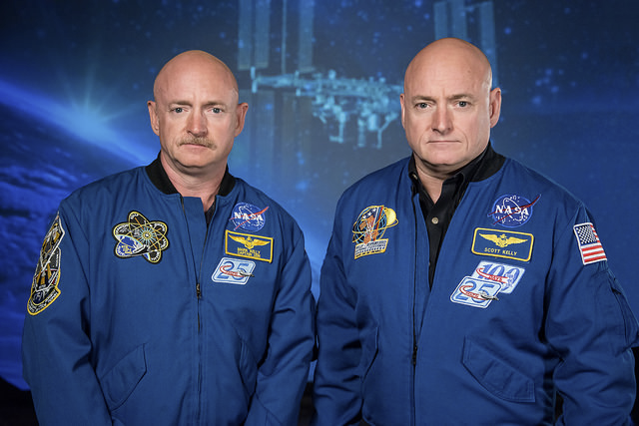
3b: A Chance in a Lifetime Opportunity?
Notes:
OK, if an omics study of one person can be worthwhile,
So can a study of the Kelly twins

Slide 11
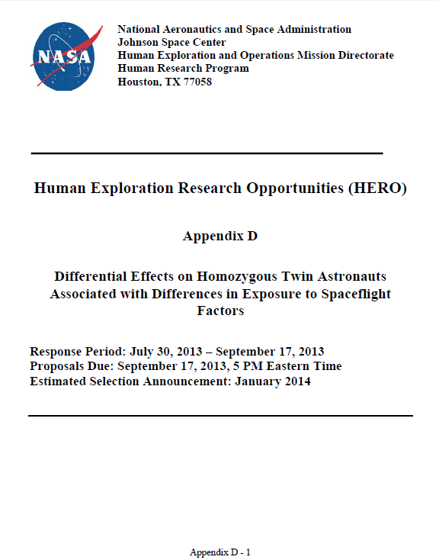
NRA Solicitation
“To capitalize on this unique opportunity,
  NASA’s Human Research Program (HRP) and the National Space Biomedical Research Institute (NSBRI) are initiating
  a pilot demonstration project focused on the use of integrated human -omic analyses to
    better understand the biomolecular responses to
      the physical,
      physiological, and
    environmental stressors
    associated with spaceflight.”
Notes:
HRP and NSBRI worked together to issue a joint solicitation.
This is a PILOT DEMONSTRATION project.
We hope to obtain some tantalizing results that will then be followed up with using more conventional studies.

Slide 12
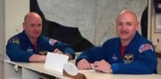
Selections
NASA Funded 10 Research Proposals In Response to its “Twins” Solicitation
2 Subjects
  Scott Kelly
  Mark Kelly
10 Selections
  Susan Bailey, Colorado State University, Differential effects on telomeres and telomerase in twin astronauts associated with spaceflight
  Andrew Feinberg, Johns Hopkins University School of Medicine, Comprehensive whole genome analysis of differential epigenetic effects of space travel on monozygotic twins
  Christopher Mason, Weill Medical College of Cornell University, The Landscape of DNA and RNA Methylation Before, During, and After Human Space Travel
  Scott Smith, NASA Johnson Space Center, Biochemical Profile: Homozygous Twin control for a 12 month Space Flight Exposure
  Emmanuel Mignot, Stanford University School of Medicine, HERO Twin Astronaut Study Consortium (TASC): Immunome Changes in Space
  Stuart Lee, Wyle Laboratories, Metabolomic And Genomic Markers Of Atherosclerosis As Related To Oxidative Stress, Inflammation, And Vascular Function In Twin Astronauts
  Brinda Rana, University of California, Proteomic Assessment of Fluid Shifts and Association with Visual Impairment and Intracranial Pressure in Twin Astronauts
  Mathias Basner, University of Pennsylvania School of Medicine, HERO Twin Astronaut Study Consortium (TASC) Project: Cognition on Monozygotic Twin on Earth
  Fred Turek, Northwestern University, HERO Twin Astronaut Study Consortium (TASC) Project: Metagenomic Sequencing of the Bacteriome in GI Tract of Twin Astronauts
  Michael Snyder, Stanford University, HERO Twin Astronaut Study Consortium (TASC) Project: Longitudinal integrated multi-omics analysis of the biomolecular effects of space travel
http://www.nasa.gov/content/nasa-selects-10-proposals-to-explore-genetic-aspects-of-spaceflight/
Notes:
40 proposals received
10 selected

Slide 13
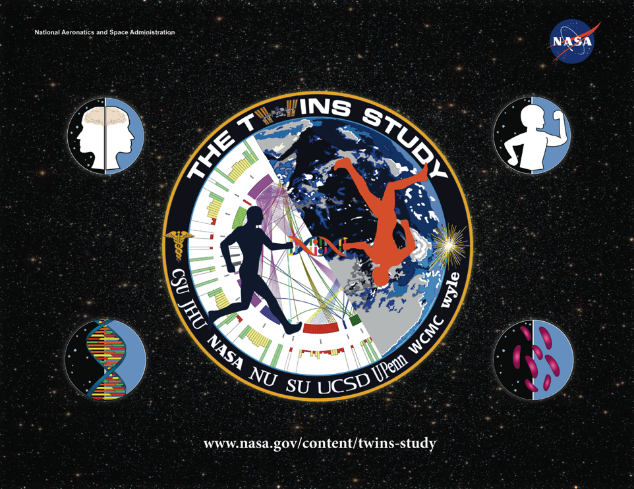
Notes:
See this web page for much more information on the Twins Study including links to media coverage

Slide 14





Differential effects on Telomeres and Telomerase in Twin
astronauts associated with spaceflight
Specific Aims
The rate at which telomeres shorten provides an informative biomarker of aging and age-related pathologies (e.g., cardiovascular disease and cancer) that captures the interplay between genetics and lifestyle factors.
We propose that for the astronauts telomere maintenance is particularly relevant, as it reflects the combined exposures (e.g., radiation) and experiences (nutritional, psychological and physical stressors) encountered during space travel.
    The Twins study provides the extraordinary opportunity to control variables of individual genetic differences, susceptibilities and lifestyle factors, making differential effects observed between the twins space-flight specific.
    Comparisons with unrelated astronauts (separate study), will allow evaluating role of genetics/individual susceptibilities.
Our goal is to assess changes in telomere length and telomerase activity associated with the upcoming yearlong ISS mission in the space- and earth-bound twin astronauts.
We hypothesize that accelerated telomere shortening and elevated telomerase activity will be associated with space flight
as compared to ground based control, in a duration and severity dependent manner.
Blood samples will be taken pre-flight (to establish baseline), in-flight (to evaluate short-term/temporary changes) and post-flight (to evaluate long-term/permanent changes)
Data sharing for other endpoints will also inform this effort
In vitro studies will investigate potential mechanisms (e.g., oxidative stress) and mitigation strategies (e.g., antioxidants)
Telomere length will be assessed using TELO-FISH
Florescence in situ Hybridization (FISH) with telomere probe on chromosomes (and interphase nuclei) is evaluated as Relative Fluorescence Intensity (RFI) distributions.
Susan Bailey, Ph.D.
Colorado State Univ
Kerry George
Wyle Labs/JSC
Implications of Research for Space & Earth
Space: This twins study will identify space-flight specific factors that influence telomere length and telomerase activity, informative biological indicators of aging and age-related degenerative diseases (e.g., cardiovascular disease and cancer). Our mechanistic investigations will begin to establish relevant relationships and suggest potential mitigation strategies for future study and to improve astronaut overall health.
Telomerase activity will be assessed using qRT-PCR TRAP
quantitative Real Time-PCR Telomere Repeat Amplification Protocol
Earth: Aging and age-related diseases like cardiovascular disease and cancer are an everyday concern on earth as well, therefore this study also seeks to make comparisons with unrelated astronauts (and controls) that will serve to identify individual susceptibility factors that influence telomere length and telomerase activity. Taken together with our mechanistic studies, mitigation strategies will be improved and applicable to all.
Notes:
These charts are ordered DNA->RNA->Protein+Metabolites-> Immunology -> Physiology -> Cognition -> Microbiome -> Integration
Telomeres = the end of our chromosomes (DNA)
Telomeres shorten with age and under stress
Will Scott’s telomere’s shorten faster than Mark’s?

Slide 15
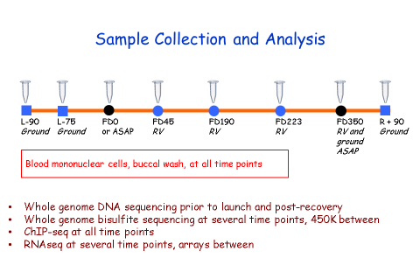
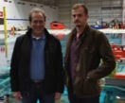
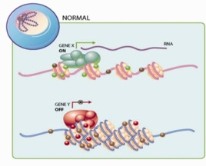
Epigenomics
Specific Aims
Aim 1. We will measure DNA methylation and chromatin at a genome-wide level in biological samples obtained from the space traveler at quarterly intervals, pre- and post-flight, and at times of unexpected exposures such as radiation events, or spacecraft environmental contamination. We also obtain measurements of the ground-based twin.
Aim 2. We will integrate epigenomic data with exposure to spaceflight conditions, looking for exposure-linked changes, and by comparison to the ground-based twin, determine whether these are transient or long-lived effects. We will also determine whether DNA mutations arise secondarily to these epigenetic changes.
Andrew Feinberg, M.D., M.P.H., and Jason Feinberg
Implications of the Research for Space & Earth
Space: Identify reversible causes of genomic damage in space, e.g. radiation or toxin induced epigenomics change; quantify aging and genomic exposure.
Earth: First human study of the epigenome over time in a defined/controlled environment.
DNA methylation
Histone modifications (>200 known)
Chromatin factor complexes
Chromatin structure
Notes:
The specific aims of many of the proposals overlapped a lot. For example, many proposals want to the look at DNA methylation.
For simplicity, these one pagers focus on the most salient features of each investigation and the ‘unique’ aspect that it brings to the Twins Study.
The epigenome is controlled chemical modifications to a) the part of DNA that does not encode the sequence and b) the proteins that pack DNA.
Changes in the epigenome change how much genes are “on” (making RNA) or “off”.
Will the ‘control levers’ that turn genes on and off be set differently in Scott and Mark?

Slide 16

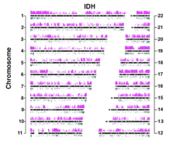

Landscape of DNA and RNA Methylation
Specific Aims: DNA to RNA
#1 – Genome-wide epigenetic profiles of DNA methylation changes
#2 – A comprehensive catalog of coding and noncoding, small and large RNA
#3 – Transcriptome-wide maps of RNA methylation sites
Δ in Epigenetics : Loci, regions, and clones
Christopher
Mason, Ph.D.
Francine Garrett-Bakelman,
M.D. Ph.D.
Δ in Transcriptome : Genes, Isoform, Edits,
Allele, SNVs, ncRNAs, Fusions, & Methylation
Implications of the Research for Space & Earth
Space: (1) Establish the genetic networks and expression patterns activated by space travel, (2) trace clonality of epigenetic changes, (3) examine the methylation of RNA
Earth: Aid research on aging, cancer, RNA biology, and circadian rhythm, all of which show differences at the (epi)genome & (epi)transcritpome
Notes:
The genes make RNA.
This study will look the actual levels of RNA made

Slide 17

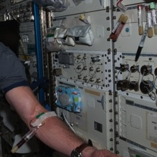
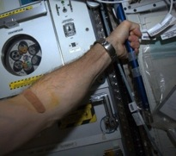
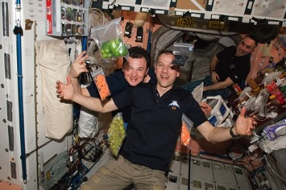
Biochemical Profile:
Homozygous Twin control for a 12 month Space Flight Exposure
Specific Aims
To provide a database of biochemical analyses from blood and urine samples. The analyses reflect a broad set of nutritional and physiological variables that may be altered as a result of the space flight environment (including diet, stress, weightlessness). Collecting data on the Ground twin will allow for a more direct comparison of the effects of space flight on human biochemistry and physiology.
Blood and urine collections
Preflight:
L-180, L-45, L-10
In-flight:
FD15, 30, 60, 120, 180, 240, 300, 360
Post flight:
R+0, R+30
Scott M. Smith, Ph.D.
Implications of the Research for Space & Earth
Space:
Improve understanding and time course of biochemical changes during flight and how the changes relate to diet during flight.
Earth:
Improve understanding of how diet can impact different biological systems.
Notes:
The RNA is used to make proteins.
The proteins conduct most of the chemistry in our body.
Will the proteins produced in Scott and Mark differ? Will their metabolites differ?

Slide 18
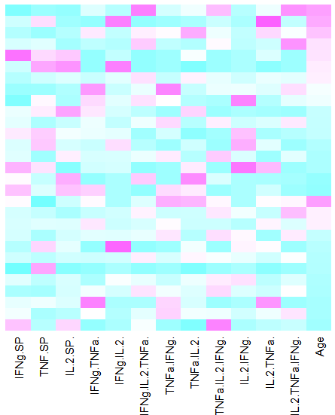


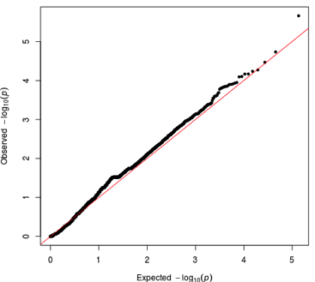
Immunome studies in space
Specific Aims
Study how long term space travel affects the immune system
We will study how parameters of the immune system change at baseline and after a seasonal flu vaccination
To do so, we study baseline and post flu parameters before, during and after a one year space flight
Cytokine production changes in flu reactive T cells following vaccination
Emmanuel
Mignot, MD, PhD
Stanford University
Implications of the Research for Space & Earth
Changes in T cell receptors clones after vaccination
Space:
Will ensure that astronauts keep a healthy immune system during long flight, and stay protected against infections from earth when visitors are coming.
Earth:
Understand how immune response to vaccination differ in twins
Notes:
This is one of the neatest ideas.
We see changes in the immune system.
Some call it dysfunction. We really don’t know that.
Both SK and MK received their annual flu shoots last fall.
They will receive the same formulation in the fall of 2015 (ISS supply logistics do not enable us to send up the 2015-2016 formulation in time)
After SK is back on Earth, both SK and MK will receive the seasonal vaccine in the fall of 2016.
This study will compare SK’s response to the vaccine in flight to his response on Earth and to MK’s responses.
Clever, safe challenge to the immune system.

Slide 19
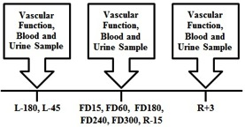
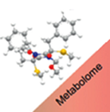
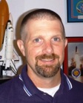
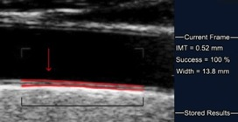
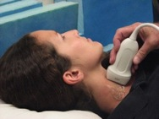
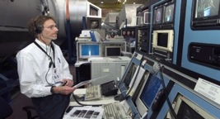
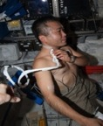

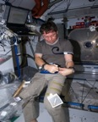
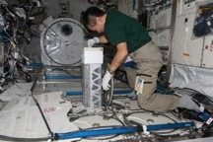


METABOLOMIC AND GENOMIC MARKERS OF ATHEROSCLEROSIS IN TWIN ASTRONAUTS
Specific Aims
To study the effects of long-duration spaceflight on the cardiovascular system independent of genotype
To investigate relationships between gene expression, metabolomic profiles, biomarkers in blood and urine, and arterial structure and function using the space-flown and the ground-based identical twin
Pre- and Post-flight Testing
Stuart Lee
Implications of the Research for Space & Earth
Inflight Operations
Space: Determine if the spaceflight environment perturbs genomic and metabolomic profiles and accelerates development of atherosclerosis (occupational health)
Earth: Develop novel insights of how longitudinal changes in genomic and metabolomic profiles are related to risk factors for atherosclerosis
Notes:
Physiology #1
Do we see ‘macroscopic’ changes in blood vessels and do those changes correlate with changes at the molecular level (the omics)?
Do Scott and Mark have the same kind of changes?

Slide 20

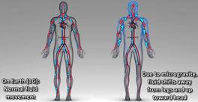


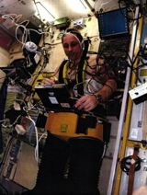


PROTEOMIC ASSESSMENT OF FLUID SHIFTS AND ASSOCIATION WITH VISUAL IMPAIRMENTS AND INTRACRANIAL PRESSURE IN TWIN ASTRONAUTS
Specific Aims
To explore proteomic and genomic biomarkers underlying space flight-induced fluid shifts and visual impairment & intracranial pressure (VIIP) symptoms.
Brinda Rana, PhD
Mike Stenger, PhD
Vivian Hook, PhD
Blood Plasma
proteins
The proteome is the set of proteins produced by the genome at a given time. Proteomics captures the state of molecular and cellular processes at a specific time point.
In-flight Operations
Blood Plasma collection Ultrasound measures
of fluid shifts
Intracranial Pressure
Intraocular Pressure Ocular Structure
Blood Pressure
Heart Rate
Vascular Resistance
Implications of the Research for Space & Earth
Space: Discovery of molecular pathways involved in the evolution of spaceflight adaptations related to fluid redistribution in-flight and the etiology of visual acuity and ocular changes in-fight and post-flight.
Pre- and Post-flight Testing
Earth: This project has broader impact on Earth-based clinical areas such as traumatic brain injury-induced elevations of intracranial pressure, hydrocephalus, and glaucoma
All in-flight operations
and:
Tissue hydration
MRI
Notes:
Physiology #2
Tied to VIIP
Do we see ‘macroscopic’ changes in VIIP symptoms and indicators and do those changes correlate with changes at the molecular level (the omics)?
Do Scott and Mark have the same kind of changes?

Slide 21

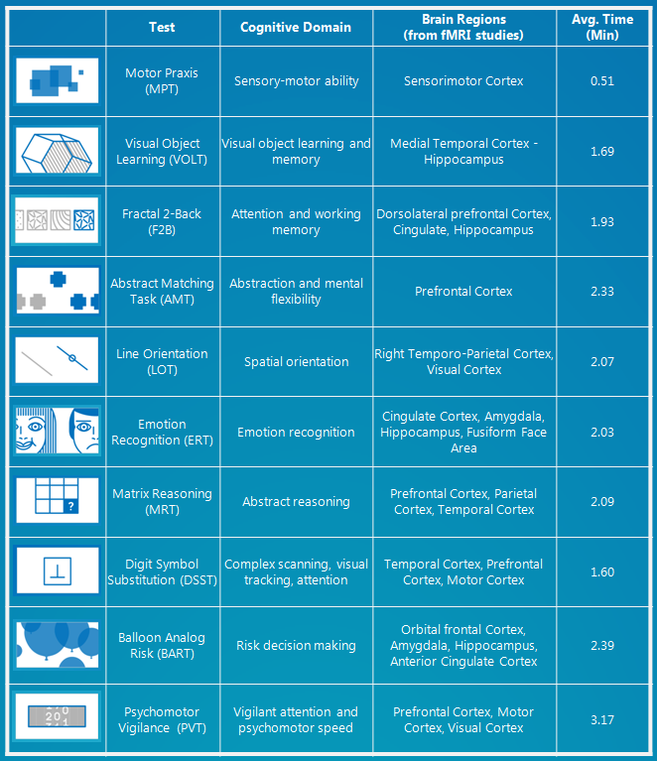

Cognitive Performance in Spaceflight
Specific Aims
There are a number of environmental stressors unique to the spaceflight environment that may affect cognitive performance, which is crucial for mission success. Our main objective in the TWINS study is to investigate whether cognitive performance is affected by initial and prolonged exposure to the spaceflight environemnt and after return to Earth. We will use the Cognition test battery, which consists of 10 brief neuropsychological tests that were specifically designed for high performing astronauts. We will compare data within subjects, between twins, relative to astronauts flying 6-month missions, and relative to normative data gathered in astronauts on the ground. The cognitive data will be correlated with markers derived from biological samples taken before, during, and after the 12-month mission.
Mathias Basner, M.D., Ph.D.
Ruben C. Gur, Ph.D.
Implications of the Research for Space & Earth
Space:
Exploration-type missions will require humans to spend unprecedented durations in space, yet our knowledge on the effects of prolonged exposure to the spaceflight environment is very limited. After the study, we will have an initial understanding of whether and to what extend prolonged ISS missions are associated with changes in cognitive performance, and how these relate to biologic markers.
The Cognition Test Battery
Earth:
The results have direct implication for other high performing populations exposed to stressful environments for prolonged periods of time on Earth.
Cognition was specifically designed for astronauts and is currently used during 6-month ISS missions and in multiple space analog environments (including Antarctica, HI-SEAS, and HERA).
Notes:
Do we see changes in cognition and do those changes correlate with changes at the molecular level (the omics)?
Do Scott and Mark have the same kind of changes?

Slide 22

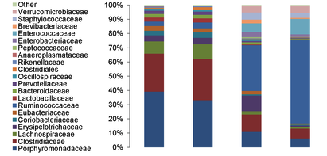
The Bacteriome in the Gastrointestinal Tract
Specific Aims
The GI tract of humans is populated by a diverse “ecosystem” of micro organisms, mostly bacteria: the bacteriome. The bacteriome can help-- contributing to digestion and immune system function-- or harm-- overgrowth of some types accompanies illness or stress.
This project will examine what changes occur to the bacterial populations over a year in space, that are different from the changes over time on Earth. Are particular types of bacteria susceptible to the space environment, and if so, which types?
Swab stool sample
Extract DNA
Make copies of bacterial gene
Sequence the copies
Identify the bacteria from the sequence
Fred Turek,
Ph.D.
Classify bacteria from each sample
Implications of the Research for Space & Earth
Space: Knowing how the bacteriome changes over time in space can help us make plans to protect astronauts’ health for longer-term space flights. For example, adjustments to diet could help maintain beneficial bacterial types.
Earth: Observing how the bacteriome changes in relation to health and environmental changes, (such as those studied in other Twin Projects) can provide insights into how the bacteriome may respond to challenges and contribute to the human host’s health.
#1 #2 #3 #4
Sample Number
Relative abundance of different families of
bacteria. Will there be systematic changes in
the twin in space not seen in the twin on Earth?
Notes:
Unlike the others, this in a sense is a study of non-human cells.
Do Scott and Mark have the same kind of changes in the bacteria present in their gut?

Slide 23

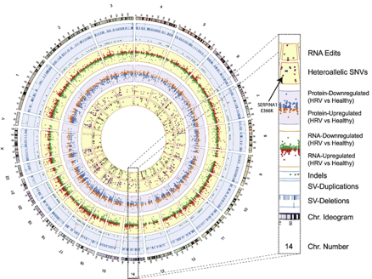

Integrated Omics: Mike Snyder, Ph.D.
Specific Aims
Our main objective in the twin study is to perform a complete analysis of all biomedical and molecular data collected during the mission to produce the singular most comprehensive portrait of the human biophysical response to the rigors of spaceflight. We are at an unprecedented era in genomic medicine, allowing for the sensitive and precise measurement of billions of biochemical molecules, which will allow us to detect the subtlest of changes in Scott and Mark’s physiology over time. By integrating these data, we can follow alterations in their cellular systems to both better understand the effects of space travel on human health, and how an astronaut’s genome may contribute to his/her own unique physiologic response to microgravity.
Michael
Snyder, Ph.D.
Juliane Winkelmann, M.D.
Implications of the Research for Space & Earth
Integrative multi-omic model
Space:
We will generate a detailed benchmark for how human physiology changes in space in great molecular detail. This wealth of data will be essential for any future planning of long duration space exploration missions, and provide a proof-of-principle for better monitoring and managing astronaut health.
Earth:
With this study, Scott and Mark Kelly will be the most thoroughly profiled twins in history, and the resultant data will offer new insights into how two siblings with nearly-identical genomes respond to different conditions.
Risk-o-gram
Notes:
Snyder pulls all this together.
All investigators will share ‘all’ of their data with one another, primarily through Mike Snyder’s computational platform.
They will publish the initial paper(s) together.
More detailed, specialized papers may be published by subsets of the 10 investigators, including just individual investigators

Slide 24






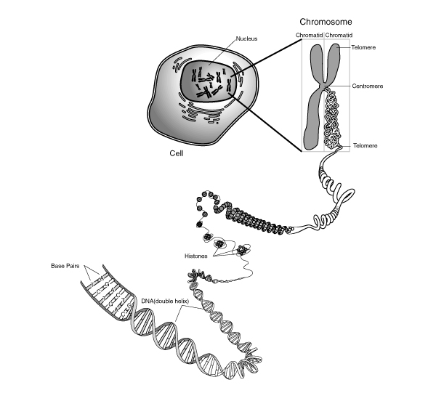
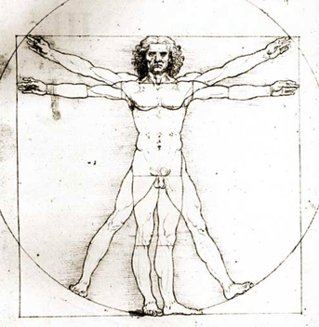


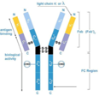

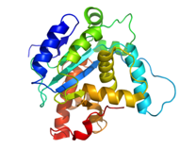



Vasculature
Lee
Cognition
Basner
Microbiome
Turek
Targeted and Global Metabolomics
Lee/Rana, Mignot/Snyder & Smith
Cytokines
Mignot
Telomere Length
Bailey
B-cells / T-cells
Mignot
Antibodies
Mignot/Snyder
Scott Kelly – ISS for one year
Chromatin
Feinberg
Mark Kelly – Earth control
DNA Mutations
Feinberg
DNA Hydroxy-methylation
Mason
large/small RNA
& RNA Methylation
Mason
DNA Methylation
Feinberg & Mason
Proteomics
Lee/Rana

Slide 25
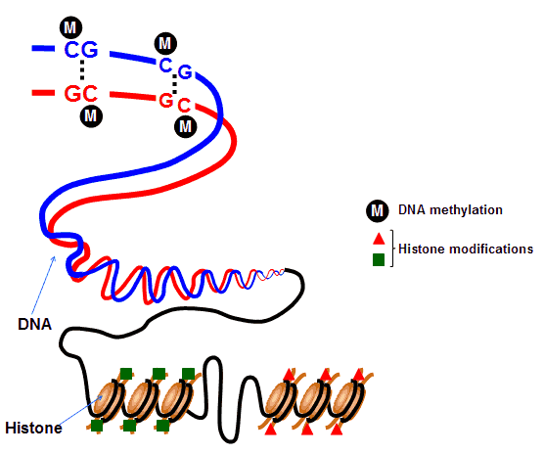
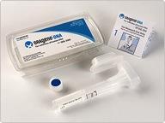
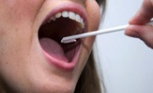
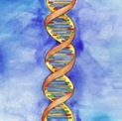
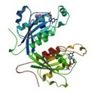
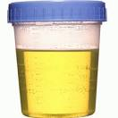
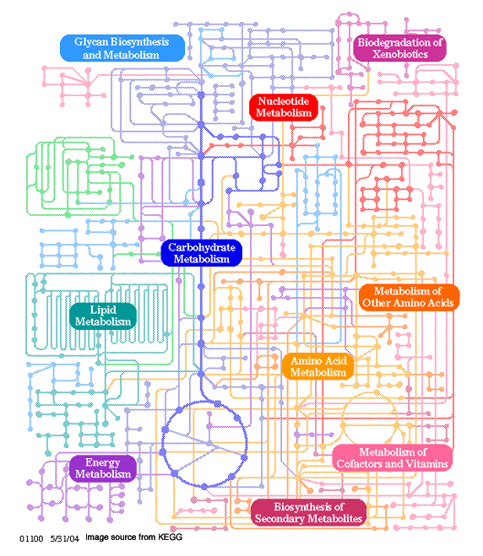
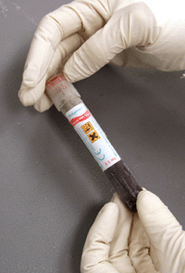
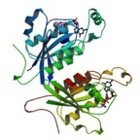
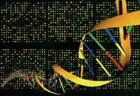



1
Epigenome
Buccal & Saliva
DNA
Proteins
Urine
Metabolites
Proteins
Blood
Epigenome
RNA
DNA
Stool
Metagenome
Notes:
The sample types for the molecular work

Slide 26
Timeline
One Year Mission Announced
Baseline Data Collection Begins
Solicitation Released
One Year Mission
Grants Announced
Last Major Post-flight Data Collection
‘12
2013
2014
2015
2016
now
Notes:
Blue data points are major sample/data collections for SK: circle=ground; triangle=flight
Green points are MK.
Other collections take place. This is just an overview.
Big wave of sample analysis will occur in the fall of 2016. Many of the omics analyses are sensitive to the batch of reagents used, the condition of the equipment, etc.
To minimize batch effects, a lot of analysis will be done after all the samples are in hand.
A few of the investigations will collected samples for longer: telomeres will take samples more than a year after return to Earth. But most will be done Fall 2016.

Slide 27

Issues Associated with Omic Research
Research ethics
  The primary risks involved in genetic research are risks of social and psychological harm, rather than risks of physical injury
    Could provoke anxiety and confusion about disease risk
    Uncover unwanted information about heritage, ancestry, and family relationships
  De-identification of genomic information
  Information given to subjects
    Individual genome sequence data?
    Interpretation of the genome sequence and/or genetic counseling?
    Option to decline to receive all or part of the results (Right Not to Know)?
  Researcher’s access to genomic information
  Interim policy on genetic research JID 1800.4
  NASA policy anticipated summer 2015
Medical care
Occupational health
Insurance (health, disability, life)
Employment activity
Notes:
The twins study drove NASA to address genetic research policies sooner that it would have.
The picture is a ticker tape parade for some astronauts. I forget which.
The point is that astronauts are highly visible figures (as well as employees) and therefore have different levels of risk in genetics research than most subjects in most studies.

Slide 28

Conclusion
The Twins Study (Scott and Mark Kelly) is NASA’s first foray into 21st-century omics research
  Built around Scott Kelly’s one year mission
The Twins Study will examine
  Genome, telomeres, epigenome
  Transcriptome and epitranscriptome
  Proteome
  Metabolome
  Physiology
  Cognition
  Microbiome
NASA is addressing
  Protections for research participants
  Use of data in medical care, occupational medicine, mission planning

Slide 29








Acknowledgements
The Twins Study Investigator Team
John Charles
Mike
Barratt
Bill Paloski
Graham
Scott
Jeff Sutton
Mark Shelhamer
Notes:
Most of the Pis in the Twins Study are shown in this group shot.
Charles and Barratt decided to do the Twins Study
Scott helped by writing the technical part of the solicitation, advising on selection, and now helps run the study. Sutton blessed Scott’s participation.
Shelhamer and Paloski continued the Charles/Barratt work.
I am like a mission scientist

Slide 30

Acknowledgements
time.com/meet-the-twins-unlocking-the-secrets-of-space/
Notes:
Thanks to our research subjects

Slide 31
Thank you

