Slide 1
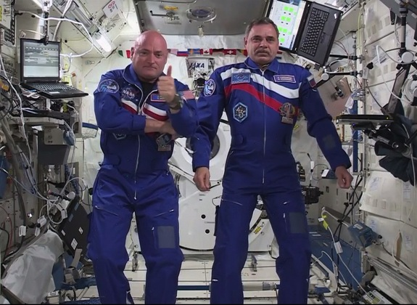
Two Guys, One Year, No Excuses
John B. Charles, Ph.D.
Associate Manager for International Science
NASA Human Research Program
NASA Enhanced Dissemination Talk: One Year Mission Edition

Slide 2
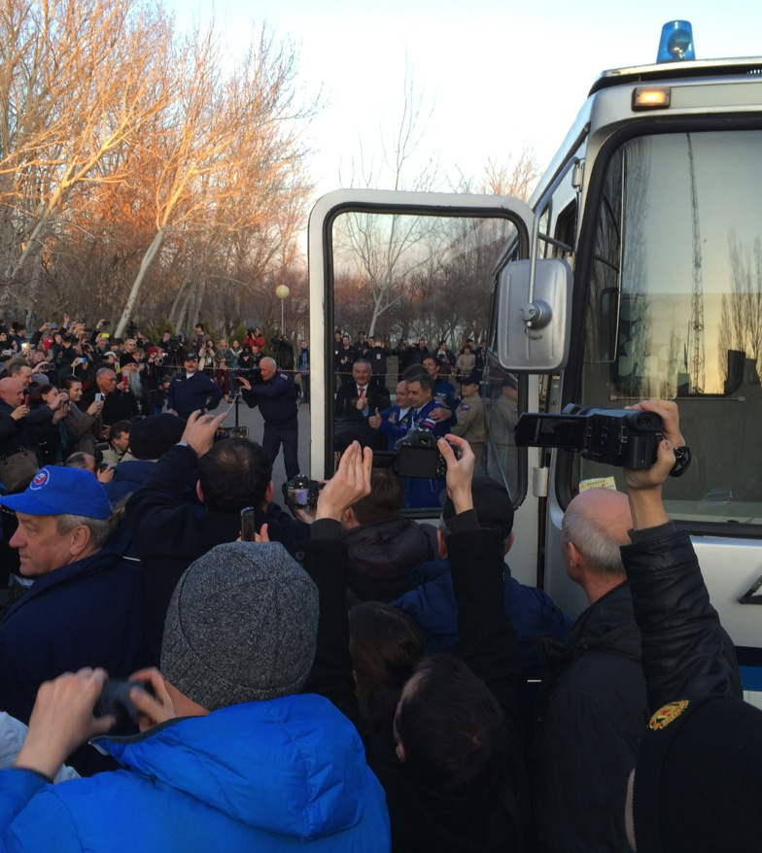
Disclaimers
One-year mission was proposed by Roscosmos, not NASA
Duration was not intended to mimic any specific future exploration-type mission
Statistically-valid results are not expected from sample size n = 2

Slide 3
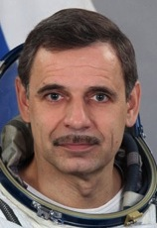
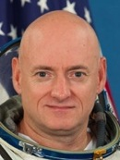
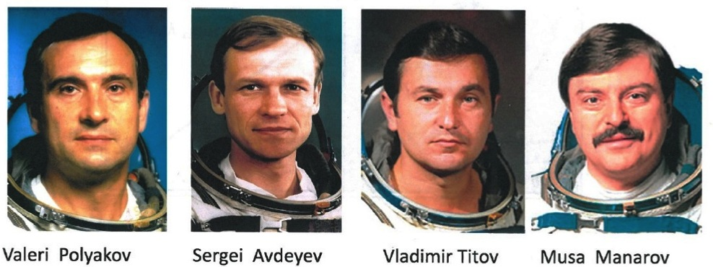
One-year fliers, past and present
Months | 14 | 13 | 12 | 11 | 10
# | 1 | 1 | 2 | 1 | 1
Year | 1994-1995 | 1998-1999 | 1987-1988 | 1987-1988 | 1992
Mikhail Kornienko
Scott Kelly

Slide 4

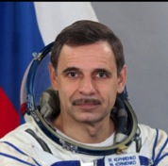
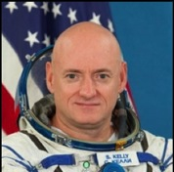
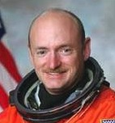

One-Year Mission Status
Multilateral biomedical investigations on US and Russian crewmembers
2012
Agency-level bilateral agreement. Candidate investigations exchanged
2013
Developed milestones, overarching principles for hardware & data sharing, cross-participation
Field Test experiment (joint, pre/post flight) initiated, transitioned to operations
Fluid Shifts experiment (joint, in-flight) initiated; implementation issues identified, resolved
Identified complementary ESA, JAXA, CSA investigations (thus “multilateral”)
2014
Completed informed consent for US investigations for both crewmembers
Crew time issues in work
Data Sharing Principles signed by SSCB
Initiated preflight baseline data collection and crewmember training
Bilateral PI meetings for collaborations, data exchange needs
Initiated Twins Study
2015
Completed informed consent for Russian investigations, baseline data collection, training
Finalized documentation for joint investigations implementation under guidance of KNTS/Soloviev
Mismatch between NASA crew time availability and requirements for Increments 45-46 (One-Year Mission, 2nd half)
Commitment to future year-long missions under discussion
Completed preparations for NASA Twins Study
Launched!

Slide 5
Human Research Objectives for One-Year ISS Mission
Utilize ISS efficiently to reduce risks of human exploration missions beyond low Earth orbit
  Implement a One-Year Mission by two ISS crewmembers (1 US, 1 Russian)
    Demonstrate benefits of joint work using multilateral capabilities and resources on ISS
      Extend earlier Russian work using 21st-century capabilities
    Assess biomedical, training, scheduling, certification and implementation issues associated with increased flight durations
  Apply experience to biomedical risk reduction research on subsequent ISS missions of all durations

Slide 6
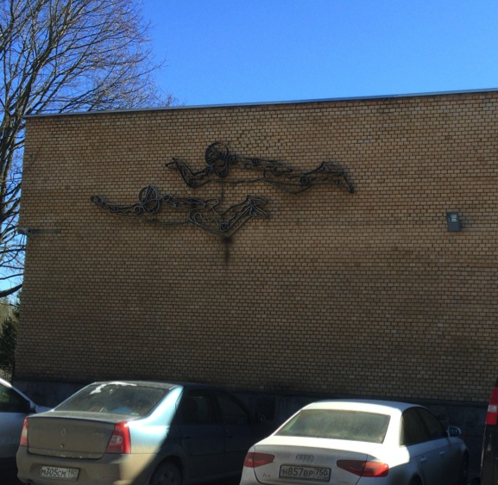
Human Research Objectives for One-Year ISS Mission (simplified)
Are we as smart as we think we are based on 15 years of 6±-month ISS expeditions?
Previous Russian experience shows no “brick walls” out to 14 months
Crewmember safety, health and efficiency on 30-month Mars round-trip missions will need “countermeasures” developed and tested on ISS
  How to extrapolate to 30-months?
    No a priori reason to expect “brick walls”
  Year-long expedition permits next-step longer evaluation under controlled circumstances

Slide 7
Human Health and Performance Exploration Risks Across All Partners to be addressed by ISS Research
Risk Area
Musculoskeletal: Long-Term health risk of Early Onset Osteoporosis. Mission risk of reduced muscle strength and aerobic capacity
Sensorimotor: mission Risk of sensory changes/dysfunctions
Autonomous Medical Care: Mission and long-term health risk due to inability to provide adequate medical care throughout the mission (Includes onboard training, diagnosis, treatment, and presence/absence of onboard physician)
Behavioral Health and Performance: Mission and long-term behavioral health risk.
Ocular Syndrome: Mission and long-term health risk of Microgravity-Induced Visual Impairment and/or elevated Intracranial Pressure (VIIP)
Nutrition: Mission risk of behavioral and nutritional health due to inability to provide appropriate quantity, quality and variety of food
Hypogravity: Long-term risk associated with adaptation during IVA and EVA on the Moon, asteroids, Mars (vestibular and performance dysfunctions) and postflight rehabilitation
Radiation: Long-term risk of carcinogenesis and degenerative tissue disease due to radiation exposure – Largely addressed with ground-based research

Slide 8
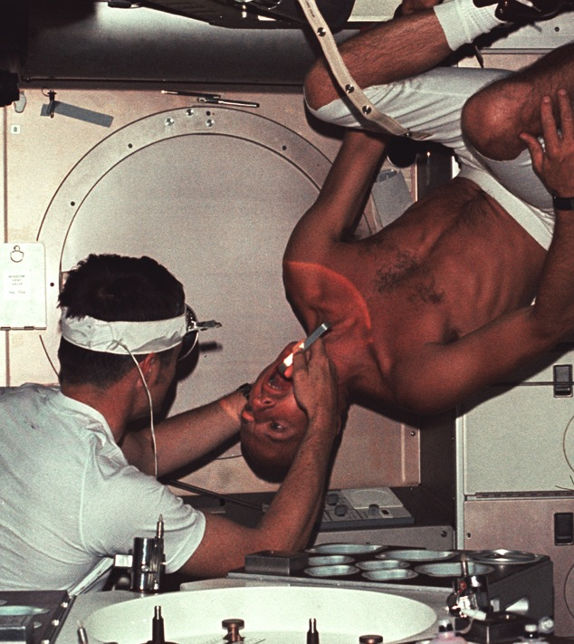
Three Major Areas of Biomedical Concern for Long Missions
Medical events
  Establish likelihood of negative events which change over time
  Characterize response of known medical conditions
Physiological deconditioning
  Establish efficacy of countermeasures for missions longer than ISS
Behavior & Performance
  Characterize trends over time
  Validate countermeasures

Slide 9
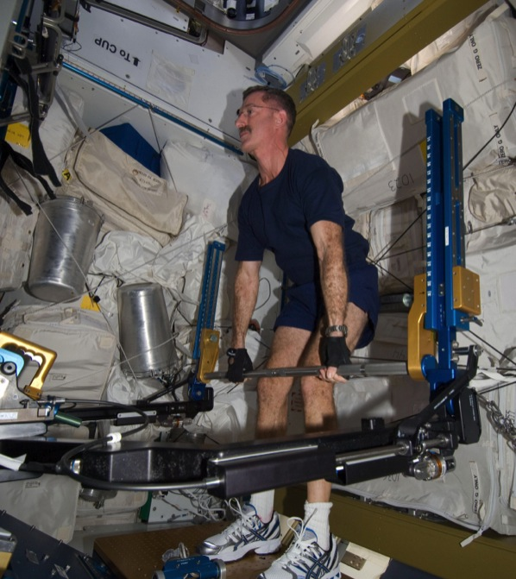
Three Major Areas of Biomedical Concern for Long Missions
Medical events
  Establish likelihood of negative events which change over time
  Characterize response of known medical conditions
Physiological deconditioning
  Establish efficacy of countermeasures for missions longer than ISS
Behavior & Performance
  Characterize trends over time
  Validate countermeasures

Slide 10
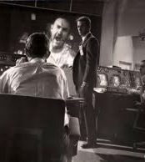
Three Major Areas of Biomedical Concern for Long Missions
Medical events
  Establish likelihood of negative events which change over time
  Characterize response of known medical conditions
Physiological deconditioning
  Establish efficacy of countermeasures for missions longer than ISS
Behavior & Performance
  Characterize trends over time
  Validate countermeasures

Slide 11
NASA Proposed Biomedical Investigations for One-Year Mission
US study
Sleep Monitoring
Reaction Self-Test
Astronaut Journals
Biochemical Profile Surveillance
QCT for Regional Bone Architecture
Functional Task Test
Scott Kelly performed these 6 (or something close) on his previous 6-month mission
Possible match for one or more of 7 Russian investigations
US Study
Fluid Shifts
Ocular Health
Sprint (including Maximal Oxygen Consumption)
Salivary
Cardiovascular Oxidative Damage
Neuroscience Operational and Functional Field Test
Cognition
Neuromapping (fMRI)
New—Scott Kelly did not perform them on his previous 6-month mission
Possible match for one or more of 17 Russian studies

Slide 12

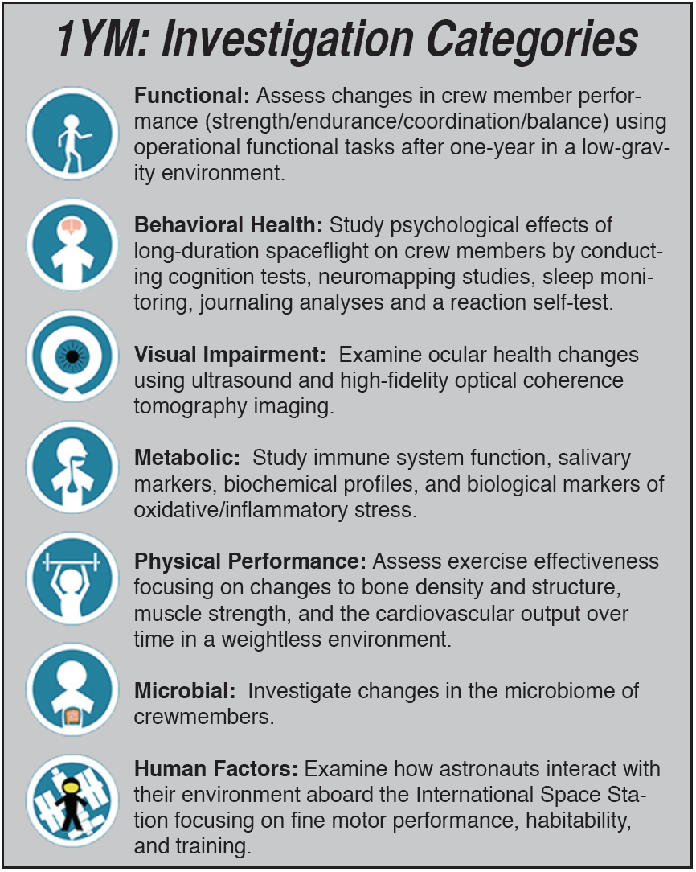
Categories of investigations

Slide 13
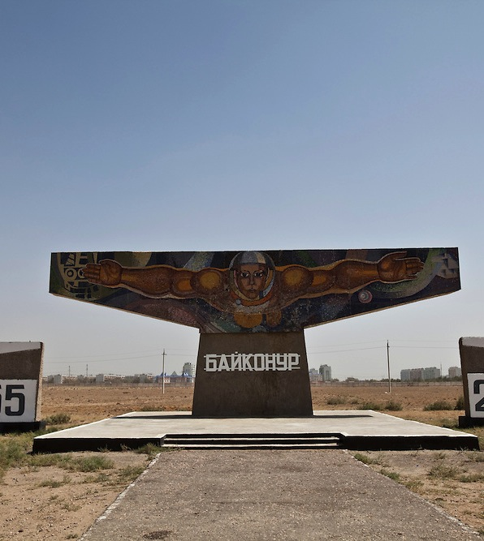
Types of Investigations
Joint
  Collaborating co-PIs from Roscosmos, NASA
  Roscosmos, NASA crewmembers as subjects
Cross-Participation
  Led by one partner (e.g., Roscosmos or NASA)
  Roscosmos, NASA crewmembers as subjects
Data Exchange
  Investigations within national programs
    No cross-participation

Slide 14
Multilateral Biomedical Science Plan for One-Year Expedition
MHRPE Risk | Category | NASA | Roscosmos | JAXA | ESA | CSA
Sensorimotor & Musculoskeletal | Functional Capacity | Field Test |  |  |  | TBD [D]
 |  | Functional Task Test [D] | Effektivnost [D]
 | Physical Performance | Sprint (control) [D] Hip QCT [D] | Korrektsia [EDOS]/Motokard [D] Profilaktika [D] |  | EDOS [Korrektsia] [D]
Sensorimotor & Hypogravity | Human Factors | Fine Motor Skills Habitability Training Retention | Russian crewmember participation only GCTC collaborator identified
Hypogravity | Metabolism | Biochemical Profile[D] CardiOx [D] Salivary Markers [D] | Morze [D] Neyroimmunitet [D] |  | Immuno-2 [D]
 | Microbial | Microbiome |  | Myco
Behavioral Health & Performance | Behavioral Health | Cognition Sleep Monitoring Reaction Self Test Journals [D] | Pilot-T Interactions-2 Content | Biological Rhythms (48 Hours)
Ocular Syndrome | Visual Impairment | Fluid Shifts Ocular Health/MedB1.10 |  | IPVI | Energy
Participation: US astronaut, Russian cosmonaut, both
Italicized: pre/post only
Korrektsia (Roscosmos) and EDOS (ESA) are same experiment
Bilateral NASA, Roscosmos investigations
  common (“joint”) shown in merged cells
  cross-participation, green font
  data-exchange only indicated by [D]

Slide 15
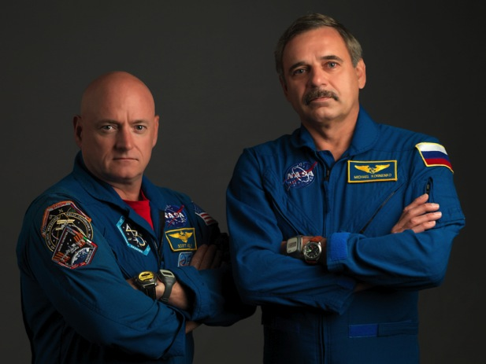

Bilateral US-Russian Work on One-Year Mission
Joint US-Russian investigations done by both crewmembers
  Ocular Health
  Fluid Shifts
  Field Test (pre/postflight only)
US investigations also done by
Russian cosmonaut
  Fine Motor Skills
  Cognition
  Sleep Monitoring
  Reaction Self Test
Russian investigations also done by
US astronaut
  Pilot-T
  Interactions-2
  Content
Data exchange only between other national investigations

Slide 16
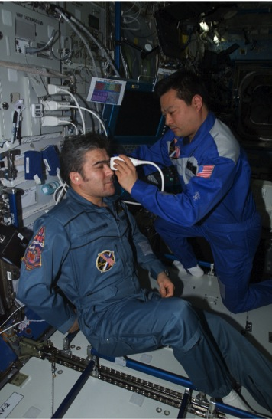
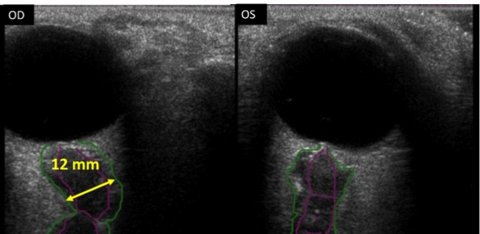
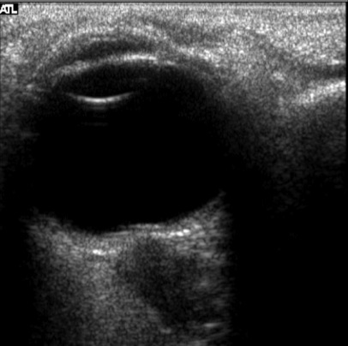
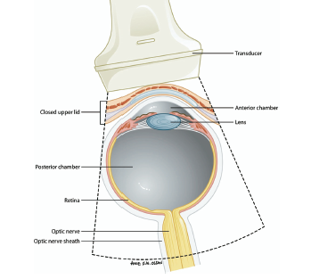
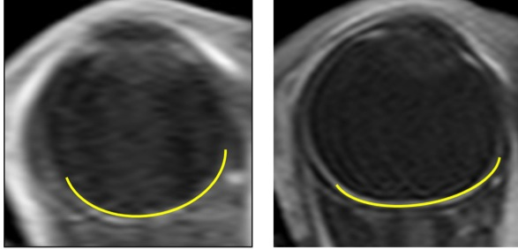
Visual Impairment and Increased ICP
50% of ISS crewmembers report vision changes after several months in weightlessness, primarily increased farsightedness
1. Increased Optic Nerve Sheath Diameter
3. Raised Optic Disc
Terrestrial Normal<5.9mm
2. Posterior Globe Flattening
Flattening of Posterior Globe
Identified as one of NASA’s highest priority medical problems
Cause not known, but headward fluid shift is suspected.

Slide 17
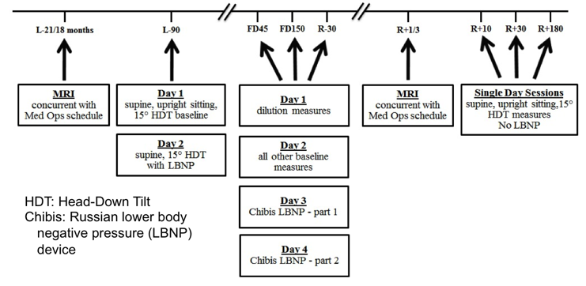
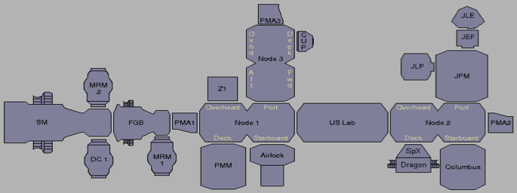
Fluid Shifts Investigation
(joint in-flight study)
M. Stenger (NASA), A. Hargens (UCSD), S. Dulchavsky (HFH), I. Alferova (RAS IBMP)
Characterize body fluid distribution pre/in/post spaceflight.
Correlate in-flight alterations of eye structure, ocular vascular parameters, vision with headward fluid shifts, vascular dimensions, flow patterns.
Determine systemic, ocular factors of individual susceptibility to development of ICP elevation, vision alterations.
Day 3
First flight: 1YM
OCT
and laptop
Day 4
Chibis
Tonopen
2 additional laptops for video routing
USND2
CCFP
DPOAE
Manometer
HRF laptop

Slide 18
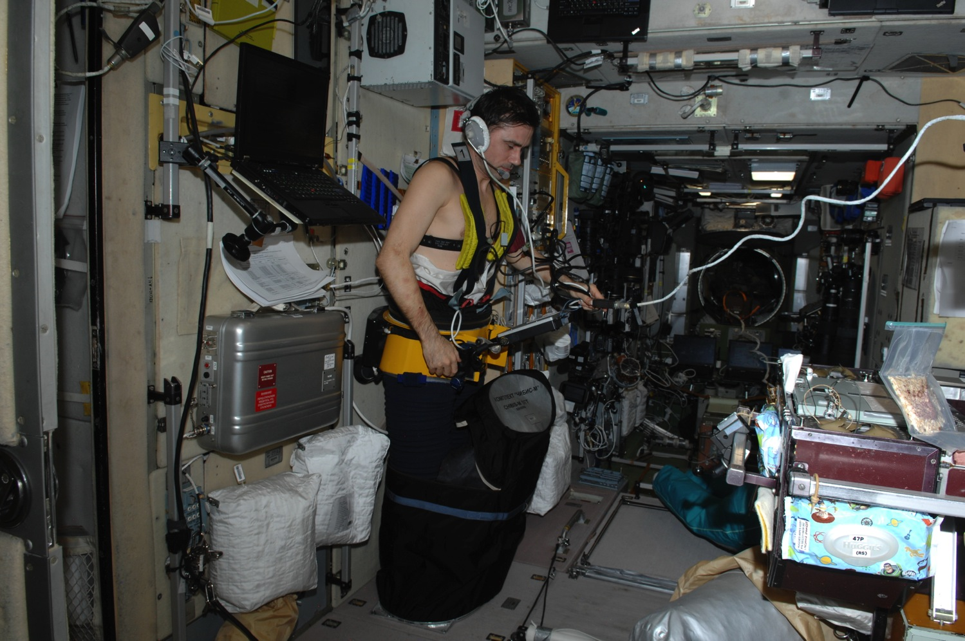

Slide 19
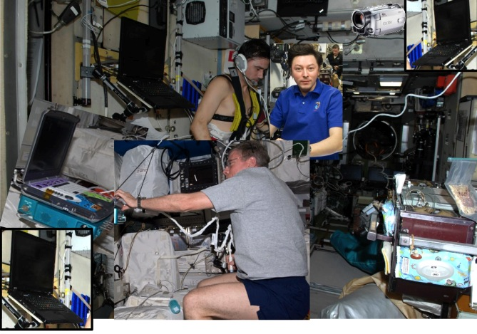

Slide 20
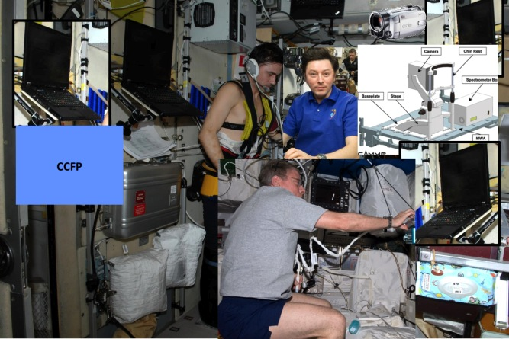

Slide 21
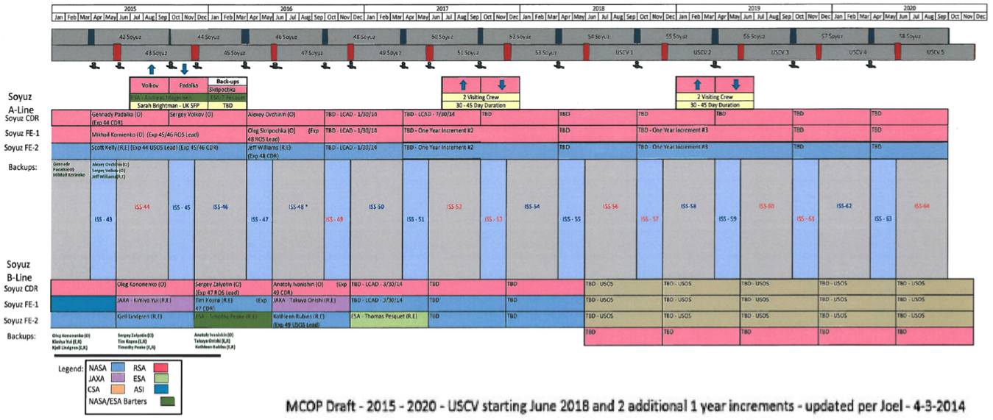
NASA Proposal for Integrated Program
Multilateral expert panels have endorsed clinically-driven biomedical research on long duration missions including additional one-year (and longer) expeditions for understanding and mitigating medical risks to provide foundation for planning exploration-class missions
NASA HRP proposal – in consideration by ISS partners
  Provide comparable data for investigations across different durations through 2024
    Ongoing 6-month missions (6MM)
    ~Biennial 1YMs
      6-month intervals
      Up to 5 more
    6-week missions (6WMs)
      paired with 1YMs
NOTIONAL

Slide 22
Summary
ISS is being utilized to reduce risks of human space exploration missions beyond low Earth orbit
  Faster risk reduction through multilateral capabilities and resources on all future ISS expeditions
  Resolving biomedical, training, scheduling, certification and implementation issues associated with increased flight durations, starting with the One-Year Mission by two ISS crewmembers
  Proposing a coherent program of research on long (one-year), short (6-week) and intermediate (6-month) missions to identify risks requiring focused attention when extrapolated to Mars mission durations

Slide 23


