Slide 1
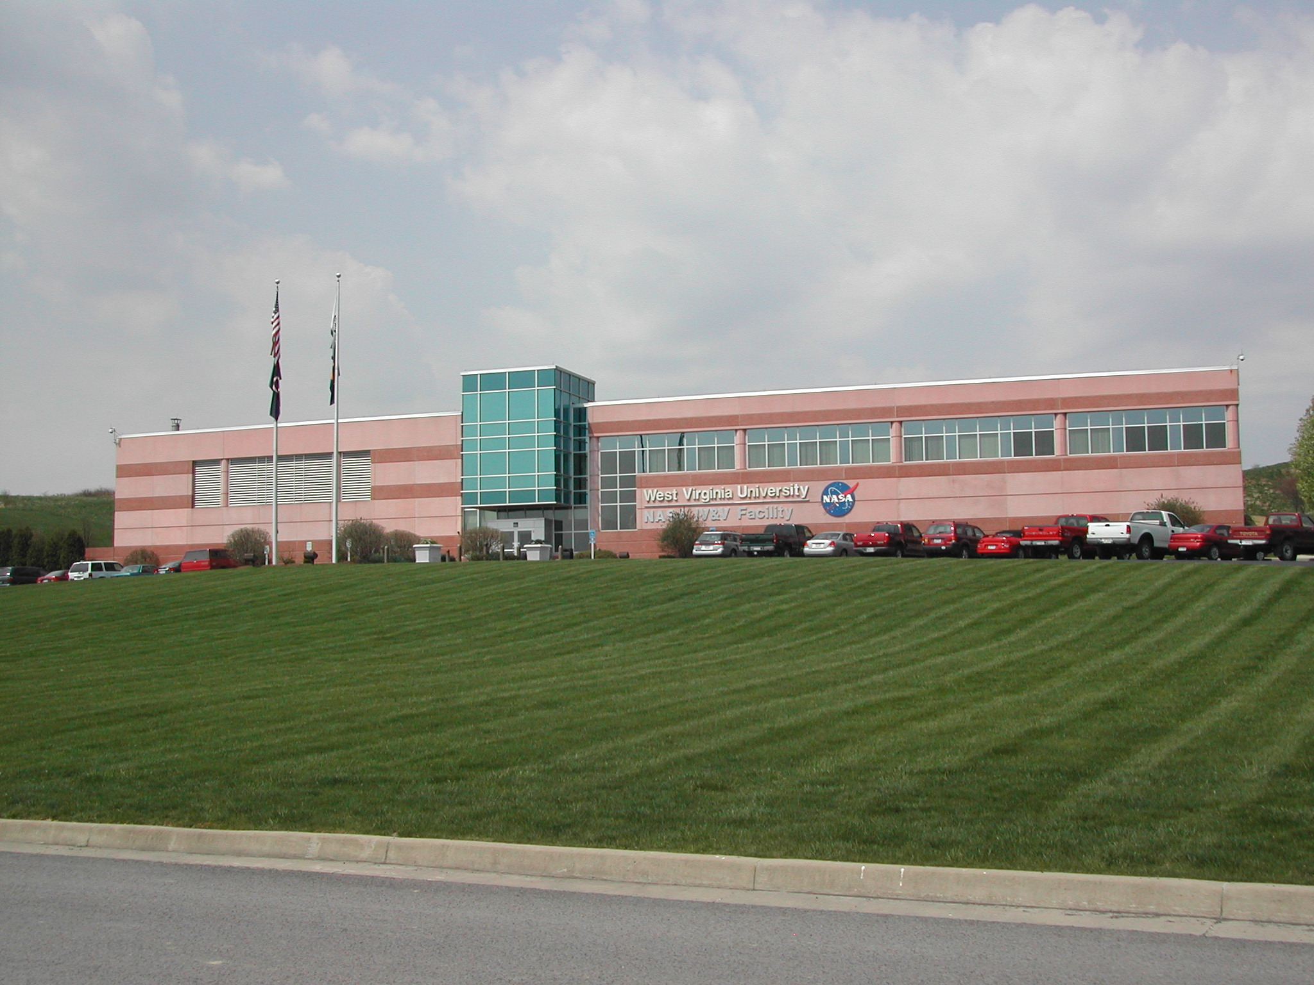
NASA IV&V
Raised Floor Space Safety Orientation
Last Updated: March 2017

Slide 2
Welcome to West Virginia's NASA IV&V Program
Providing orientation for new employees, to ensure a safe stay while at NASA is the goal of our staff. This orientation is required for all employees including interns at both Building 1 and Building 2 as well as any other remote offsite locations where there is program sponsored work.

Slide 3
Voluntary Protection Program
Safety is our number 1 value.
We are an OSHA Voluntary Protection Program (VPP) Star worksite. Achieving the Star certification means that our workplace goes above and beyond minimum safety requirements. The OSHA VPP is designed to promote excellence in safety and health by recognizing facilities with outstanding occupational safety and health management systems. It is based on a cooperative relationship between management and employees to promote employee protection and emphasize the continual identification and elimination of hazards in the workplace.
For more info on VPP you can go to the following link:
http://www.osha.gov/dcsp/vpp/

Slide 4
Employee Safety Committee
The NASA IV&V Program has an active employee safety committee in place to help promote safety and health awareness for all NASA IV&V personnel.
This committee meets on a regular basis to discuss and act on any health and safety issues, events, or safety concerns or recommendations.
To participate on the committee please contact your supervisor and email David.P.Sheldon@nasa.gov or Joseph.E.Irons@ivv.nasa.gov
Contact safety committee members @ members

Slide 5
Health & Safety Issues
Follow the IV&V Safety reporting located on our Facility Services page procedure @
O&M Services - Policies & Procedures - Safety Reporting Policy
Report all Health & Safety concerns, including any close calls or accidents, to David Sheldon @ 8289, the Security Police at extensions 8200 or 5200
  304-367-8200 (Building 1) or 681-753-5200 (Building 2)
You may also record a close call or mishap by using NMIS NASA MISHAP INFORMATION SYSTEM. NMIS Home

Slide 6
In case of Fire (B1)
Follow the Emergency Evacuation plan located on our Facility Services page @
O&M Services - Policies & Procedures - Emergency Evacuation Policy
Building 1, 100 University Drive
Everyone must move as far away from the building as possible so that passage of emergency vehicles and emergency personnel is not obstructed. If exiting from the front entrance, stand beyond the flag poles. If exiting from the rear entrance, stand on the second tier parking lot. If exiting from a side door, stand 100 feet away from the building. Follow the diagrams on the next two pages, (depending on the floor you are located on), in this document to find the nearest exit.

Slide 7
Building 1: First Floor Evacuation Plan

Slide 8
Building 1: Second Floor Evacuation Plan

Slide 9
In Case of Fire (B2)
Building 2, 5000 NASA Boulevard
Everyone must move as far away from the building as possible so that passage of emergency vehicles and emergency personnel is not obstructed. If exiting from the rear entrance, stand in the front of the building on the grass. If exiting from a side door, stand 100 feet away from the building. Follow the diagrams on the next two pages, (depending on the floor you are located on), in this document to find the nearest exit.

Slide 10
Building 2: Second Floor Evacuation Plan

Slide 11
Building 2: Third Floor Evacuation Plan

Slide 12
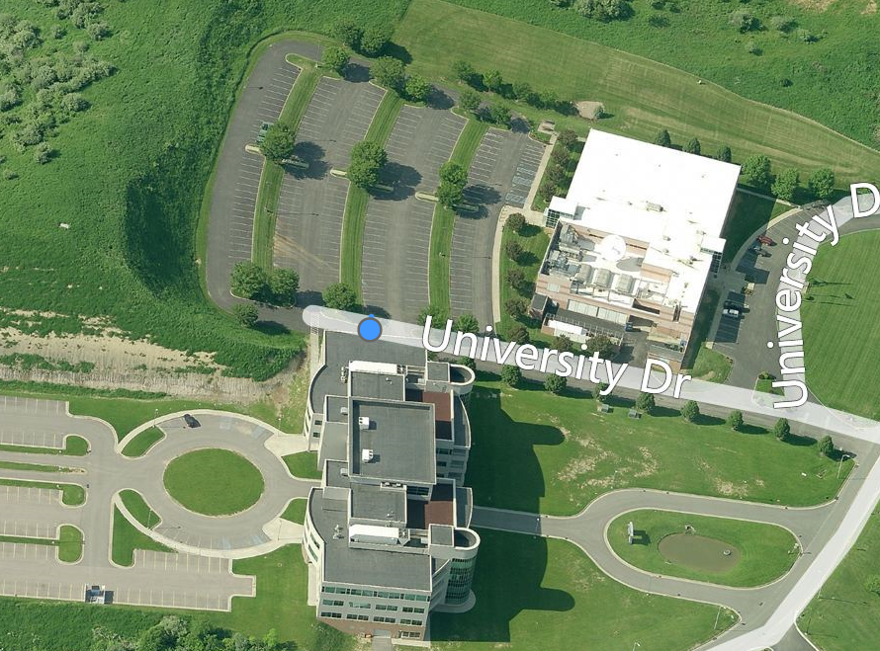
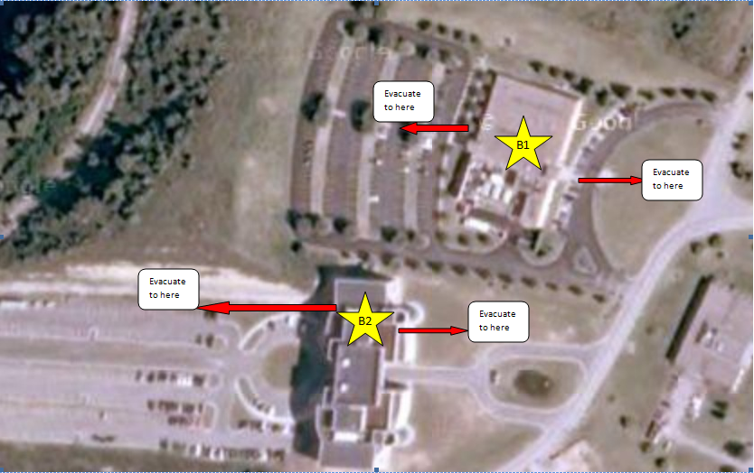
Evacuation Routes
Evacuation locations

Slide 13
In case of a Medical Emergency
Follow the Medical Emergency Procedure located on our Facility Services page @
O&M Services - Policies & Procedures - Medical Emergency Policy
Dial 8200 or 911 directly.
All Security Police Officers are trained in First Aid, CPR, & AED.

Slide 14
IV&V Building Emergency Plan
Please review the Facility BEP located on ECM.
The link is below:
https://ecmles.faircon.net/livelink/livelink/open/4392920

Slide 15
If you host Visitors & Guests
As the host it is your responsibility to ensure the safety and well being of your guest while they are on site. Stay with your guest as required and ensure they are familiar with our emergency evacuation procedure.
If issued a temporary badge, Ensure they return their badge upon leaving the Facility
Review Visitors responsibilities located on our Facility Services page @ escorting visitors

Slide 16
Contact Information
Emergencies: dial ext. 8200 or 911
Physical Security Services: dial ext. 8200/5200, or email security@ivv.nasa.gov
Maintenance requests: email ivv-maintenance@lists.nasa.gov or call 8224 7am-4pm.
Network Operations(NetOps) IT Help Desk: dial ext. 8237, or email help@ivv.nasa.gov
IT Services Department Website: http://ithelpdesk.ivv.nasa.gov
NASA IV&V Facility Guide:
NASA IV&V Computing Guide
NASA related Policies & Procedures:
O&M Services - Policies & Procedures

Slide 17
NASA Safety Culture
NASA Safety Culture...It's in Our DNA
Safety Culture’s mission at NASA is to create an environment where everyone works safely, feels comfortable communicating safety issues, learns from mistakes and successes, feels confident balancing challenges and risks while keeping safety in the forefront, and trusts that safety is a priority.
NASA’s Safety Culture Model is based on five criteria, or factors.
Reporting-
Just
Flexible
Learning
Engaged

Slide 18
NASA IV&V Program welcomes you!
I have read and understood the New Employee Safety Orientation.
________________________________
Print name Signature Date
If you have any questions please contact David Sheldon@ 8289.
*Please print, sign, and return to Security

