Slide 1
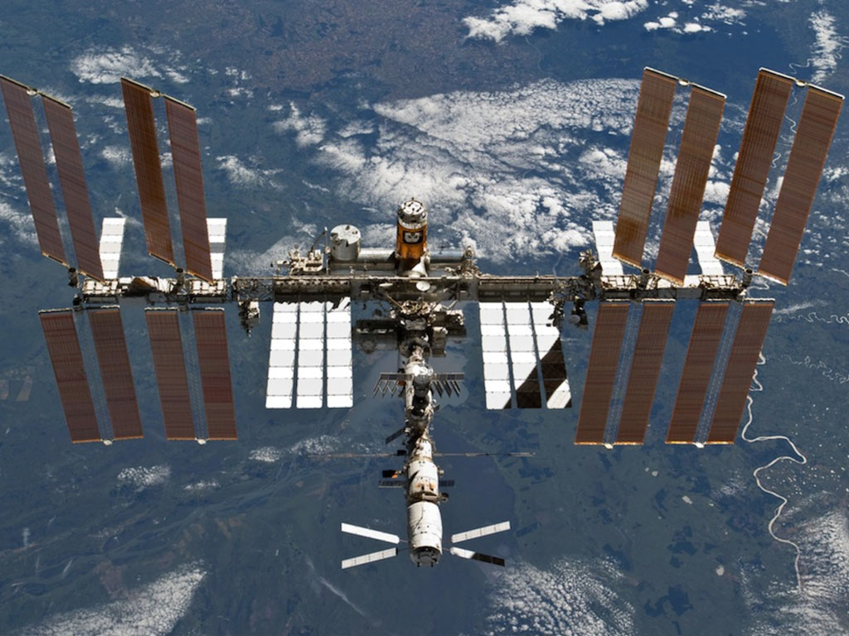
William H. Gerstenmaier
Associate Administrator
Human Exploration and Operations
NASA Headquarters

Slide 2
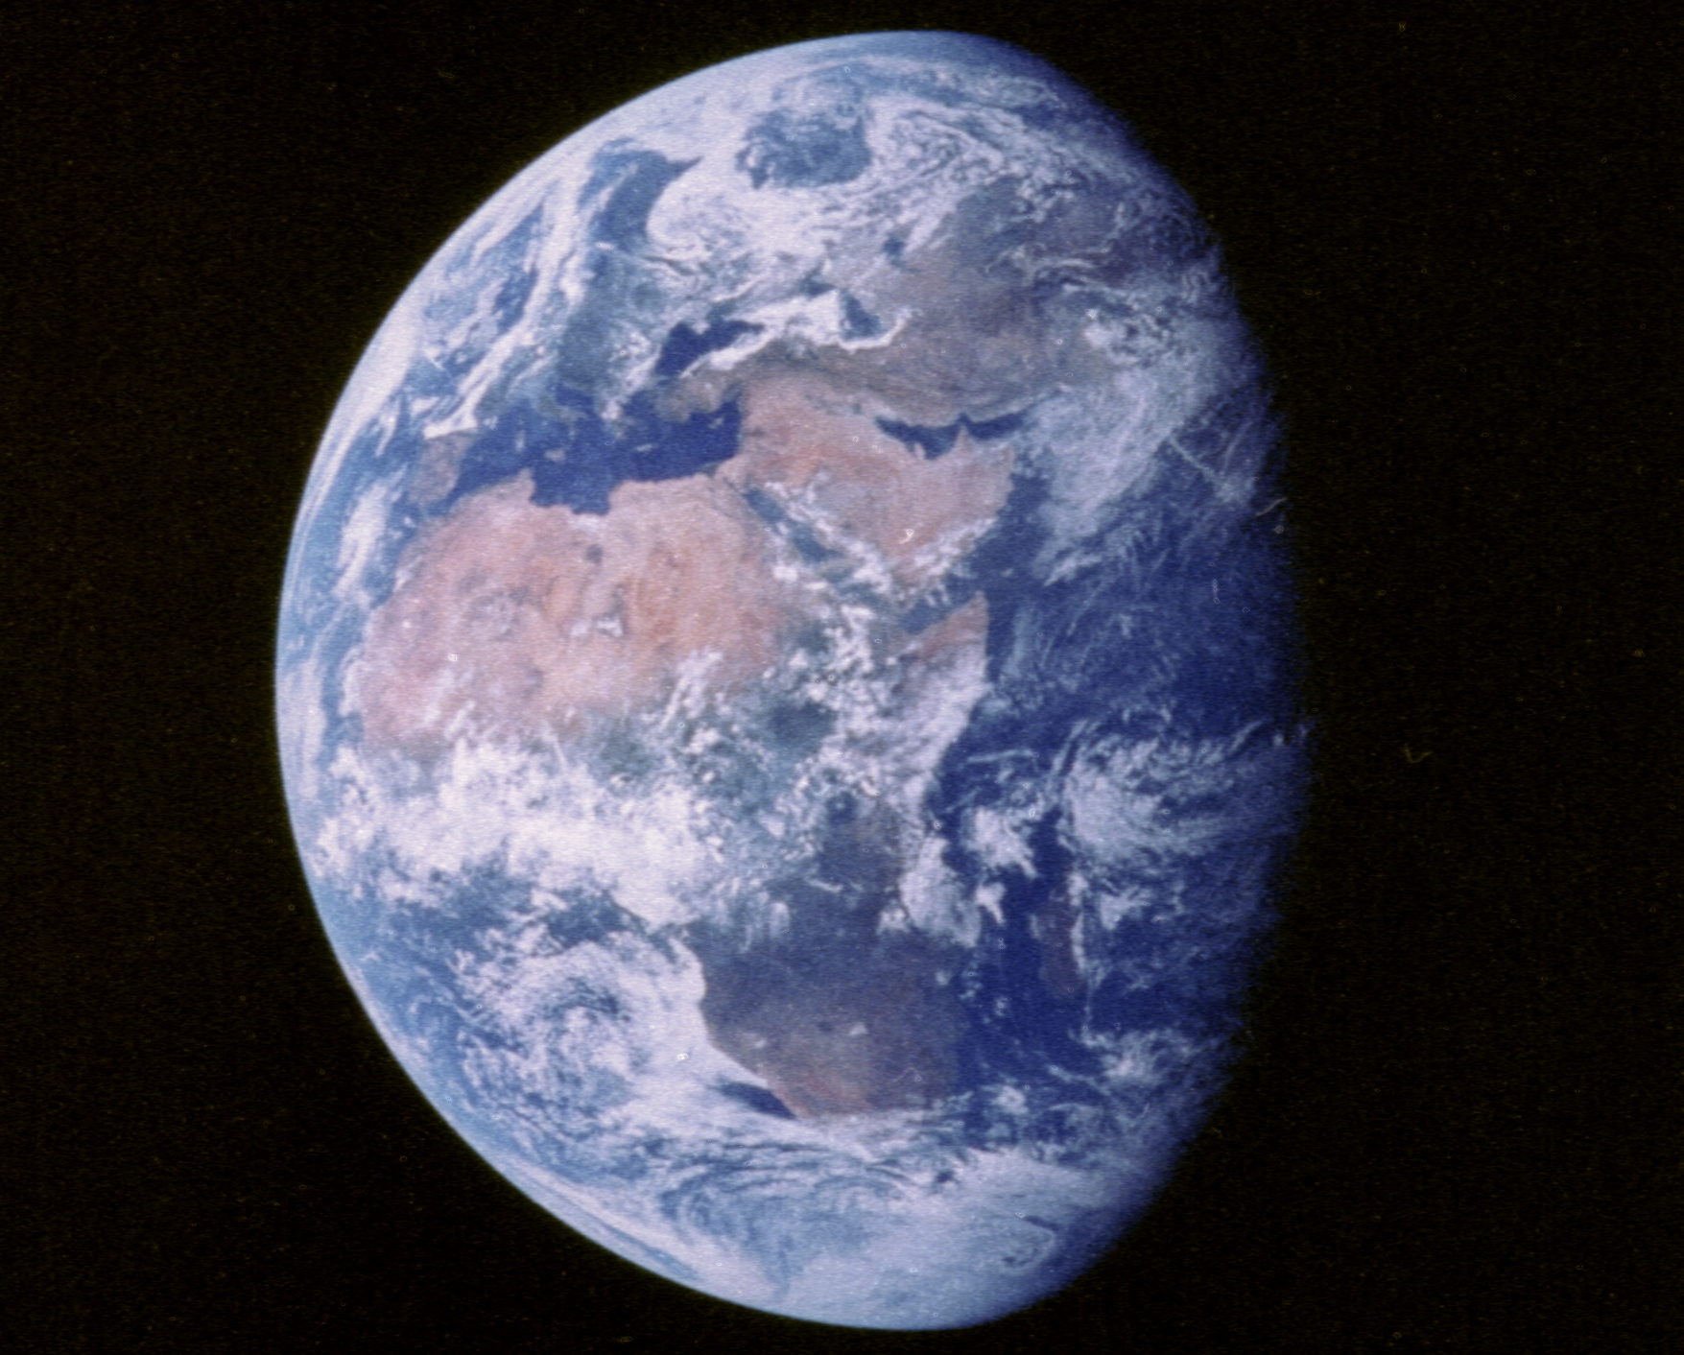
Notes:
Apollo 11 view of Earth taken shortly after lift off on 16 July 1969 from a distance of 180,000 km. Most of Africa can be seen at the center of this image, as well as parts of Europe and western Asia, partly covered by clouds, and most of the Middle East. Apollo 11 was in translunar insertion at the time of this photograph, on its way to the historic first moon walk on 20 July. The Earth is 12,740 km in diameter. North is at 11:00. (Apollo 11, AS11-36-5355)

Slide 3
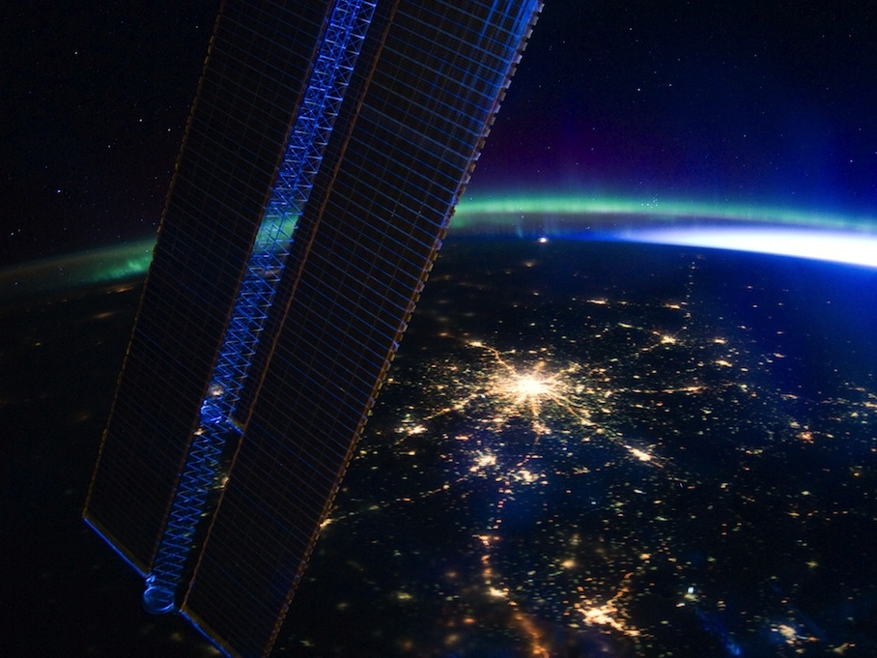
Notes:
ISS030-E-185321 (28 March 2012) --- Moscow, Russia appears at the center of this nighttime image photographed by one of the Expedition 30 crew members aboard the International Space Station, flying at an altitude of approximately 240 miles. A solar array panel for the space station is on the left side of the frame. The view is to the north-northwest from a nadir of approximately 49.4 degrees north latitude and 42.1 degrees east longitude, about 100 miles west-northwest of Volgograd. On the horizon in the background can be seen a small sample of Aurora Borealis, airglow and daybreak.

Slide 4
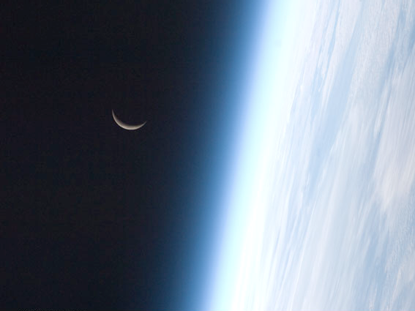
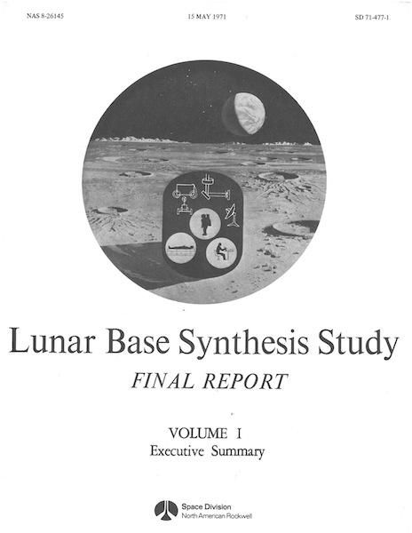
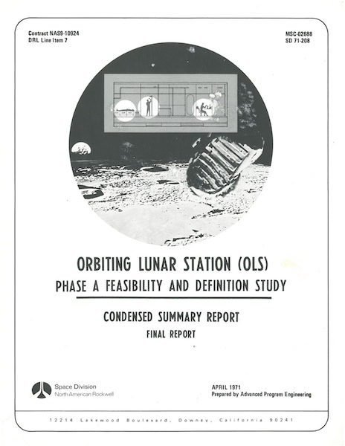
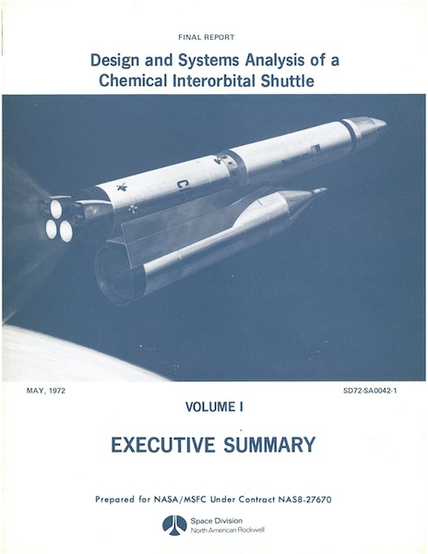
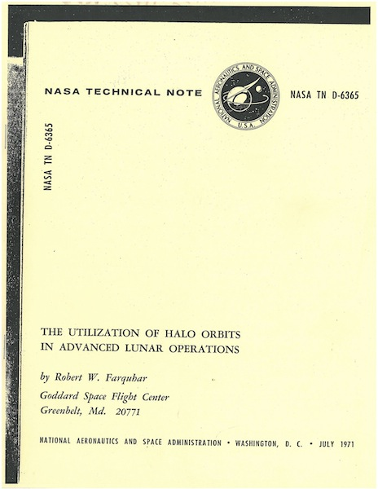
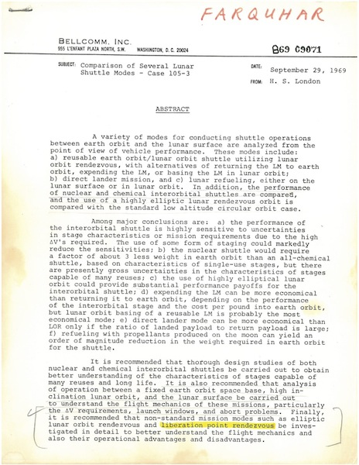
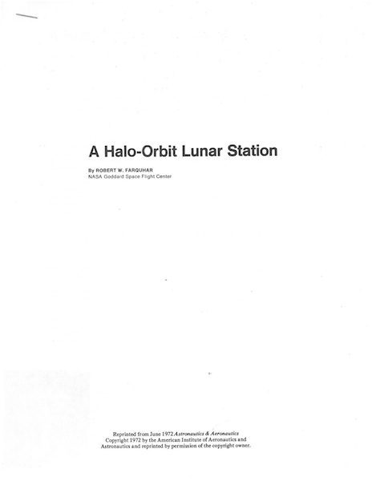
Notes:
Images courtesy http://orbitaldebris.jsc.nasa.gov/photogallery/beehives.html#geo

Slide 5
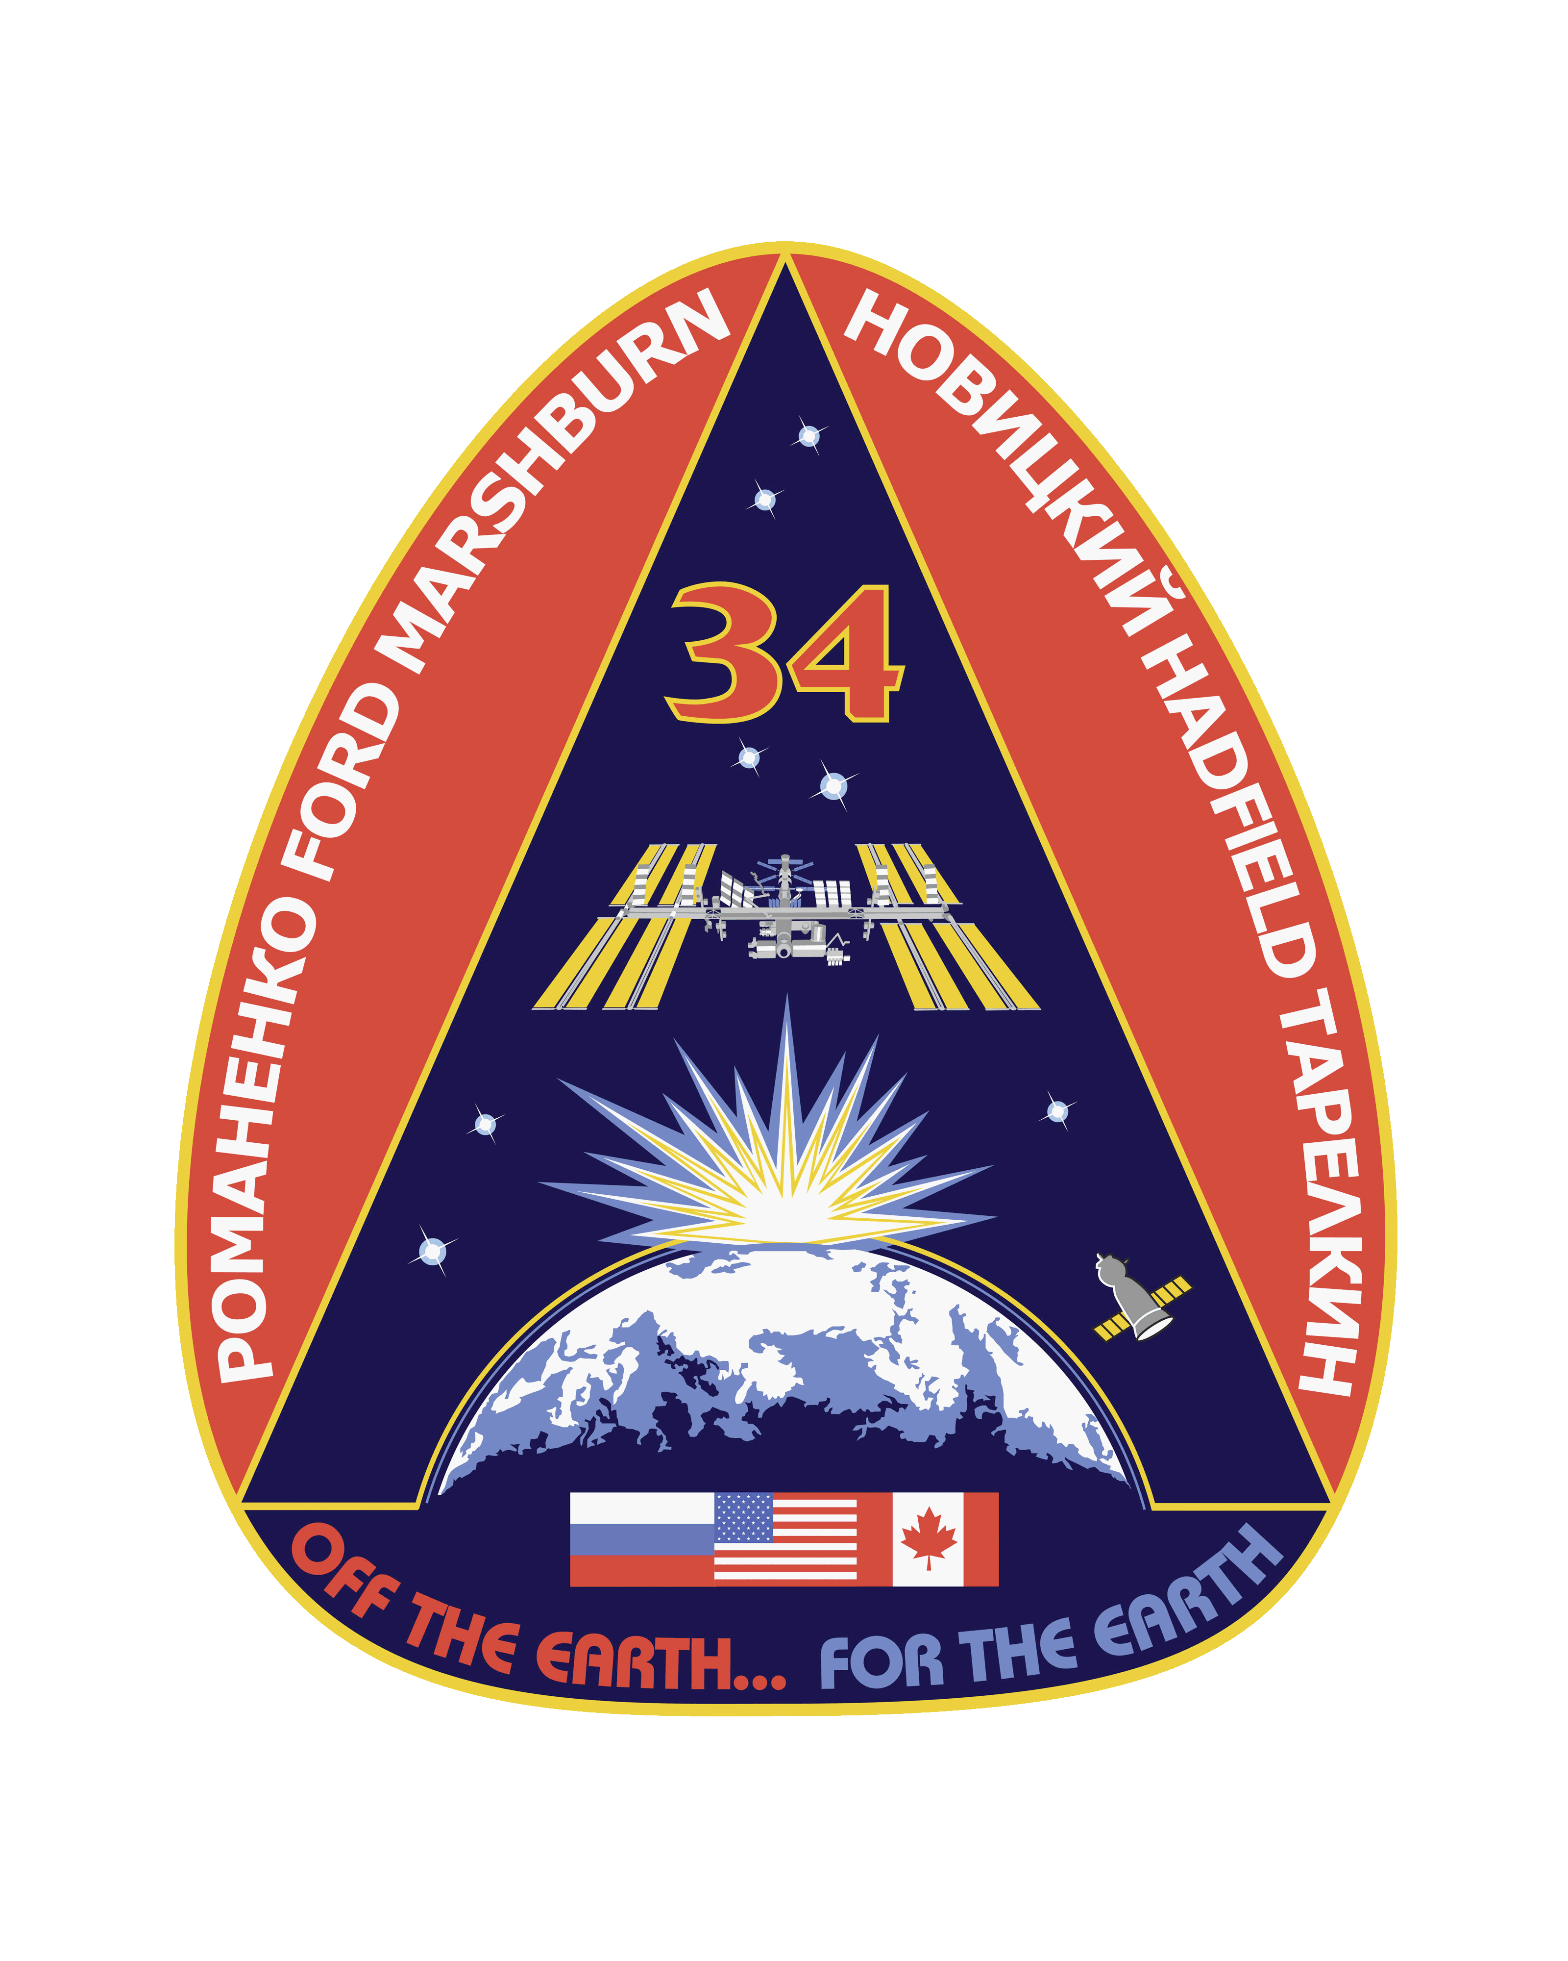

Slide 6
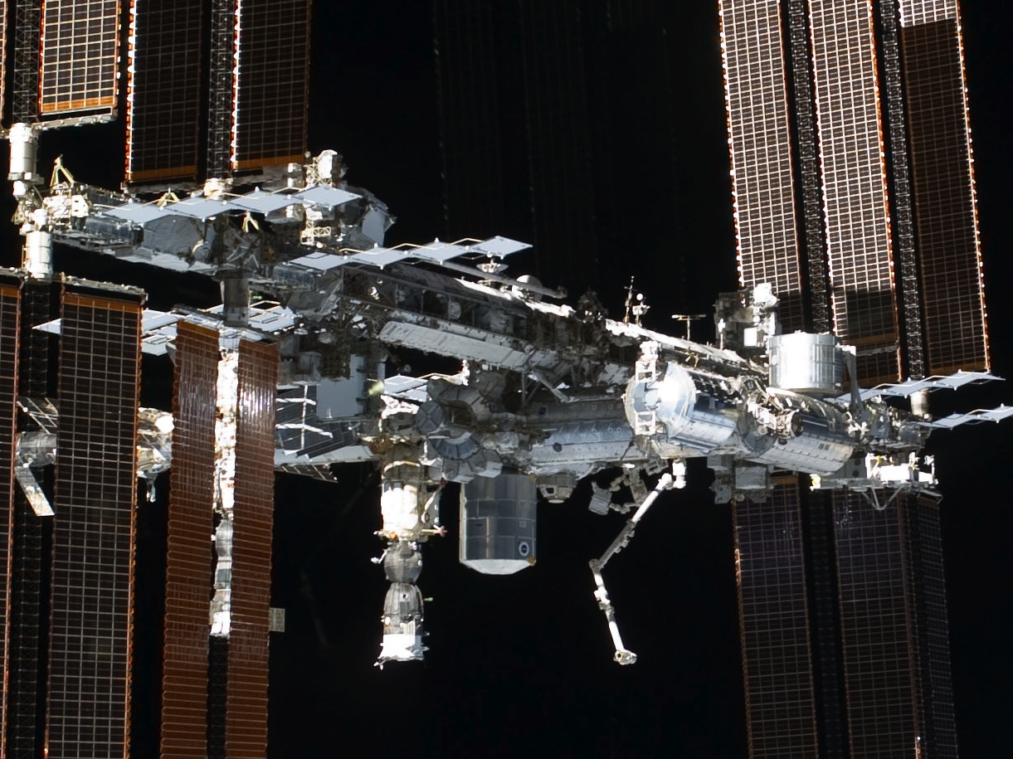

Slide 7
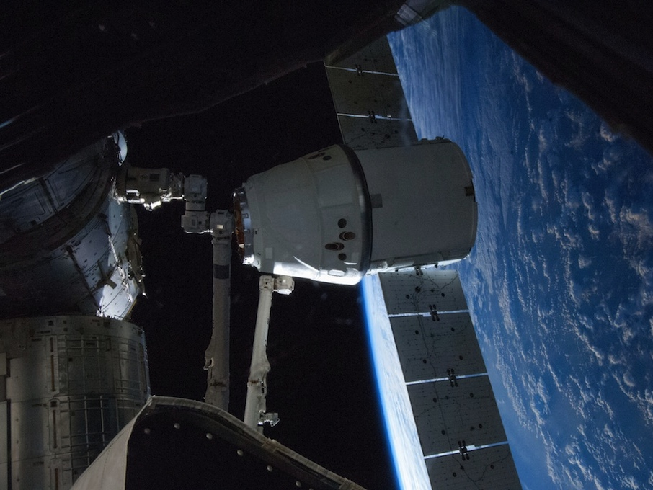

Slide 8
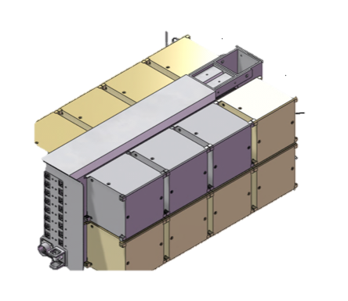
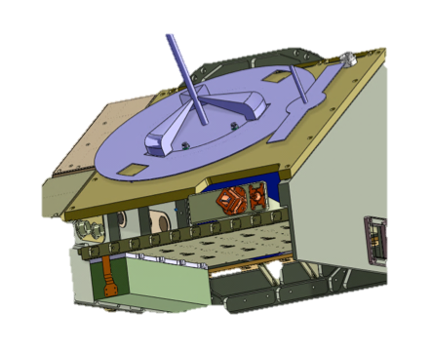
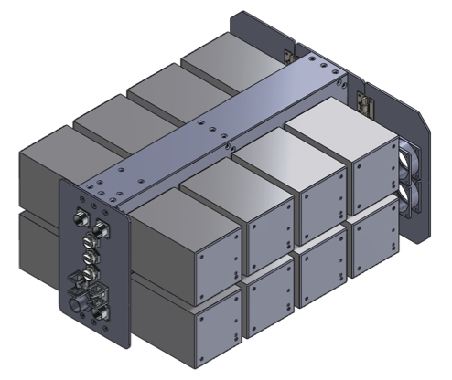
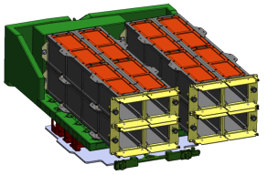
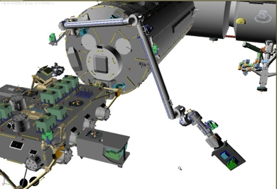
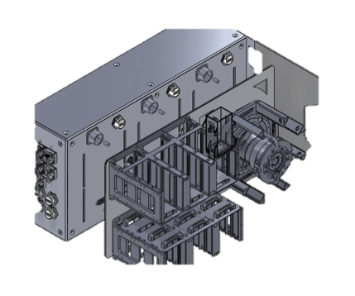
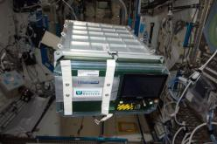
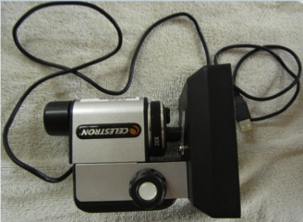
NanoRacks External Platform – future capability
NanoRacks Frame-1 and Frame-2
NanoRacks CubeSat Deployer System – future capability
NanoRacks Frame-1a and Frame-2a
NanoRacks Plate Reader
NanoRacks Platform-3/EADS-Astrium BioRack Centrifuge
NanoRacks Transmission Microscope
NanoRacks Reflective Microscope
Notes:
Frame-1 and Frame-2, Plate Reader, Transmission Microscope, Reflective Microsope, and Platform-3 are currently on-orbit.

Slide 9
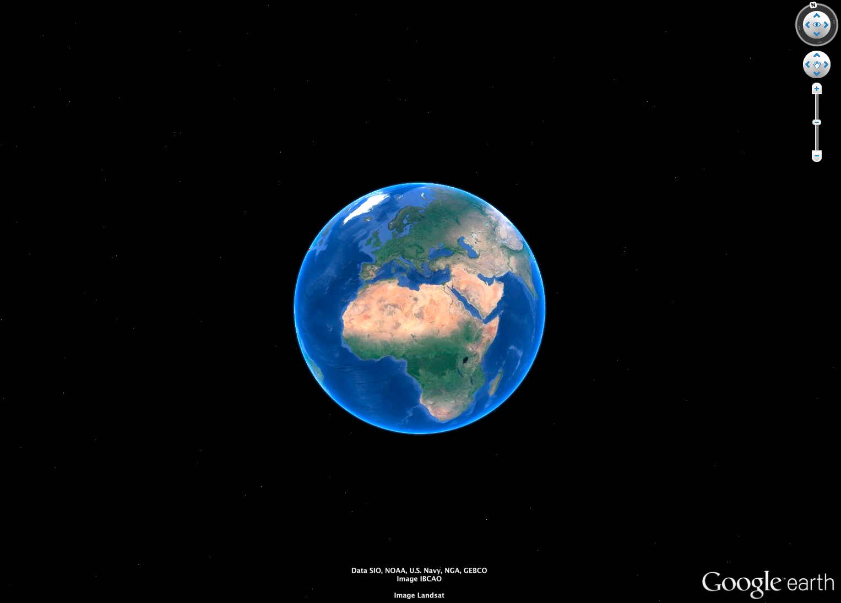
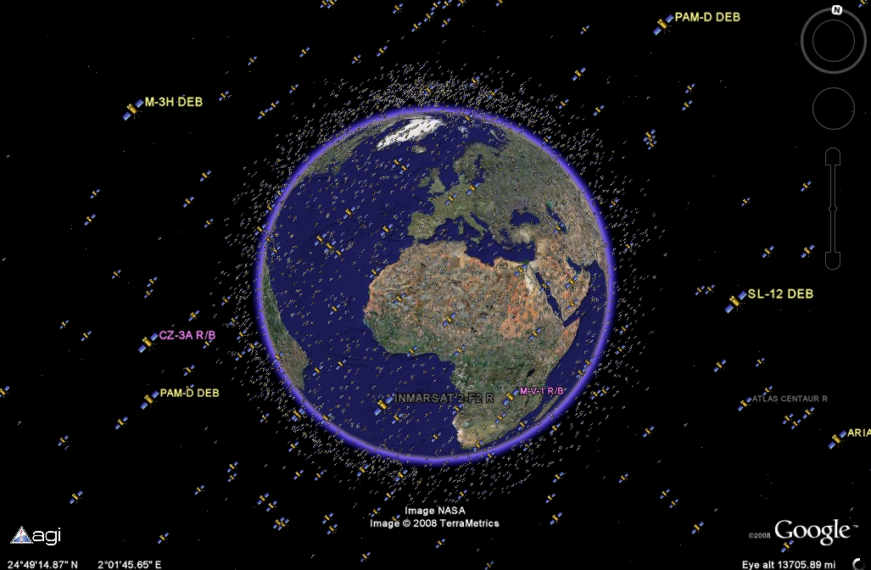
…2013
1969…
Notes:
Today: http://www.universetoday.com/17754/explore-earths-satellites-with-google-earth/

Slide 10
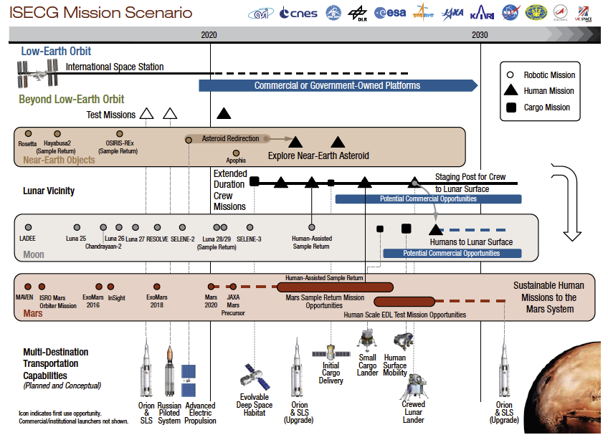
Notes:
From August 2013 GER.

Slide 11
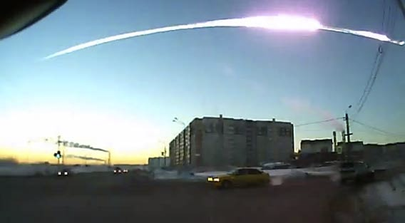
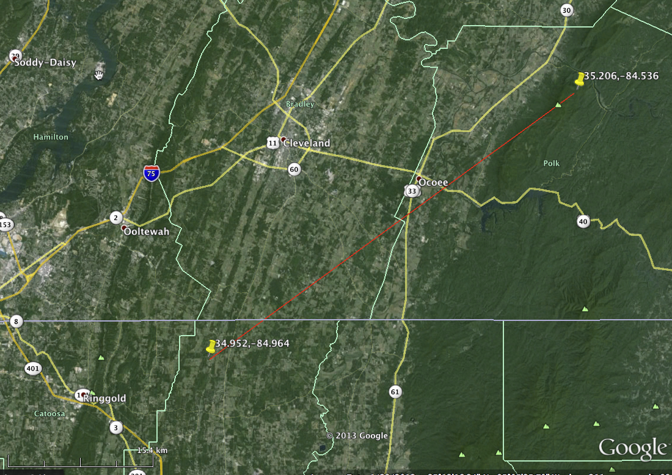
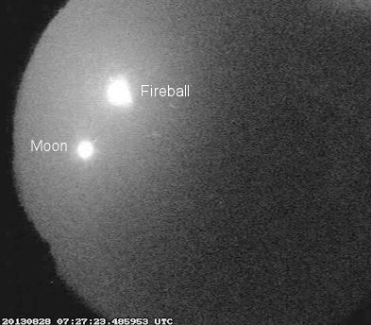
Chelyabinsk, Russia - 2/15/13
Tennessee, USA - 8/28/13
Notes:
Ground picture: http://www.slate.com/blogs/bad_astronomy/2013/08/08/chelyabinsk_meteor_astronomers_trace_it_back_to_a_potential_parent_asteroid.html
NASA's Meteoroid Environment Office has upgraded its estimates of a major fireball that exploded over the southeastern USA around 2:30 AM on August 28th. Lead researcher Bill Cooke says "the fireball reached a peak apparent magnitude of -16, about 20 times brighter than a Full Moon, and cast shadows on the ground. This indicates that the meteoroid had a mass of more than 110 kg (240 lbs) and was up to a meter in diameter. It hit the top of Earth's atmosphere traveling 25 km/s (56,000 mph)."
http://spaceweather.com/archive.php?view=1&day=05&month=09&year=2013

Slide 12
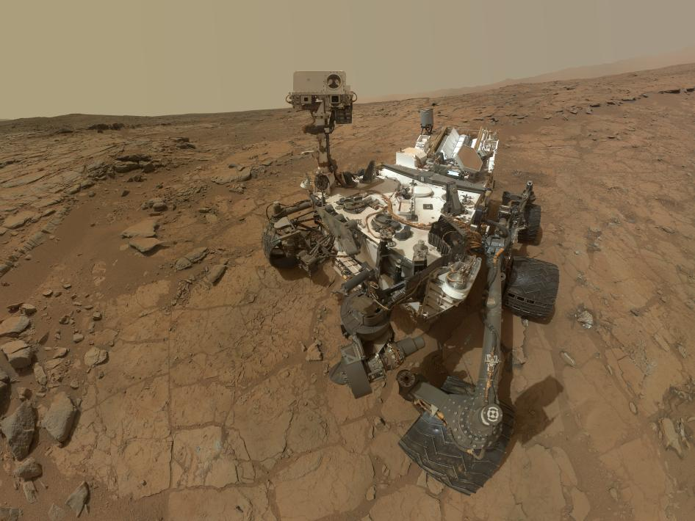
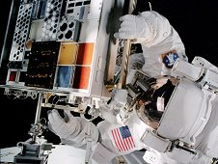
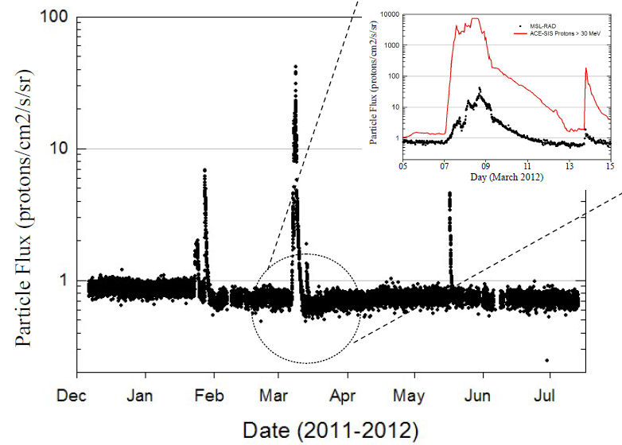
Notes:
RAD charged particle flux observations during ~7 months of cruise included contributions from 5 solar energetic particle events. The inset compares the particle flux observed by RAD to that observed by instruments on the ACE spacecraft. The MSL spacecraft structure (backshell, heatshield, etc.) provided significant shielding from deep space radiation, significantly reducing the particle flux compared to ACE. Credit: NASA/ACE/RAD
Paint picture: http://www.nasa.gov/mission_pages/station/research/news/curiosity_coating.html Paint is visible on the RTG white fins on the back top of the rover.

Slide 13
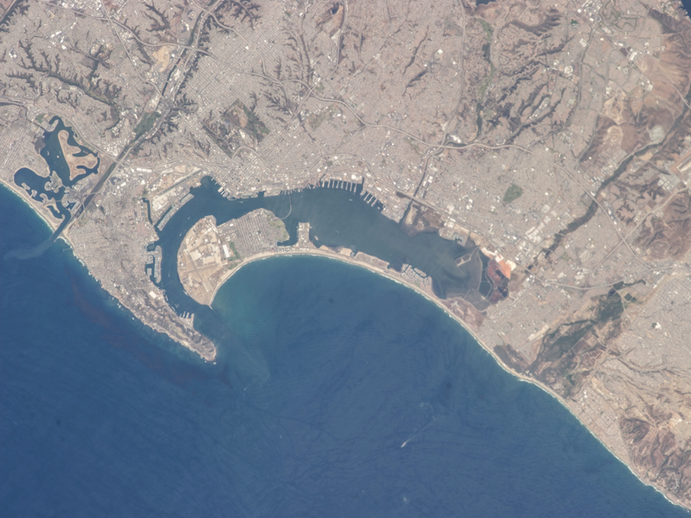
You are here.
Notes:
ISS035-E-27265
Date: 20130423 (YYYYMMDD)

Slide 14
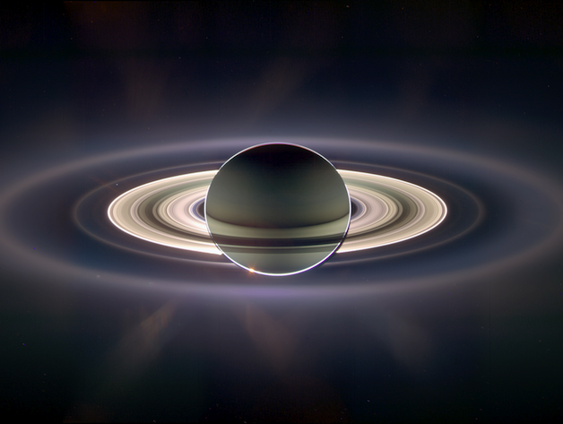
You are here.

Slide 15
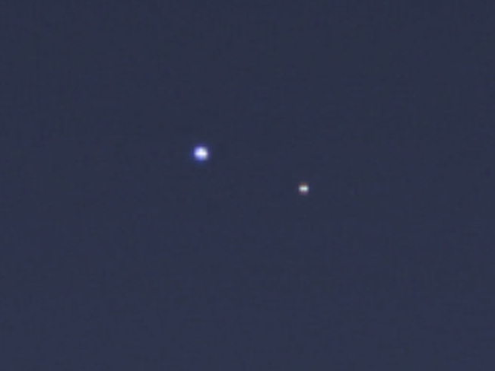
[REDIRECT ASTEROID HERE]

