Slide 1
Kathryn Lueders Associate Administrator, Space Operation’s Mission Directorate (SOMD)
NASA
Bio:
https://www.nasa.gov/feature/kathy-lueders-associate-administrator-for-space-operations/
August 30, 2022

Slide 2
National Aeronautics and Space Administration
NASA Space Operations Overview
Kathryn Lueders
Associate Administrator NASA’s Space Operations Mission Directorate NASA Headquarters, Washington D.C.
@KathyLueders
/kathryn-lueders

Slide 3
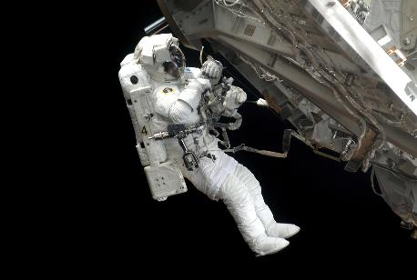
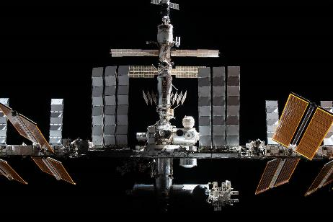
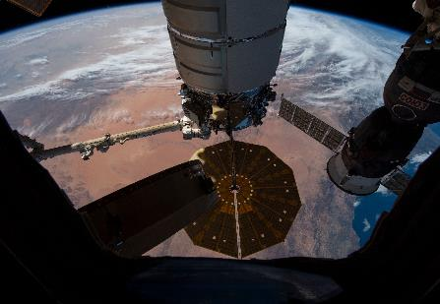
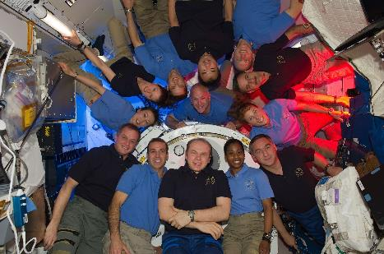
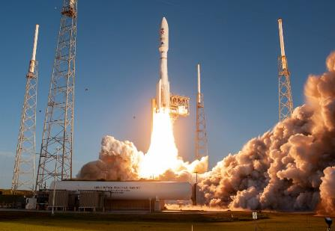
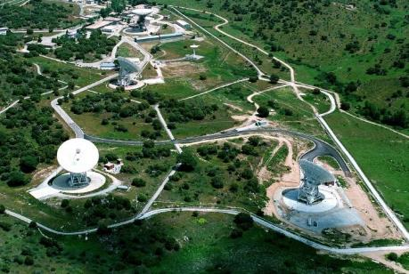
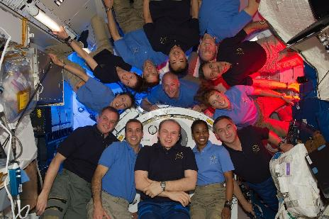
NASA Space Operations
Nurturing the capabilities needed to build a new future in space
International Space Station – Commercial Space – Space Communications and Navigation Human Spaceflight Capabilities – Launch Services – Exploration Operations

Slide 4
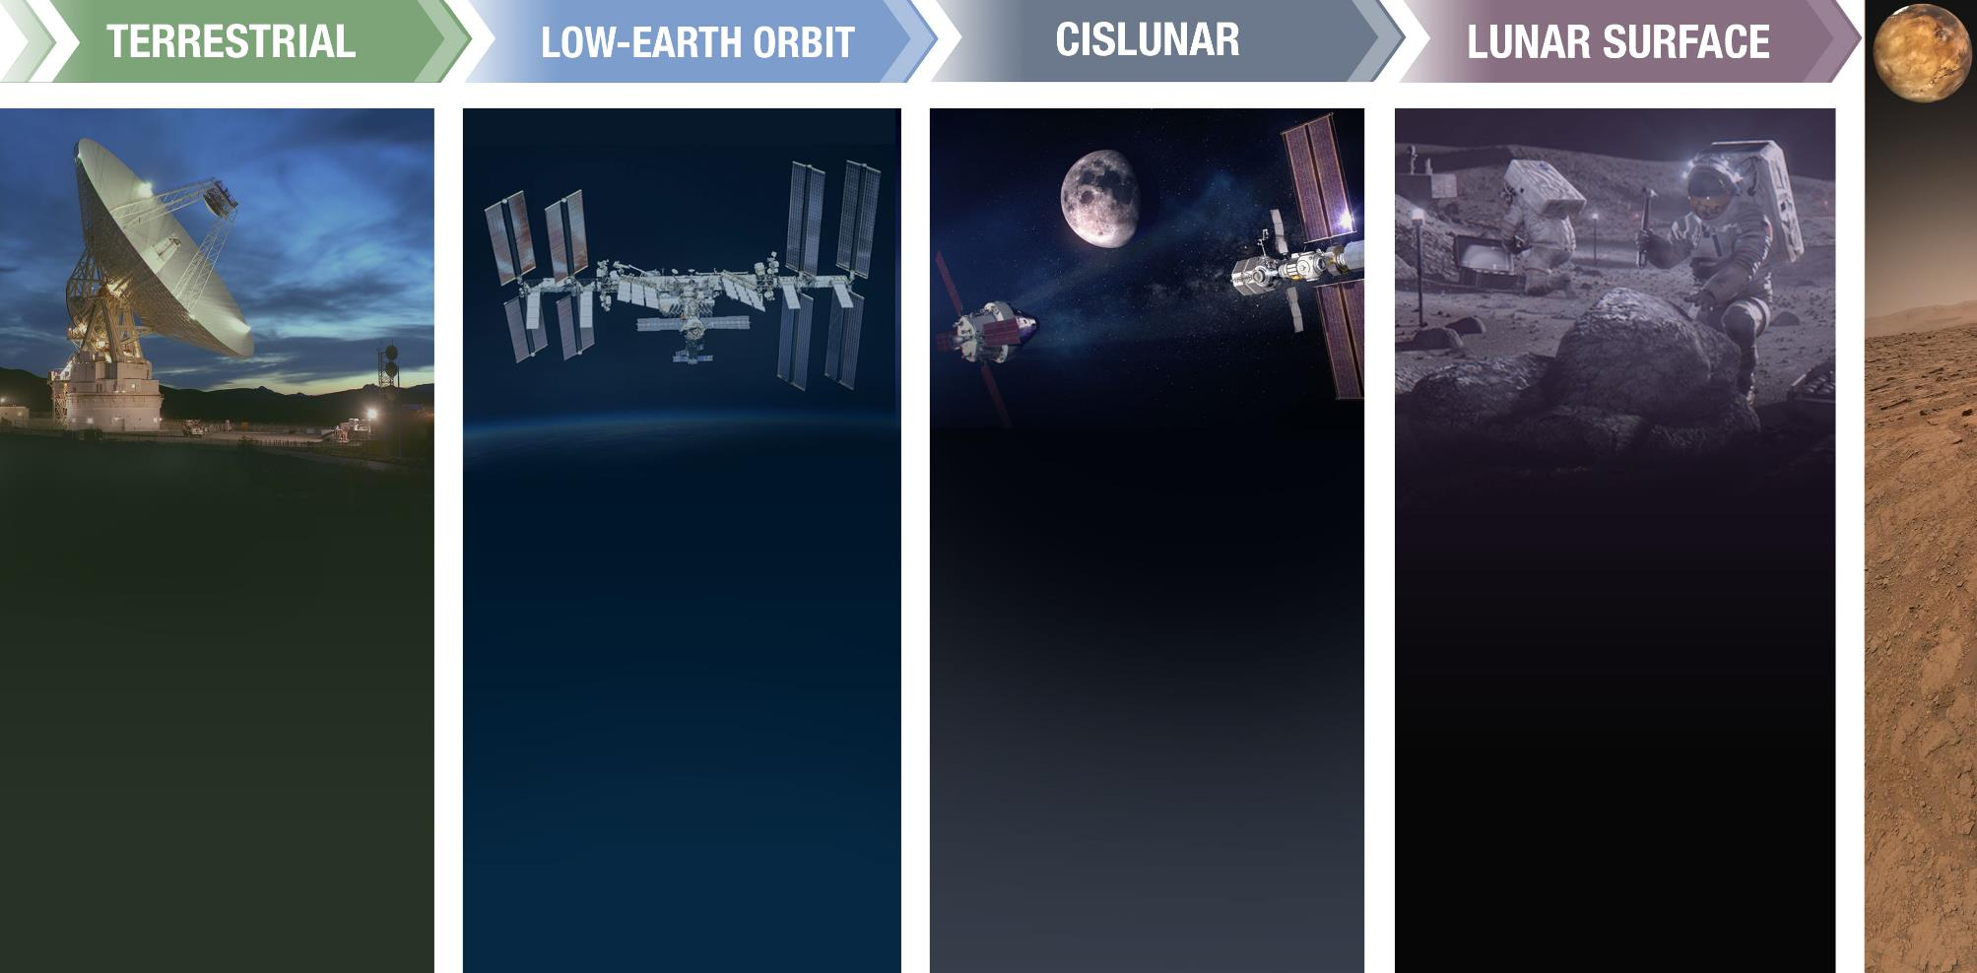
Current and Planned Operations Across Multiple Platforms
Earth-based facilities, operations, capabilities and workforce enable our exploration of space in low-Earth orbit, at the Moon and Mars, and beyond. Each component is critical to mission success.
On to Mars!
Microgravity operations in low-Earth orbit provide a home to our astronauts aboard the International Space Station, which serves as training ground for long-duration missions off Earth and a proving ground for deep space operations.
Plans for cislunar space have spurred the development of the Artemis transportation systems, infrastructure, and new capabilities needed to create an active presence on and around the Moon.
A sustainable presence on the lunar surface involves investment in advanced space systems, communications, and robotics that will teach us how to maintain human operations and crew health away from Earth for extended periods of time.

Slide 5
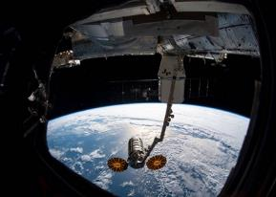
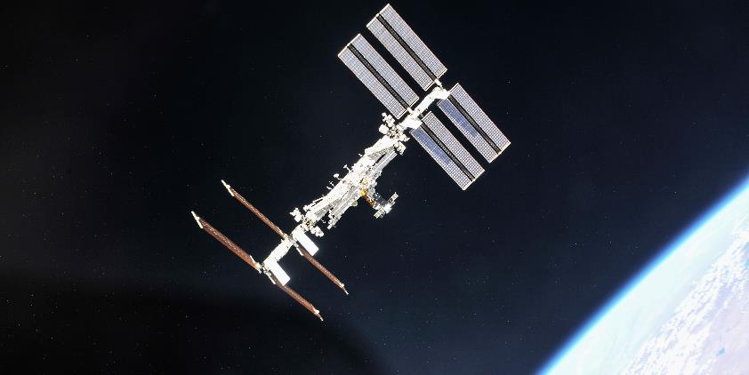
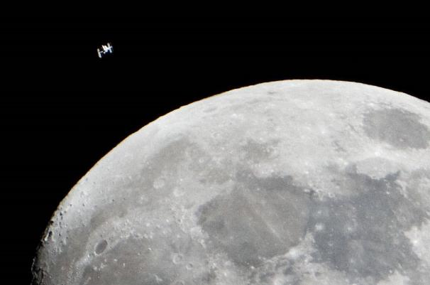
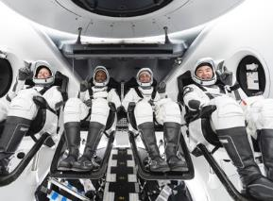
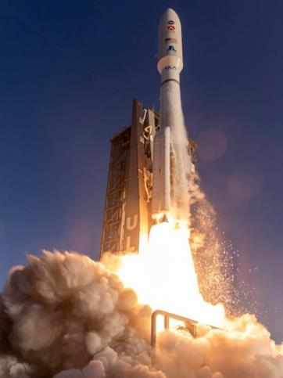
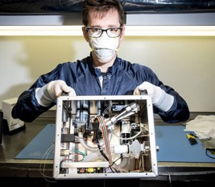
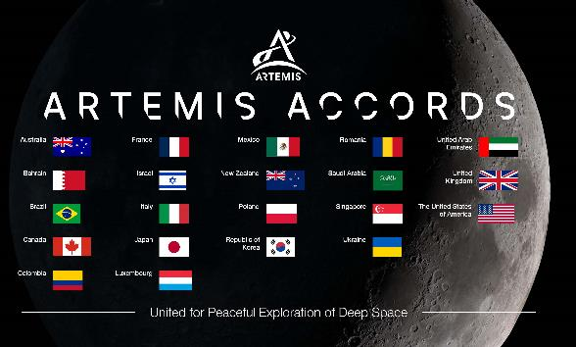
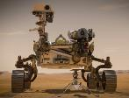
Building the Space Economy for Future Generations
Returning to the Moon with Artemis
It Takes a Big Team to Make History! History!
Making Medical and Research Breakthroughs
Learning from Science Robotic Precursors
Living and Working in Space
Collaborating with Partner Nations

Slide 6
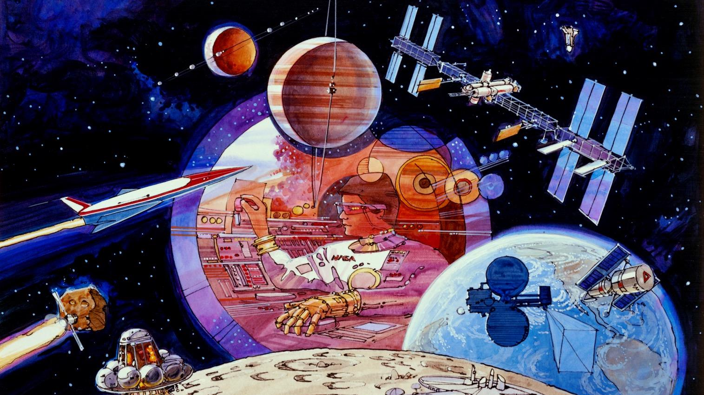
Solving Big Problems Requires Innovation

Slide 7
We are all space people.
Expansive teams are critical to what we’re achieving now and what we will achieve moving forward. Participation is essential.

Slide 8
National Aeronautics and Space Administration
@KathyLueders
/kathryn-lueders

