Slide 1
A3 ROM Cost Assessment
27 June 2017

Slide 2
A3 ROM Cost Assessment
Statement of Work Sub‐Task 6 – A3 Full Scale Test ROM Estimate Assessment
BWXT activities include:
Evaluate equipment/system needs and quantities from the structures, systems, and components described in the A3 test stand gap assessment document NASS‐ES‐100889
Provide the quantities of mechanical, electrical, and I&C hardware required to meet the requirements of the conceptual A3 test stand design
Provide input to NASA for creation of a ROM cost estimate of the equipment
Estimate engineering and licensing costs for A3 ground test
Notes:
Is our equip list one of several inputs?
We need to understand the baseline in more detail
Made progress under this SOW to set nuclear expectations for design considerations

Slide 3
A3 ROM Cost Assessment
Process to develop equipment list –
Review NASS‐ES‐100889 and develop a high level process flow diagram for each system identified. No design work performed
Estimate operating philosophy
Identify equipment required
Estimate layout to determine feet of pipe/duct required
Perform preliminary sizing for equipment identified
Develop equipment list for each system
Estimate which systems will be safety related
Perform similar tasks for electrical and I&C systems/equipment

Slide 4
A3 Full Scale ROM Assessment
Existing NASA ground test concept divided into 22 systems /subsystems
Additional 21 systems were identified to address identified gaps
Develop functions and concepts for the additional systems
Evaluate equipment types and sizes, approximate instrument and electrical needs, estimate safety related functions and equipment
NTP-GTF Systems Breakdown
(BWXT: NASS-ES-100889)

Slide 5
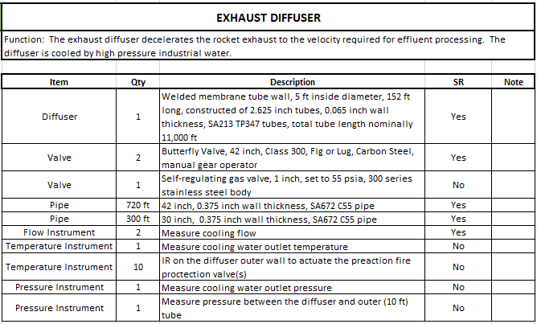
System Example

Slide 6
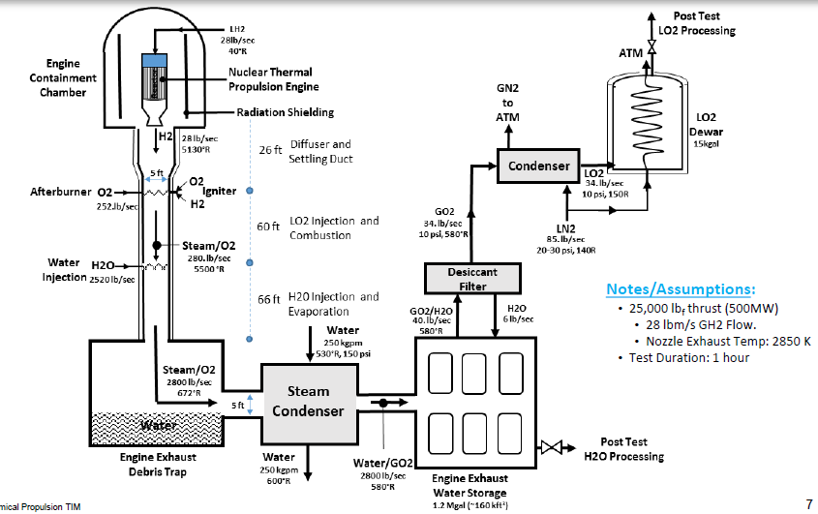
Design Aspects Influencing ROM
Baseline design based on April 20 meeting:

Slide 7
Design Aspects Influencing ROM
Design Differences – Nuclear Cooling / Confinement Influence
Spray/Diffuser Cooling – Once through De-ionized (DI) water
Use of Higher Pressure Industrial Water (HPIW) to cool diffuser and condense the exhaust
Gas removal from exhaust storage
Work completed that applies to current design
LH2 and LO2 supply
Cooling required for fuel quenching
Test Cell
Effluent Gas Handling

Slide 8
ROM BOM Approach
Focus on systems needed to license the design with the US Nuclear Regulatory Commission
Consider events that will influence the design
Results in additional systems and/or requirements
Decay Heat Removal
Emergency Core Cooling
Requirements on LH2, LO2, Cooling Water supply
Shielding
Radiation Monitoring
Radwaste systems
Severe Accident Mitigation – Core relocation

Slide 9
Event Considerations Influencing ROM
Normal Operation:
Power Operation
Assume No Fuel Leakage, No Radiation Outside of Shield Test Cell
Assume Partial Fuel Leakage, or Shine through Diffuser
Startup Conditions
No Fuel Leakage (New Fuel)
Shutdown Conditions
No Fuel Leakage (Spent Fuel)
Shutdown Conditions (Assume Partial Fuel Leakage, Shine where fuel relocation has occurred)

Slide 10
Event Considerations Influencing ROM
Potential Maximum Hypothetical Events:
Pipe Break/Loss of Hydrogen Coolant At Power Conditions
Loss of Diffuser Active Cooling Resulting in Fire
Severe Accident:
Complete Relocation (One Piece), Core Critical
In slides below:
Red reflects a difference with the current concepts as we understand.
Black is expected.
Figures based on new concept for discussion. Where an item was previously noted, it was not included again to help simplify

Slide 11
Event Considerations Influencing ROM
Normal Power Operation
Power Operation, Assume No Fuel Leakage, No Radiation Outside of Shield Test Cell
H2/Reactor Coolant
Core Heat Removal (Potentially Safety Related)
Reactor
Digital Control
Exhaust Capture
Auxiliary Support Systems
Process and Effluent Radiation Monitoring. (Potentially Non-safety Related)
Electrical Systems
Security Control
Notes:
Safety-Related (NRC Glossary): In the regulatory arena, this term applies to systems, structures, components, procedures, and controls (of a facility or process) that are relied upon to remain functional during and following design-basis events. Their functionality ensures that key regulatory criteria, such as levels of radioactivity released, are met. Examples of safety-related functions include shutting down a nuclear reactor and maintaining it in a safe-shutdown condition.
Basic component. (10 CFR Part 21, Section 21.3, Definitions)
(1)(i) When applied to nuclear power plants licensed under 10 CFR part 50 or part 52 of this chapter, basic component means a structure, system, or component, or part thereof that affects its safety function necessary to assure:
(A) The integrity of the reactor coolant pressure boundary;
(B) The capability to shut down the reactor and maintain it in a safe shutdown condition; or
(C) The capability to prevent or mitigate the consequences of accidents which could result in potential offsite exposures comparable to those referred to in § 50.34(a)(1), § 50.67(b)(2), or § 100.11 of this chapter, as applicable.
(ii) Basic components are items designed and manufactured under a quality assurance program complying with appendix B to part 50 of this chapter, or commercial grade items which have successfully completed the dedication process.
(2) When applied to standard design certifications under subpart C of part 52 of this chapter and standard design approvals under part 52 of this chapter, basic component means the design or procurement information approved or to be approved within the scope of the design certification or approval for a structure, system, or component, or part thereof, that affects its safety function necessary to assure:
(i) The integrity of the reactor coolant pressure boundary;
(ii) The capability to shut down the reactor and maintain it in a safe shutdown condition; or
(iii) The capability to prevent or mitigate the consequences of accidents which could result in potential offsite exposures comparable to those referred to in §§ 50.34(a)(1), 50.67(b)(2), or 100.11 of this chapter, as applicable.
(3) When applied to other facilities and other activities licensed under 10 CFR parts 30, 40, 50 (other than nuclear power plants), 60, 61, 63, 70, 71, or 72 of this chapter, basic component means a structure, system, or component, or part thereof, that affects their safety function, that is directly procured by the licensee of a facility or activity subject to the regulations in this part and in which a defect or failure to comply with any applicable regulation in this chapter, order, or license issued by the Commission could create a substantial safety hazard.
(4) In all cases, basic component includes safety-related design, analysis, inspection, testing, fabrication, replacement of parts, or consulting services that are associated with the component hardware, design certification, design approval, or information in support of an early site permit application under part 52 of this chapter, whether these services are performed by the component supplier or others.

Slide 12
Event Considerations Influencing ROM
Related to Figure Provided:
Core Heat
Removal
Process &
Effluent Rad.
Monitoring

Slide 13
Event Considerations Influencing ROM
Normal Power Operation (Cont.)
Power Operation, Assume some Radionuclide transport from Fuel, or Shine through Diffuser
H2/Reactor Coolant
Core Heat Removal (Potentially Safety Related)
Reactor
Digital Control
Exhaust Capture
Auxiliary Support Systems
Radiation Monitoring. (Potentially Non-safety Related)
Dedicated Rad Systems (Drains, HVAC)
Radioactive Waste Management (Potentially Non-safety Related)
Electrical Systems
Security Control
Shielding
Assumed 1% Leakage of Fission Products

Slide 14
Event Considerations Influencing ROM
Related to Figure Provided:
Dedicated Rad Systems Not Shown (Drains/HVAC), radiologically controlled area unclear.
Shielding (Esp.
For Neutrons/
Gammas)
Radwaste Management (Not shown)

Slide 15
Event Considerations Influencing ROM
Normal Power Operation (Cont.)
Startup Conditions, No Fuel Leakage:
Air/Fuel Transfer (New Fuel)
Fuel Handling & Storage
N2/Inert
H2/Reactor Coolant
Reactor
Digital Control
Exhaust Capture
Auxiliary Support Systems
Process and Effluent Radiation Monitoring. (Potentially Non-safety Related)
Electrical Systems
Security Control

Slide 16
Event Considerations Influencing ROM
Normal Power Operation (Cont.)
Shutdown Conditions, No Fuel Leakage:
Air/Fuel Transfer (Spent Fuel)
Fuel Handling & Storage (Potentially Safety Related and Non safety related, Augmented Quality)
N2/Inert
H2/Reactor Coolant
Transition to Decay Heat Removal (Potentially Safety Related)
Reactor
Digital Control
Exhaust Capture
Auxiliary Support Systems
Process and Effluent Radiation Monitoring. (Potentially Non-safety Related)
Electrical Systems
Security Control
Shielding

Slide 17
Event Considerations Influencing ROM
Related to Figure Provided:
Spent Fuel Handling and Storage Not Shown
Intended Configuration for Decay Heat Removal Unclear

Slide 18
Event Considerations Influencing ROM
Normal Power Operation (Cont.)
Shutdown Conditions, Assume Partial Fuel Leakage, Shine where fuel relocation has occurred:
Air/Fuel Transfer (Spent Fuel)
Fuel Handling & Storage (Potentially Safety Related and Non safety related, Augmented Quality)
N2/Inert
H2/Reactor Coolant
Reactor
Digital Control
Exhaust Capture
Radioactive Waste Management (Potentially Non-safety Related)
Auxiliary Support Systems
Process and Effluent Radiation Monitoring. (Potentially Non-safety Related)
Dedicated Rad Systems (Drains, HVAC)
Electrical Systems
Security Control
Shielding

Slide 19
Event Considerations Influencing ROM
Maximum Hypothetical Events
Pipe Break/Loss of Hydrogen Coolant From At Power Condition
H2/Reactor Coolant
Pressurized Test Cell
Engineering Safeguards - Emergency Hydrogen Core Cooling (Potentially Safety Related)
Engineering Safeguards - Transition to Decay Heat Removal (Potentially Safety Related)
Reactor
Reactor trip using Control Drums (Potentially Safety Related)
Digital Control
Facility Protection Layer (Potentially Safety Related)
Exhaust Capture (Portions potentially Safety-Related)
Auxiliary Support Systems
Radiation Monitoring. (Potentially Non-safety Related)
Cooling Water (Potentially Safety Related)
Spray Water (Potentially Safety Related)

Slide 20
Event Considerations Influencing ROM
Maximum Hypothetical Events (Cont.)
Pipe Break/Loss of Hydrogen Coolant From At Power Condition (Cont.)
Radioactive Waste Management (Non-safety, Augmented Quality)
Electrical Systems
Divisional support of electrical systems. (Potentially Safety Related)
Security Control
Shielding
Assumed Partial Core Relocation Due to Structural Degradation
Structural Support (Potentially Safety Related)

Slide 21
Event Considerations Influencing ROM
Related to Figure Provided:
Safety Related
Cooling Function?
Must assure redundancy, diversity and separation for those items deemed safety related.
Test Cell Pressurization
No Configuration for ECC Present
Potentially Safety Related
Particulate Transfer Handling Unclear
Completely Passive System for normal operation with turbo pumps, as compared to safety case uncertain.
Notes:
Single Failure (10 CFR 50 Appendix A):
Single failure. A single failure means an occurrence which results in the loss of capability of a component to perform its intended safety functions. Multiple failures resulting from a single occurrence are considered to be a single failure. Fluid and electric systems are considered to be designed against an assumed single failure if neither (1) a single failure of any active component (assuming passive components function properly) nor (2) a single failure of a passive component (assuming active components function properly), results in a loss of the capability of the system to perform its safety functions².
2 - Single failures of passive components in electric systems should be assumed in designing against a single failure. The conditions under which a single failure of a passive component in a fluid system should be considered in designing the system against a single failure are under development.

Slide 22
Event Considerations Influencing ROM
Maximum Hypothetical Events
Loss of Diffuser Active Cooling Resulting in Fire
H2/Reactor Coolant
Reactor
Reactor trip using Control Drums (Potentially Safety Related)
Digital Control
Facility Protection Layer (Potentially Safety Related)
Exhaust Capture
Auxiliary Support Systems
Cooling Water (Potentially Safety Related)
Spray Water (Potentially Safety Related)
Radiation Monitoring. (Potentially Non-safety Related)

Slide 23
Event Considerations Influencing ROM
Maximum Hypothetical Events
Loss of Diffuser Active Cooling Resulting in Fire
Radioactive Waste Management (Potentially Non-safety, Augmented Quality)
Electrical Systems
Divisional support of electrical systems.
Security Control
Shielding
Assumed Partial Core Relocation Due to Structural Degradation.
Structural Support (Potentially Safety Related)

Slide 24
Event Considerations Influencing ROM
Related to Figure Provided:
What assures mission of cooling diffuser? Must assure redundancy, diversity and separation.

Slide 25
Event Considerations Influencing ROM
Severe Accident
Complete Core Relocation (One Piece), Core Critical
Digital Control
Exhaust Capture
Missile Protection
Water Management to avoid steam explosion.
Auxiliary Support Systems
Radiation Monitoring. (Potentially Non-safety Related)
Dedicated Rad Systems (Drains, HVAC)
Radioactive Waste Management (Potentially Non-safety, Augmented Quality)
Electrical Systems
Security Control
Shielding
Robust External Structure

Slide 26
Event Considerations Influencing ROM
Related to Figure Provided:
No Debris Trap/Water Management shown. What mitigates steam explosion in the event of complete core relocation?

Slide 27
Next Steps
Design and Licensing processes are developed together
BWXT has the expertise to both complete and integrate processes
Design experience with other nuclear designs and NASA concepts gained through the ROM BOM process
BWXT has broad design and licensing experience
13 NRC issued licenses to fabricate, process, utilize and store nuclear materials
Provided design and licensing support to nuclear utilities for 34 nuclear power plants
NRC pre-application work for MIPS non power reactor
Currently fabricates the fuel assemblies for HFIR, ATR, MITRR
Past specialty work efforts on SNTP and JIMO projects

