Slide 1
The Simple Management and Analysis of Requirements and Traceability (SMART) Tool
Travis Dawson
Michael Facemire
Charles Broadwater

Slide 2
Genesis

Slide 3
The Need
Much of what IV&V does involves tracing (or evaluating developer traces) of one artifact element to another, e.g.
  Higher-level requirements (parents) to lower-level, dependent requirements (children)
  IV&V model elements to FSW requirements
  Potentially, any life-cycle artifact element to any other
  etc, etc, etc
The traces themselves are their own “objects” with their own characteristics, fields, etc.
  Want to capture IV&V analysis notes
  Want to assert IV&V traces in addition to developer traces, and distinguish between them
  A link field in one item with a pointer to another item is not sufficient
Analysis notes can lead to findings or to assurance evidence, and we need a way to support these
We don’t need a database in which we enter our analysis results, we need a tool to facilitate that analysis

Slide 4
Conceptual User Requirements
Artifacts
  Ability to represent a wide variety of artifacts
  Ability to display artifacts with native formatting (graphics, etc.)
Facilitating analysis
  Ability to attach IV&V-interest attributes to both parent and child elements
  Ability to capture attributes and analysis notes for reqts & traces
  Support development of issues and assurance evidence
Visualization/Navigation
  Ability to easily load and link various artifacts
  Ability to see lists (with filtering) of elements for selection
  Ability to view parent, child and trace simultaneously
Deployment
  Ability to support multiple analysts in the same data set, often geographically dispersed
  Ability to support multiple projects without new development
  Ability to represent custom fields without development

Slide 5
Timeline
RTAT Proposed as IV&V Research Initiative
RTAT Extended to include graphics, UML components
ORBIT reqts discovery/ trade study
MAVEN
SMART
MER RTA “Tool”
ORBIT Roll-Out
Variety of customers, including MRO, SIRTF, Dawn, OCO, Deep Impact
ICESat-2
SMART
Ares IV&V
Pre-SMART
MER IV&V
Juno
SMAP SMART
ESMDI
Analyst Utopia
Ares
Antiquity
2001
2002
2003
2004
2005
2006
2007
2008
2009
2010
2011
2012
2013
RTA Requirements Traceability Analysis
RTAT A specific RTA tool
ORBIT IV&V tool based on PTS Integrity (formerly MKS Integrity) to capture issues (initially), requirements analysis (later), and risks (future)

Slide 6
MAVEN SMART

Slide 7
MAVEN IV&V Tool Selection
Two viable options
  Submit a request for SWAT to make the necessary updates to ORBIT
  Reuse an existing in-house developed tool
Due to several factors, the team decided to re-use an existing in-house developed tool
Several in-house options were considered; however, the SMART tool developed for SMAP was determined to offer the best solution for MAVEN

Slide 8
SMART Baseline Tool
Requirements based - view any project requirement along with supporting attributes
Ability to import requirements with embedded images
Ability to import issues from ORBIT and associate the issues with analysis records
Microsoft Access frontend with SQL Server backend – supports distributed users and real time data synchronization
Requirements traceability – for the selected requirement in focus
  Display all parent requirements
  Display all child requirements
  Display all child requirements of the parent requirements
  Add a recommended parent or child trace to any requirement
  Add an analysis comment to any trace
  Indicate whether a trace is valid
Requirements validation assessment form
  Contains quality assessment and analysis note fields used in MKS
Built in filters
  Filter on latest version only
  Filter on assigned analyst or other custom requirement tag
  Maintain multiple filters even if analyst manually filters another field

Slide 9
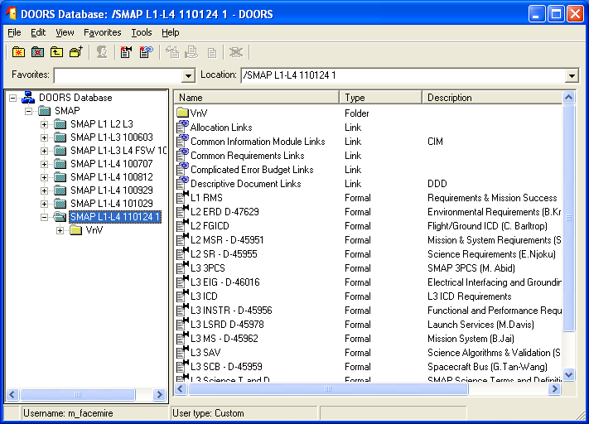
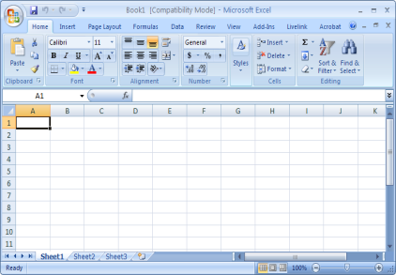
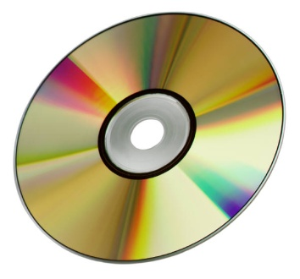
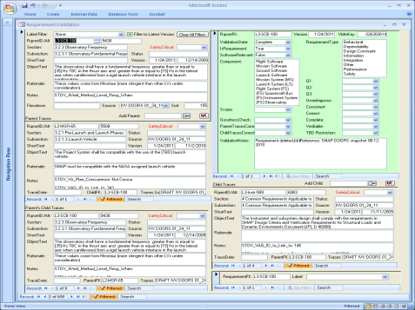
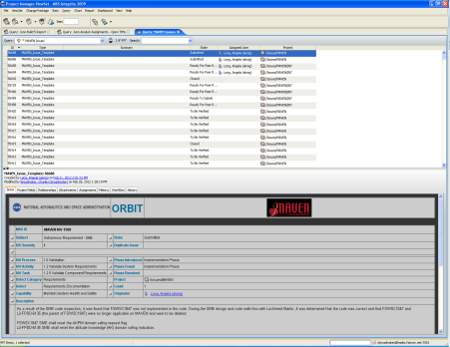
SMART Context
Build
Deliveries
(FSW & UT Code)
DOORS
Rqmts & Traces
Excel
perl scripts
SMART
Analyze Artifacts & Record Results
MS Access Front End
SQL Server Tables
Analysts
Draft
Findings
TIM X-Refs
ORBIT
Excel
Issues, & Observations
Notes:
Original slide from 6/8/2011 IVVO Technical Discussion presented by Mike Facemire

Slide 10
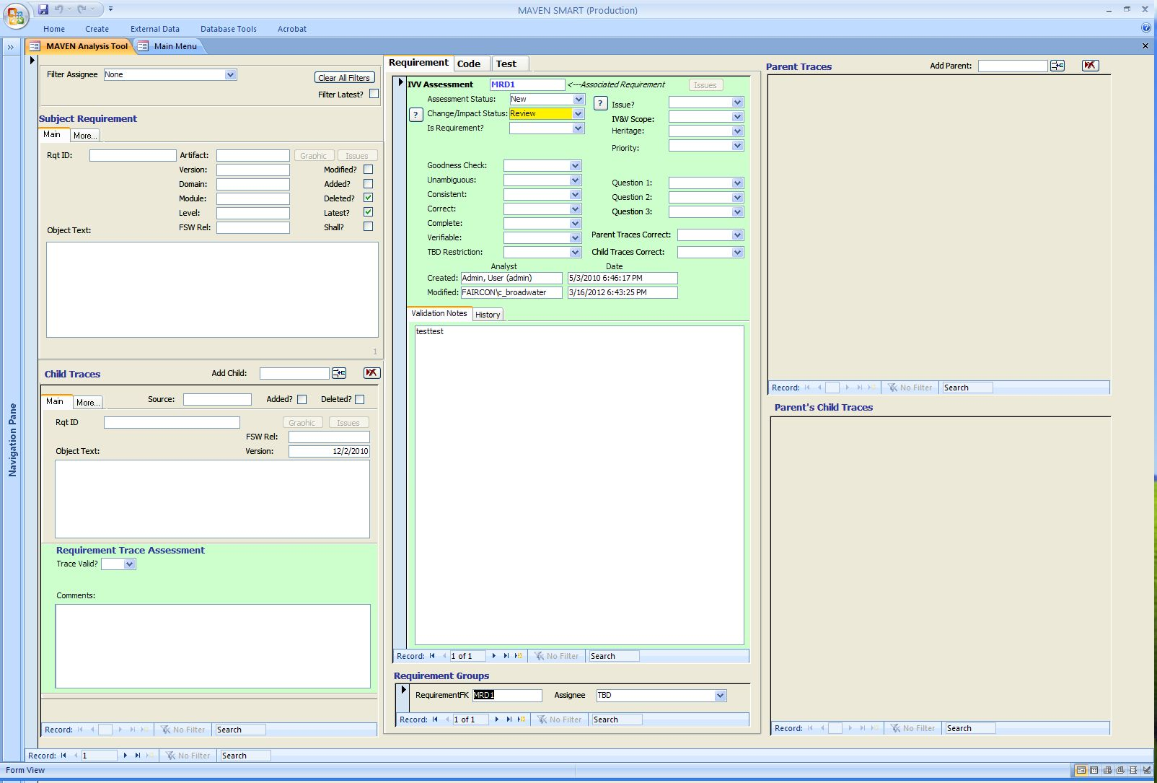
Analysis Form

Slide 11
In-Process Enhancements
Generalization of forms among artifact types
  Removal of requirement artifact as the only left-hand artifact
Enhanced navigation
  addition of list navigation
Allowing multiple instances of forms

Slide 12
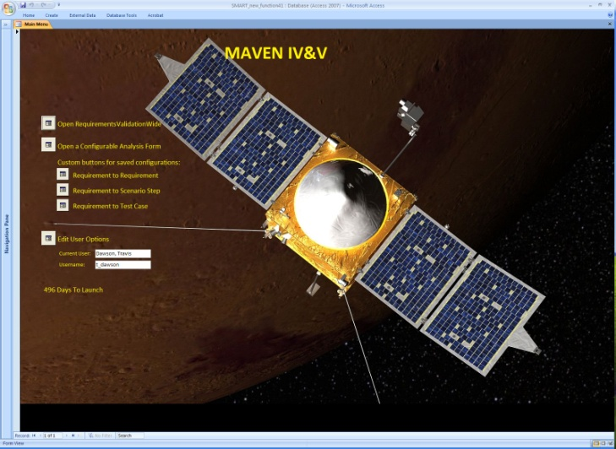

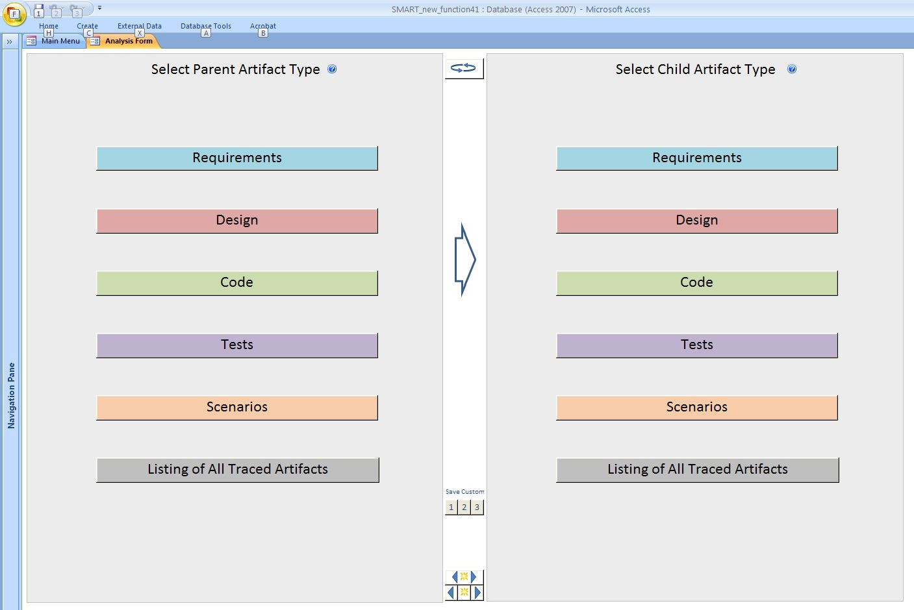
Configurable Analysis Form

Slide 13
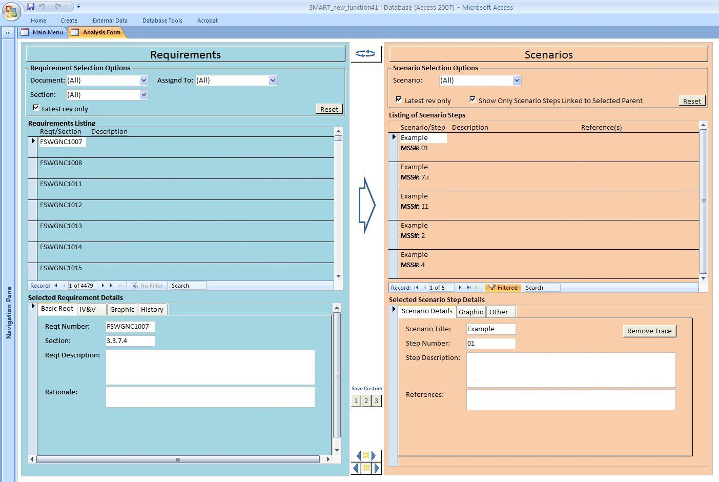
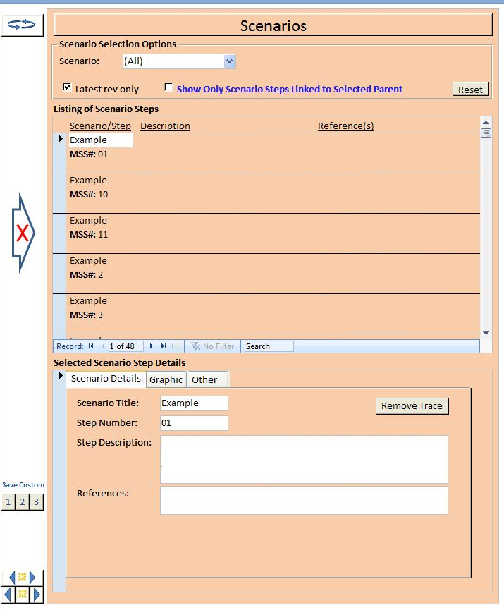
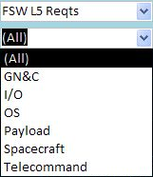
Example: Requirements to Scenarios

Slide 14
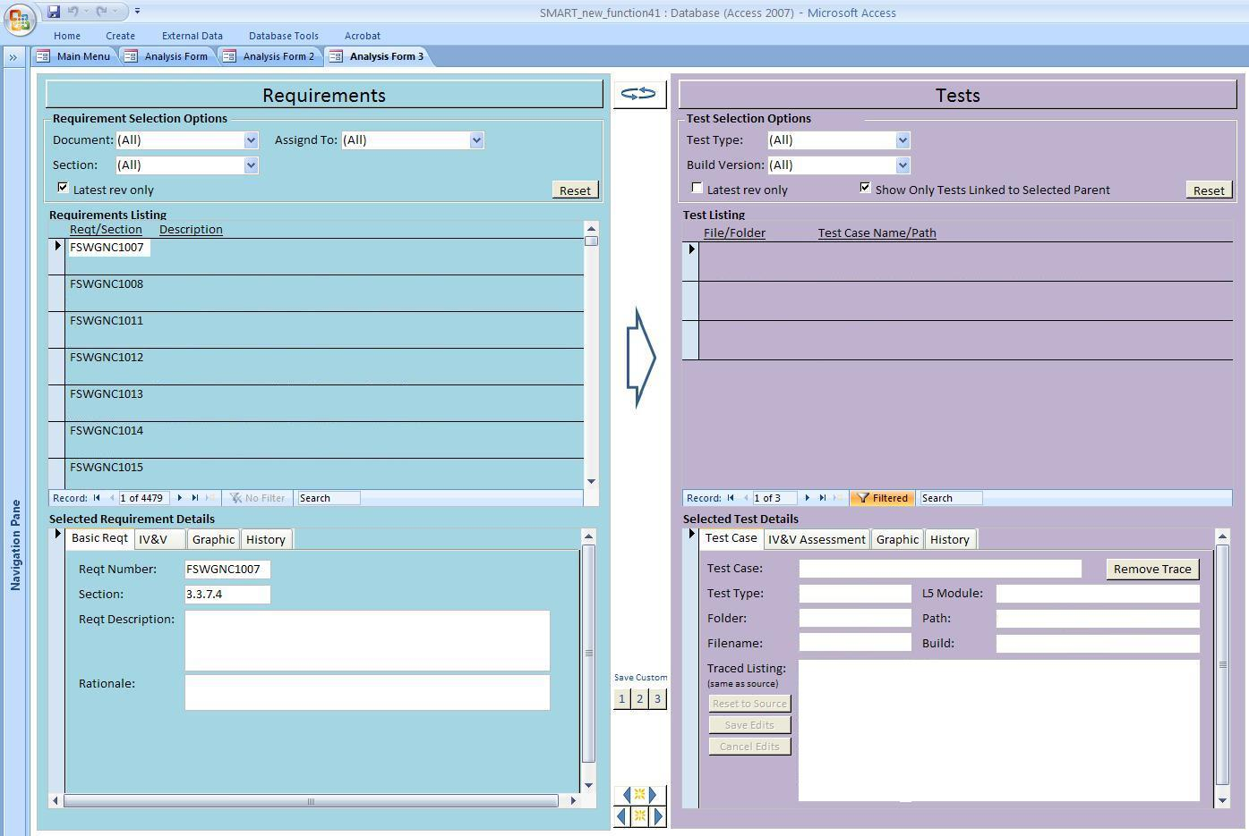
Multiple Analysis Forms

Slide 15
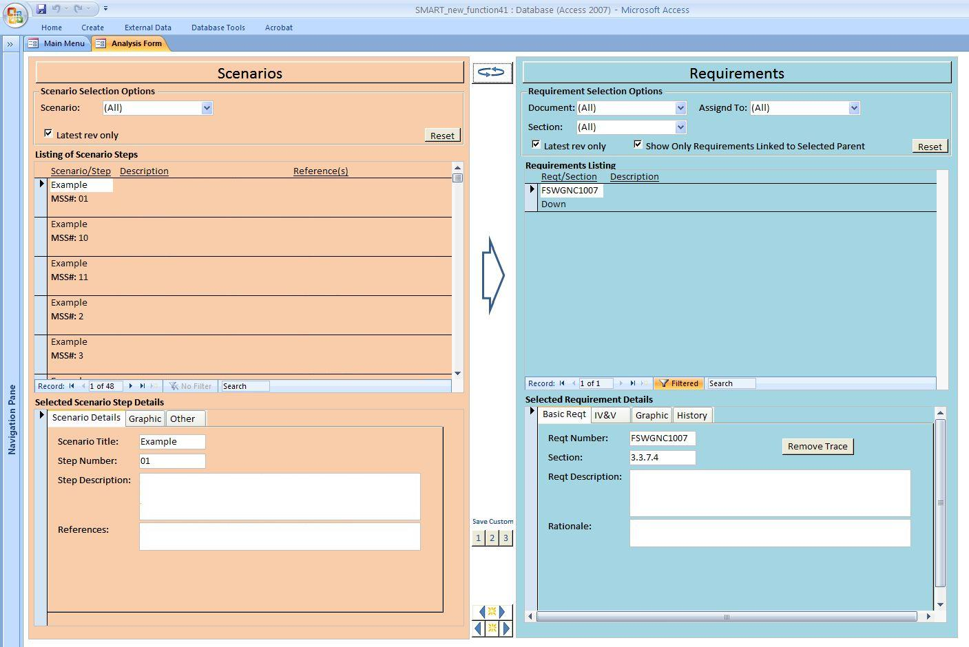
Swapping Left and Right Side

Slide 16
User Requirements Report Card

Slide 17
Future of SMART

Slide 18
Potential Enhancements
Anything to bring report card grades up
Generalization across projects
Using common data model
Native-formatted requirements
  OLE
  html
Extend mapping targets
Simplify data structures
Better support for issue development
Better support for assurance evidence

Slide 19
Ownership
Enterprise vs Project
Analysts vs SWAT

Slide 20
Conclusions

Slide 21
Conclusions
SMART is field-proven
  Multiple projects, many issues generated
  I assert a unique capability (currently supported, traceability tool)
SMART has a large user and user-developer base
SMART has had initial discussion with SWAT on enterprise support
SMART has planned enhancements that are progressing

Slide 22
Backup Charts

Slide 23
SMART Queries
Change Impact Analysis
Changed Requirement Text (ObjectText)
New Requirements
Deleted Requirements
New Traces
Deleted Traces

Slide 24
Factors Behind Tool Selection
Like MAVEN, SMAP was initially using MKS to support requirements validation
  Led to a nearly one-to-one mapping between the fields in MKS and the requirements validation form in SMART
  Analysts would already be familiar with fields
  Made migrating analysis records from MKS to SMART straightforward
MAVEN and SMAP projects use DOORS for requirements and traceability
  Resulted in a database schema and features oriented towards handling artifacts from DOORS
SMART now has a multimission pedigree
  Instantiations of the tool used on Juno, ESMDI, Ares, ICESat-II, SMAP, and now MAVEN – helping establish the framework for a common tool to be used on IV&V projects
  MAVEN benefits from multiple enhancements made to the tool to support the various projects
  Due to MAVEN inheriting analysts from Juno, there was already an experience base with the tool and its architecture
SMART relies on a Microsoft Access frontend
  Flexible architecture and easy to tailor and modify on the fly - does not require a formal change request process
  Considerable experience on the team with Access and database development

Slide 25
SMART for MAVEN Enhancements
Added MAVEN-specific scoping qualifiers
Added fields to support change/impact analysis
Added several requirement fields to facilitate filters
Code analysis form
  Allows analyst to trace one or more functions to a requirement
  Analyst can select the function from dropdown list, which pre-populates a code snippet field
  Analyst can add comments on each trace, as well as comment on the traceability overall if multiple functions are traced to the requirement
Test validation form
  Modeled after code analysis form
  Instead of relying on user to trace test requirements, tool will use developer provided traces
  Designed to support unit test validation and acceptance test validation tasks

Slide 26
Future Enhancements
Develop a form to support analysis of mini-scenarios (basic form developed)
Develop a form to support the general code inspection task
Provide broader coverage of AVT task
Conditional formatting based on various flags

