Slide 1
IV&V of Critical Behavior September, 2012 Shirley Savarino, TASC

Slide 2
Technical Rigor (from 2011 workshop)

Slide 3
Purpose and Agenda
Purpose – purpose is to provide a summary of the EDL activities performed to date and intended benefits (coverage, finding types) associated with each task, including EDL GNC
We believe this can be a case study of how Technical Rigor is applied to a critical behavior
Agenda
EDL Overview
IV&V Tasks Performed
Summary

Slide 4
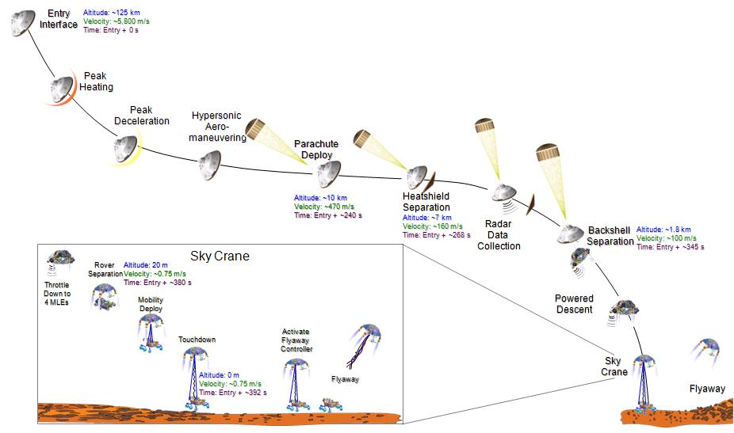
MSL EDL Overview
Final Approach Phase: From Entry -5 Days to Entry Interface -2 Hours
Pre-Entry: From EI-2 Hours to EI-15 Minutes
Exo-Atmospheric Entry: From EI-15 Minutes to the Point of Entry Interface
Atmospheric Entry: From EI to Parachute Deployment
Supersonic Parachute Descent: From Parachute Opening to Backshell Separation
Powered Descent: From BSS to Rover Separation
Sky Crane: From Rover Separation to Touchdown Detection
Fly-Away: From TD to Descent Stage Impact

Slide 5
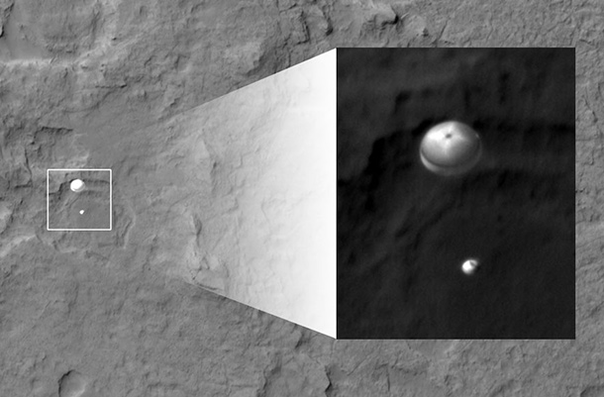
August 5, 2012: Curiosity has landed!

Slide 6
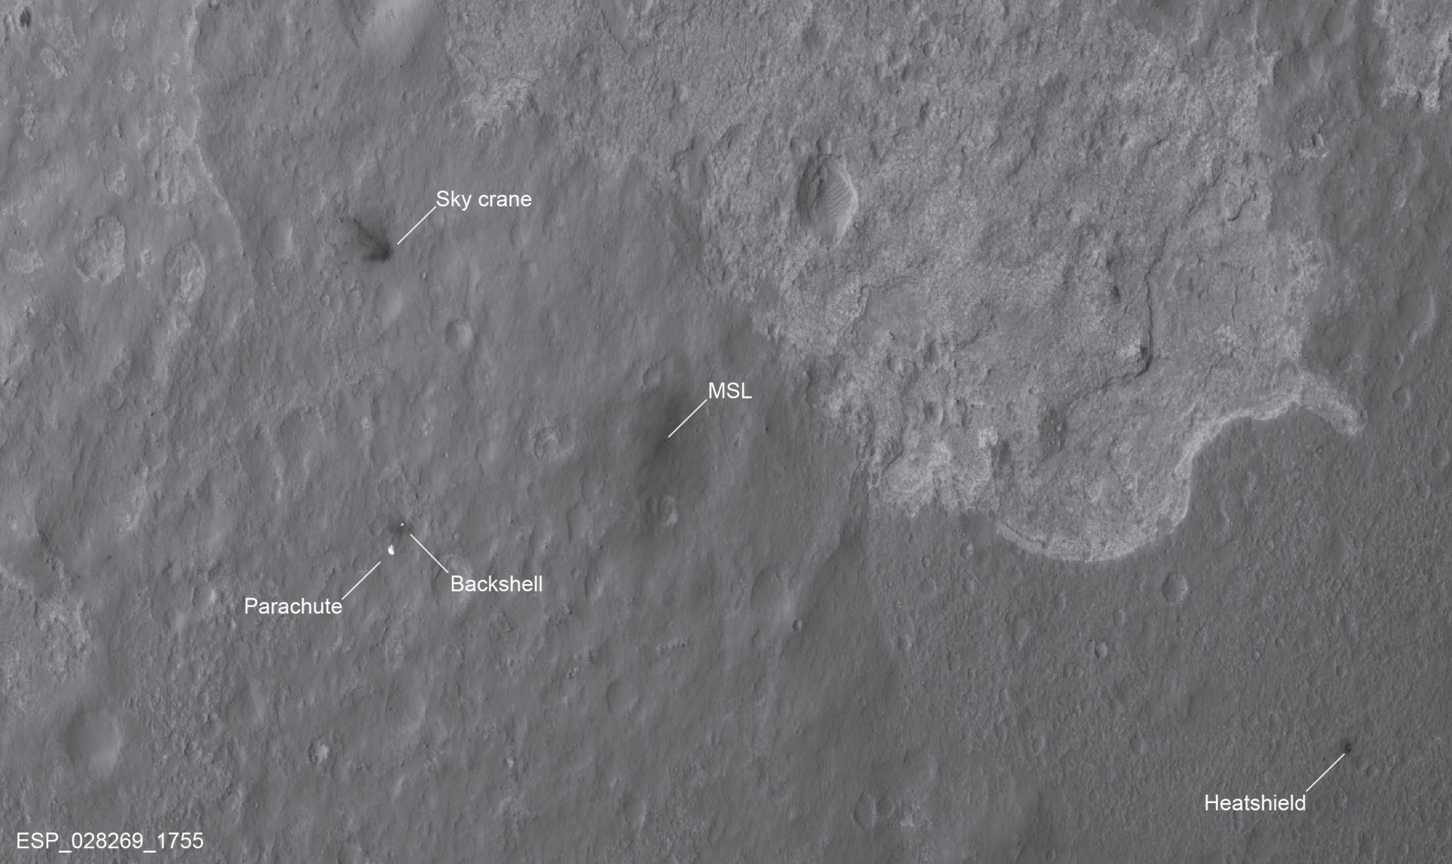
Landing site, after the landing
Mount Sharp
Sky Crane
MSL
Backshell
Parachute
Heatshield

Slide 7
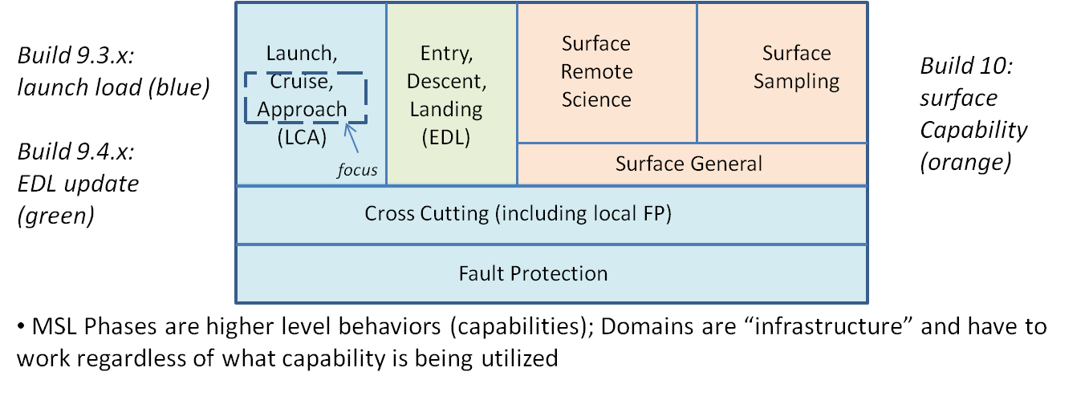
MSL Phase/Domains; Build 9.4
EDL content is the focus of Build 9.4, but requires a good amount of the cross cutting and fault protection domain to operate
EDL activities require the cross cutting and fault protection domains to operate, the associated tasks with these domains provided in annex.

Slide 8
EDL: IV&V Scope, Activities Performed, Status
IV&V Requirements, Design, Code Analysis
IV&V Test Analysis
Scope
Requirements/design analysis, evaluating requirements quality (catalog method) and requirements trace to design (catalog method)
Semantic and Syntactic code analysis (catalog methods)
Additional technical rigor in the areas interface, design and code analysis
IV&V efforts focused on logic, control, and “goodness” of the code implementation.
Performance aspects of EDL were not evaluated (no validation from IV&V, verification performed during IV&V test analysis).
Launch/Cruise/EDL FDDs
Cruise Attitude Estimation, Control and Propulsion
Entry, Descent, and Landing (EDL)
EDL Actuators
EDL Sensors
EDL Comm
MEDLI
Actuators and Motor Control Update
Coordinated Communications Behavior
MSSS Imaging (MARDI, MAHLI, and MastCams)
Cross Cutting
EDL
Test
Fault Protection
EDL: E-5 days to L+10 days (includes pre-EDL
and “readiness for surface ops”)
NASA IV&V PM: “I want us to do anything we can to help make EDL successful”

Slide 9
EDL – Activities Performed (Continued)
Additional EDL Analysis performed
Analysis Area | IV&V Efforts | Task Overview | Benefit to EDL GNC | Coverage (parts of EDL)
Reqts/ Design Analysis | Ensure “no Harm” by instrument operations (MEDLI, MARDI) Events and Control/Sensors/ Actuators FDD Interface Analysis EDL MAIN to EDL GNC Interface Analysis Nav Filter Analysis GNC Requirements Validation (GNC requirements not captured in FDDs) Mode Commander Analysis EDL FP Design Analysis | Evaluation of the two instruments to ensure operation won’t affect EDL in negative manner Detailed look at GNC sensors and actuators Verify correct implementation of interfaces between software modules Same as above Quality of GNC requirements Ensure mode commander (GNC) implemented correctly, including interfaces to nav filter; timeline engine Validation/verification of EDL engine fault protection | Addresses question 2 relative to instrument operation during EDL Ensured sensors/ actuators specified, designed and implemented correctly Ensured interfaces and handoffs between key EDL modules implemented correctly same as above All GNC requirements consistent, correct, testable, complete Ensured mode commander implemented correctly against timeline and with timeline engine and nav filter Validated and verified fault protection (timeline based) | All of EDL All of EDL through two scenarios (cruise/EDL transition; powered descent) All of EDL All of EDL All GNC requirements All of EDL All of EDL

Slide 10
EDL – Activities Performed (Continued),
Analysis | IV&V Efforts | Task Overview | Benefit to EDL GNC | Coverage
Timeline Violations | Assure Timing Related Requirements and Design are Implemented Correctly in EDL Timeline | Three way trace between requirements/ design and code to ensure performance related behaviors are implemented correctly | Absolute time sequences are correctly implemented | Entire timeline
Code Analysis | EDL/GNC Requirements Implementation Analysis EDL Autocoder Analysis (Timeline Implementation) EDL/GNC/Nav Filter Design to Code Trace Timeline Engine Analysis Fault Monitor Analysis | All GNC requirements traced to code, performance requirements deferred to test Ensured EDL autocoder performs code translation correctly from xml file Developed independent understanding of interfaces and ensured correct implementation Assessed timeline engine and how it runs relative and absolute time sequences Reviewed fault protection enables during EDL and validated and verified implementation of timeline FP (catchup, rollback) | Confidence EDL GNC requirements implemented correctly w/ performance limitations Correct use of autocoders Interfaces in code Timeline engine works correctly Fault protection during EDL is appropriate and implemented correctly | Entire Timeline
Test Analysis | Additional intensity/rigor on test analysis of performance based requirements associated with EDL GNC | See next slide

Slide 11
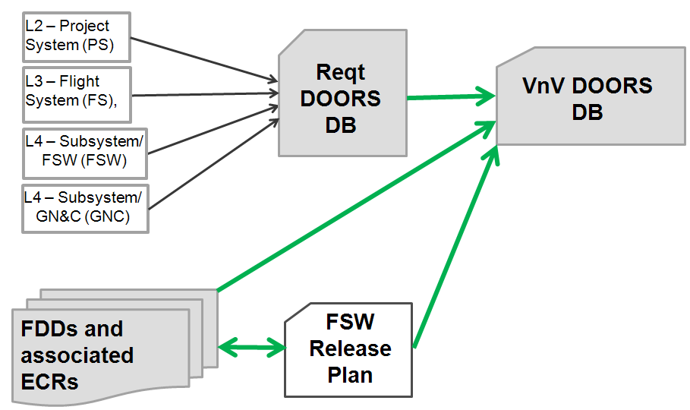
Test Analysis: Ensure correct coverage of test analysis (across MSL, including EDL)
IV&V Requirements, Design, Code Analysis
IV&V Test Analysis
Scope
MSL Test Analysis Challenges
MSL project verification activities are challenged by a distributed requirements management system and a lot of forward work (Risk 20)
IV&V test effort has special software regression analysis to establish correctness of the requirements being verified - Project is using IV&V results as a “wedge” to correct their systems
IV&V Test analysis for Build 9.3 addresses the following
Cross Cutting: All
“EDL”: Launch, Cruise and Approach
activities
Fault Protection: All
Cross Cutting
EDL
Test
Fault Protection
Requirements
Flowdown
Requirements
Captured via…
Test Program
Captured via…
41% diff,
16% diff
15% diff
5.9%
diff

Slide 12
IV&V Analysis Results
IV&V performed substantial analysis on the EDL sequence
High quality designs produced by the developer, JPL
We initially identified some high severity requirements/design issues but many of these resulted in documentation concerns
There were some code issues that were quickly fixed by the developer
Artifacts were non-traditional, but they were very good
The assurance from IV&V provided additional confidence that EDL was correctly implemented, particularly in the areas of logic and control
The MSL IV&V team presented status and analysis results at the Certification of Critical Event Review-1 which focused on the EDL software on May 30th. The Project Technical Authority congratulated IV&V on the thoroughness and completeness of analysis and stated to the review board that IV&V has provided additional assurance and confidence to the Project.

