Slide 1
A Catalog of Methods for Performing IV&V
Patrick Theeke
Phillip Loftis
Notes:
This presentation will outline the catalog of methods, the way it was created, and its future. Basic content will be presented as organized by the mapping to the IV&V Technical Framework (09-1). Efforts to help ensure its acceptance and utility to IV&V will be presented, and conclude with how the Catalog of Methods contributes to the delivery of consistent, high quality of IV&V to development projects even while being open to innovation and growth.

Slide 2
Agenda
Forming
Storming
Norming
Performing
Notes:
The creation of a Catalog of Methods for Performing IV&V can be dvided into the standard teaming cycles

Slide 3
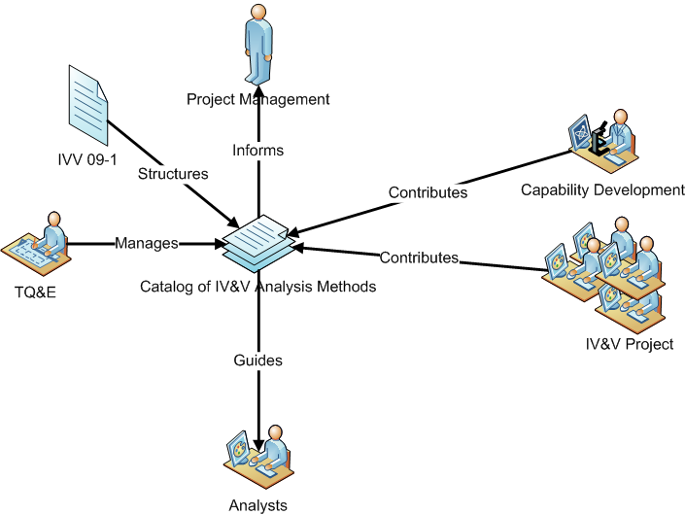
Forming – Envisioning the Catalog

Slide 4
IVV 09-1: Independent Verification and Validation Technical Framework
“The purpose of this system level procedure (SLP) is to establish a consistent method for providing IV&V technical services to customers, sufficient to ensure safety and risk mitigation for the successful deployment of software-intensive systems. “
This SLP defines a structure for all of the possible goals of performing IV&V
Notes:
The basis for the CoM

Slide 5
Players
Technical Quality and Excellence (TQ&E)
Capability Development
IV&V Projects/Analysts
Notes:
TQ&E is a group within the IV&V Office that is responsible for, among other things, managing the CoM
Capability Development is a group within the IV&V Office that is responsible for expanding and improving the types and methods for delivering IV&V services to our customers
IV&V Project and Analysts perform IV&V analysis to provide assurance to customer (past (including way past) and present)

Slide 6
Storming – Implementing the Vision
Initiated by TQ&E in 2010
Format
Structure
Contents
Institutionalization
Notes:
An early decision was made to focus on content, and as such, a minimally sufficient format and structure was defined (Excel)
Documents were written to describe how the CoM would be managed, including mechanisms to grandfather existing methods, add new methods, refine documented methods, and remove out-dated methods.
References to 09-1
A maturity continuum was created to expand the possible range of methods that could be employed by projects, including experimental methods – the goal is not to stifle or limit, but rather to manage the methods employed by IV&V projects

Slide 7
Storming – Priming the Pump
Be opportunistic early: Collect methods that are actually being used on real IV&V Project right now
Exercise the planning documents with the methods collected to refine the processes and structure
Involve IV&V project leadership and analysts in the process

Slide 8
Norming – Growth and Value
Expand method collection to near- and mid-term needs of projects
Encourage CD and IV&V projects to document their experiences directly and provide them to the Catalog
Incorporate additional resources on a part time basis to expand value and awareness
Let coverage of 09-1 drive method definition and collection
Regularly socialize the current status and future plans

Slide 9
Performing – The Catalog as an Organizational Asset
The Catalog is now an integral part of NASA IV&V
Planning
Execution
Improvement
Notes:
Planning – a TS&R is documented as part of the planning process to identify the methods to be employed to accomplish the assurance goals of each project
Execution – the methods are used by analysts to help inform their day-to-day analysis activities (e.g. work instructions)
Improvement – as new tools, techniques and experiences are gained on IV&V projects, through Capabilities development, and other sources the Catalog is updated to reflect efficiencies, best-practices, options and general improvements

Slide 10
Tech Framework Mapping
Screen shot
Notes:
Coverage, availability and diveristy

Slide 11
Synopsis
Screen shot
Notes:
Comprehension of application and approach

Slide 12
Analysis Steps
Screen shot
Notes:
Level of abstraction

Slide 13
Future of the Catalog
Continue to define and refine methods
Create a new and better structure of documenting the Catalog
Consider expansion of the Catalog to incorporate goals from sources other than IVV 09-1
Improve the explicit integration of the Catalog into the planning, execution, and enterprise improvement activities
Notes:
Extend coverage of 09-1 goals (including diversity of options) by defining new methods
Interns over Summer 2012 prototyped a vision of the Catalog in a Wiki format
Other potential sources include SMA and IEEE 1012-2012

Slide 14
Questions
?

