Slide 1

Applying NASA-STD-7009 Standard to Models and Simulations
NASA's 2013 Annual Workshop on Independent Verification and Validation of Software
September 12, 2013
By
Darilyn Dunkerley
TASC, Inc.
Darilyn.M.Dunkerley@ivv.nasa.gov

Slide 2
Talk Objective
The History of NASA-STD-7009
NASA-STD-7009 Objectives
Who Has Used NASA-STD-7009?
What’s the Big Deal About Models & Simulations (M&S)?
Structure Vs. Dynamic M&S Development Balance
M&S Standard Application at NASA IV&V
Reflections on Developing NASA-STD-7009
Compliant M&S Products
Questions?

Slide 3
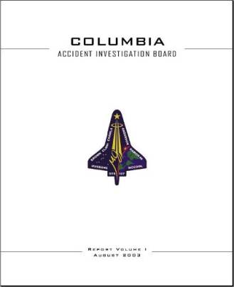
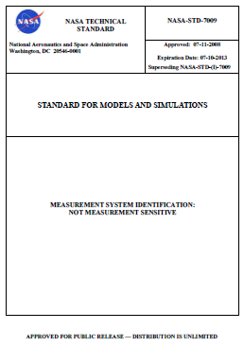
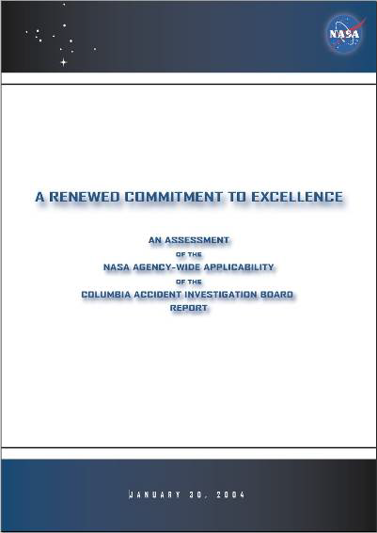
The History of NASA-STD-7009
Columbia Accident Investigation Board (CAIB) Report
NASA-STD-7009
Standard for Models and Simulations
Action 4 from the CAIB Report states: “Develop a standard for the development, documentation, and operation of models and simulations…”
Diaz Team Report - NASA
NASA-STD-7009, Section 1.2 states:
This standard applies to M&S used by NASA and its contractors for critical decisions in design, development, manufacturing, ground operations, and flight operations.
Diaz Team # R13, CAIB # R3.8-2 states:
“All programs should produce, maintain, and validate models to assess the state of their systems and components.”
Notes:
http://history.nasa.gov/columbia/CAIB_reportindex.html
www.nasa.gov/pdf/55691main_Diaz_020204.pdf‎
standards.nasa.gov/documents/detail/3315599

Slide 4
NASA-STD-7009 Objectives
This standard was developed in response to Action 4 from the 2004 report “A Renewed
Commitment to Excellence,” which stated the following:
“Develop a standard for the development, documentation, and operation of models and simulations:
  a. Identify best practices to ensure that knowledge of operations is captured in the user interfaces (e.g., users are not able to enter parameters that are out of bounds),
  b. Develop process for tool verification and validation, certification, reverification, revalidation, and recertification based on operational data and trending,
  c. Develop standard for documentation, configuration management, and quality assurance,
  d. Identify any training or certification requirements to ensure proper operational capabilities,
  e. Provide a plan for tool management, maintenance, and obsolescence consistent with modeling/simulation environments and the aging or changing of the modeled platform or system,
  f. Develop a process for user feedback when results appear unrealistic or defy explanation.”
* This material was extracted from the NASA-STD-7009 document (Section 1.1) and reformatted for readability

Slide 5
Who Has Used NASA-STD-7009?
As models and simulations are used more prevalently, the need to manage them accurately is critical.
This standard has been adapted in several industries:
  NASA: Currently Multi-Purpose Crew Vehicle (MPCV) is using this standard
  DOD: MIL-STD-3022 CHG-1
    Department of Defense Standard Practice Documentation of Verification, Validation, and Accreditation (VV&A) for Models and Simulations (April 2012)
  FDA/NIH/NSF: 5th Computer Models and Validation for Medical Devices (June 11-12, 2013)
    “Adapting NASA‐STD‐7009 to Assess the Credibility of Biomedical Models and Simulations”, Lealem Mulugeta, Project Scientist, NASA Digital Astronaut Project
  NSAS Space Radiation Risk Project Review, National Academy of Sciences, Houston, Texas January 12, 2012
    “NASA‐STD‐7009”
NASA’s 2013 Annual Workshop on Independent Verification and Validation September 12, 2013
Notes:
“Guidance for Space Program Modeling and Simulation”, SAAB, AEROSPACE REPORT NO.TOR-2010(8591)-17, June 30, 2010
NASA-STD-7009” NSAS Space Radiation Risk Project Review National Academy of Sciences, Houston, Texas January 12, 2012

Slide 6
What’s the Big Deal About M&S?
Models and Simulations (M&S) are used on NASA missions (and other industries) to exercise software without requiring the hardware components to be included early in the mission lifecycle.
  For example, M&S can send commands to the FSW to fire thrusters without the thrusters being fired (That would not be safe!!)
M&S allows various scenarios to be run without having the full system available.
  Intended to help facilitate the system development process
Most importantly M&S products provide valuable feedback to decision-makers on design/architecture elements of the system early on
  For example, possibly a simulation of the FSW interacting with a 1553 Bus Simulation, versus Space Wire Simulation. A system designer selects one design over another often based on simulation results.
NASA’s 2013 Annual Workshop on Independent Verification and Validation September 12, 2013

Slide 7
Structure Vs. Dynamic
M&S Development Balance
Dynamic Nature of M&S Products
  Pros:
    Facilitates system development and design decisions
    Allows for more rapid software development
  Cons:
    Configuration a challenge to manage
    Documentation of assumptions and components are not always kept current
The Balancing Act Between Structure and
Dynamic Development Continues ….

Slide 8
M&S Standard Application at
NASA IV&V
To date, two evaluations have been done:
  Analysis and Management Framework Model (AMF) Criticality Assessment (done as part of a NEAP intern effort the summer of 2013)
  James Webb Space Telescope (JWST) participated in performing an abbreviated evaluation effort recently.
Notes:
AMF project has been developing a model for the last 2 years, applying Object Oriented principles to the NASA IV&V environment.

Slide 9

NASA IV&V AMF Project
7009 Criticality Assessment
AMF project has been developing a model to manage analysis data products at NASA IV&V
NASA-STD-7009 was imported into the AMF Model
  Each 7009 requirement was atomically referenced and traced based on relevancy to the AMF model;
  Each trace was evaluated within the model and assessment comment was stored with each trace.

Slide 10
7009 Criticality Assessment (Cont.)
AMF Model Element
7009 Requirement
AMF Model Element
7009 Requirement
AMF Model Element
7009 Requirement
AMF Model Element
7009 Requirement
Assessment of AMF Model Element given a particular 7009 Requirement
Analysis took place during the summer of 2013 with the participation of the AMF IV&V team with the effort of Robert Hewitt, NEAP Summer Intern
The results of the assessment were stored within the AMF model (per each trace)
Assessment of the trace included as part of the trace
Assessment report to be generated from AMF

Slide 11
7009 Criticality Assessment –
Conclusion
7009 Criticality Assessment Results
  The AMF project performed disciplined development practices from the beginning.
    Model assumptions, uses, and constraints were able to be found relatively easy
  The AMF project is 7009 compliant based on their phase of development
  Future efforts include:
    Assessment report formulation
    Training on the AMF usage

Slide 12
JWST 7009 Criticality Assessment
A more abbreviated approach was taken with the JWST project
  A set of questions (20 to be exact) were sent to the project for feedback
  As with the standard the types of questions that were asked included the following:
    Do you document the model/database usage?
    Are the components well-documented?
    Is the configuration management for the model (and its components) well-established?
    Is there a well-defined input/output data set defined?

Slide 13
JWST 7009 Criticality Assessment Conclusion
The IV&V project provided sufficient information in response to the questions. They indicated the following:
  Although late in the development lifecycle for this product, the IV&V team was able to retrieve most of the data items that are required by a 7009 Compliant project.
  This review was informal intended to familiarize the team with the 7009 standard
Notes:
http://webbtelescope.org/webb_telescope/multimedia/db/the_observatory/webb_model_goddard/medium

Slide 14
Reflections on Developing
NASA-STD-7009 Compliant M&S Products
The earlier in the development lifecycle of an M&S product the more detailed/usable the information available for 7009 Criticality Assessment.
Information required to be retained by a 7009 Compliant M&S product, is consistent with System Engineering Best Practices.

Slide 15
Questions?

Slide 16
BACKUP Slides

Slide 17
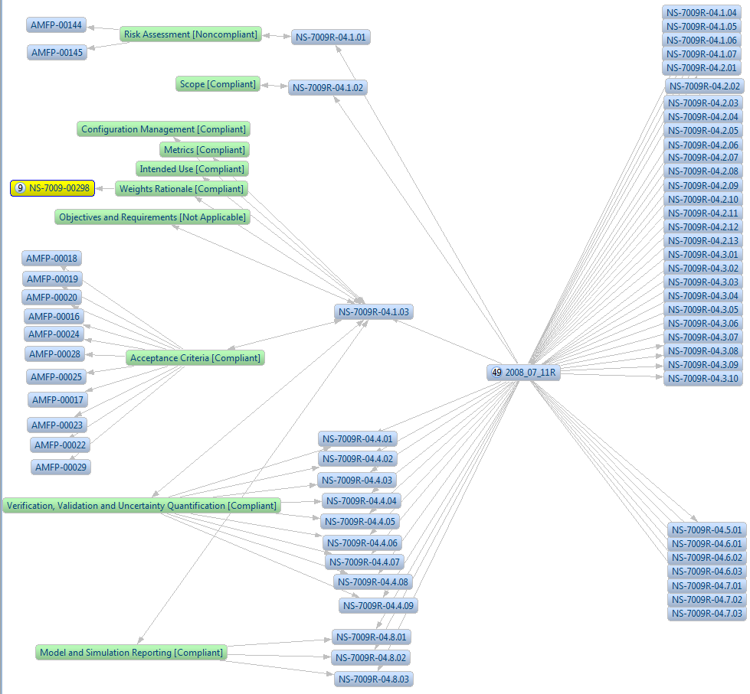
Actual AMF 7009 Criticality Assessment Traceability
Notes:
This is a product of the NEAP Summer Intern (Summer of 2013) that worked with the AMF team (Robert Hewitt) to produce this material

Slide 18
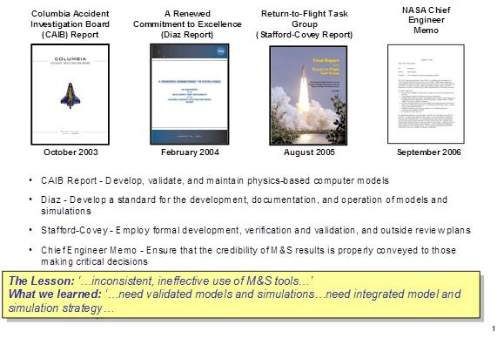
Study Done to Correlate Existing Software Engineering Principles with M&S Standard
http://swehb.nasa.gov/display/7150/7.15+-+Relationship+Between+NPR+7150.2+and+NASA-STD-7009#_tabs-2

Slide 19
Major Areas of Focus in M&S Standard
4.1 Programmatics
4.2 Models
4.3 Simulations and Analyses
4.4 Verification, Validation, and Uncertainty Quantification
4.5 Identification and Use of Recommended Practices
4.6 Training
4.7 Assessing the Credibility of M&S Results
4.8 Reporting Results to Decision Makers

Slide 20
Section 4.1: Programmatics
This information is how a M&S product will be viewed and used by management
  How will model be used by Management to make decisions?
  Is all information related to usage and recommendations (as a result of M&S)

Slide 21
Section 4.2 Models
More technical elaboration of contents and usage of the model
Version control of the model established.
Input and output datasets

Slide 22
Section 4.3: Simulations and Analyses
M&S expected results documented.
  How does an analyst know the model/simulation worked?
  Elaboration of its intended use.
  Elaboration of the pedigree of the model.
  Computation requirements are vetted.
  How results are provided to decision makers.

Slide 23
Section 4.4: Verification, Validation, and Uncertainty Quantification
M&S V&V process is produced
  Results are analyzed to determine veracity of the M&S design/content
Identification and Use of Recommended Practices

Slide 24
Section 4.6: Training
How the result will be presented to the user community.
CM requirements
How to recognize success/failure in the M&S results.
How the results may impact existing procedures/policies.

Slide 25
Section 4.7: Assessing the Credibility of M&S Results
NASA-STD-7009 has a fairly rigorous set of criteria applied by way of scoring the M&S product’s credibility.
  Appendices B.2/B.3 will be evaluated for each M&S product

Slide 26
Section 4.8: Report Results to Decision Makers
Results are reported to decision makers which include the following information:
  Acceptance criteria are elaborated.
    Unachieved acceptance criteria
    Violations of any assumptions for any model
    Violations of limits of operation
    Execution warnings/error messages
    Unfavorable outcomes
    Waivers to any of the requirements in this standard
  Uncertainties are estimated and reported
  Credibility of the M&S results which may include sub-factor weights (determined in 4.7)

Slide 27
References of Note
“Guidance for Space Program Modeling and Simulation”, SAAB, AEROSPACE REPORT NO.TOR-2010(8591)-17, June 30, 2010 (slide 5)
“NASA-STD-7009” NSAS Space Radiation Risk Project Review National Academy of Sciences, Houston, Texas January 12, 2012 (slide 5)
Relationship between NASA System Engineering Handbook (NASA-HDBK-7150.2) and NASA-STD-7009 (performed by SSO)
  http://swehb.nasa.gov/display/7150/7.15+-+Relationship+Between+NPR+7150.2+and+NASA-STD-7009#_tabs-2 (backup slide)
NASA/SP-2010-576, Version 1.0, April 2010, NASA Risk-Informed Decision Making Handbook (Office of Safety and Mission Assurance, NASA Headquarters)
  www.hq.nasa.gov/office/codeq/doctree/NASA_SP2010576.pdf
NASA Standard 7009 Training (created by NASA)
  http://standards.nasa.gov/training/NASA-STD-7009/index.html‎

