Slide 1



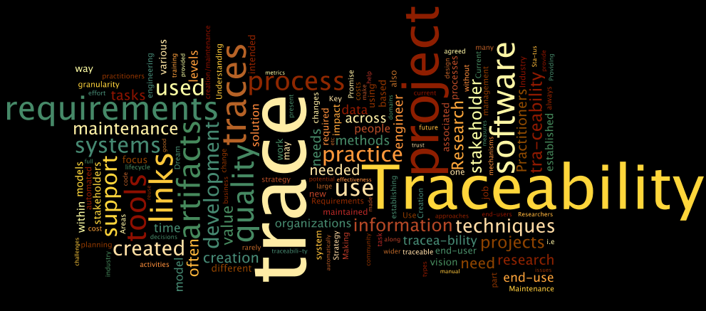
TraceLab Player: From Researchers to IV&Vers
Jane Hayes, PhD Wenbin Li, ABD
hayes@cs.uky.edu
Jane Cleland-Huang, PhD Adam Czauderna, MS
jhuang@cs.depaul.edu
Funding for the work discussed in this presentation provided by the National Science Foundation grants # CNS0959924, CCF0810924, CCF 0447594, CCF 0306303,and Siemens Corporate Research, and NASA grant # NNX06AD02G .

Slide 2
Outline
COEST Overview
Tracing
TraceLab Overview
TraceLab Player
Demo
Questions

Slide 3

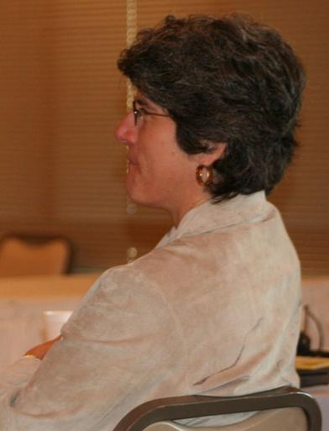
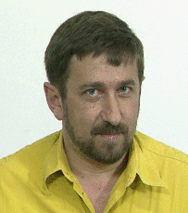
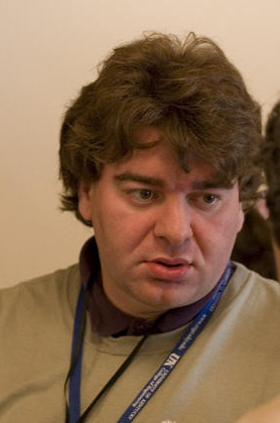


A Forward Looking Idea…
Idea: Form a Center of Excellence for
Software and System Traceability (COEST)
The first CoEST meeting occurred under the St.
Louis Arch at ICSE 2005. It was attended by
Jonathan Maletic, Guilio Antoniol, Alex
Dekhtyar, Jane Cleland-Huang,
Jane Hayes, and
several students

Slide 4
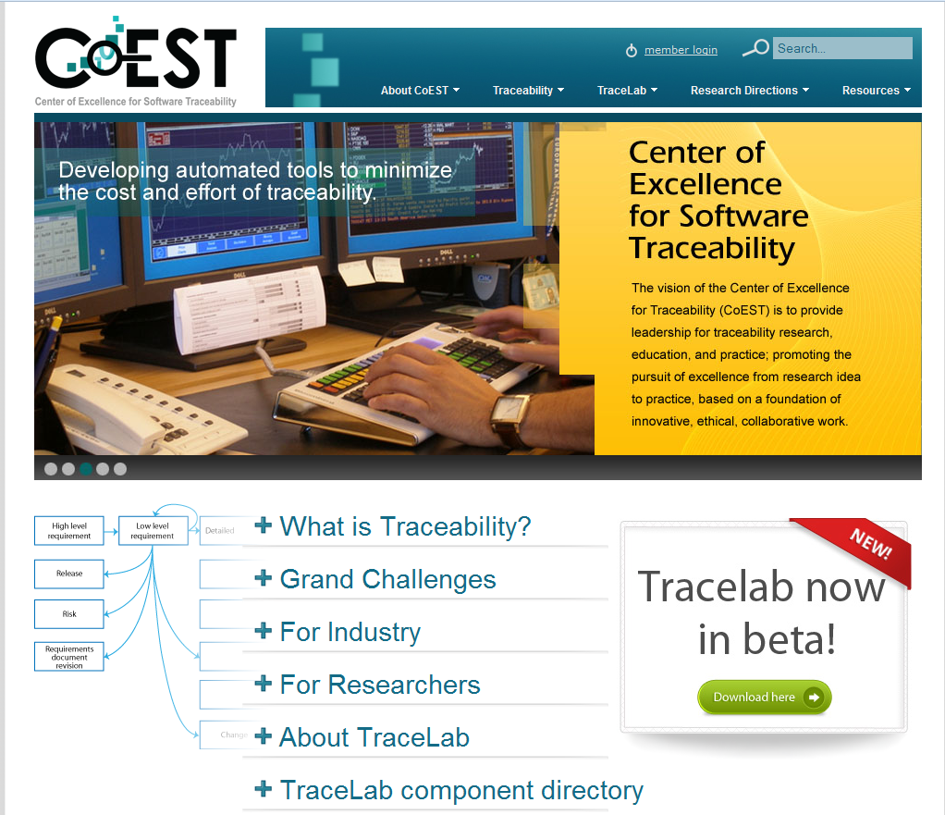
www.coest.org

Slide 5
Importance of Trace Matrices (TMs)
COEST Overview
Tracing
TraceLab Overview
TraceLab Player
Demo
Questions
Some V&V/IV&V Activities that Require TMs
  Criticality analysis
  Requirement satisfaction
  Change impact analysis
  Hazard reachability analysis
  Regression testing
  Traceability analysis
  Risk analysis
  Test Plan and Test Case Generation
  Interface analysis
  Consistency checking

Slide 6
Study of Methods
[Ant02,Cle05,Hay06,Mar03,Zhou10+]
COEST Overview
Tracing
TraceLab Overview
TraceLab Player
Demo
Questions
  Various methods
    Vector Space Model
    Probabilistic Model
    Latent Semantic Indexing
    Rule-based
    Event-based
    Natural Language Processing
  Focus on precision
    Thesaurus
    Phrasing
    Filtering

Slide 7
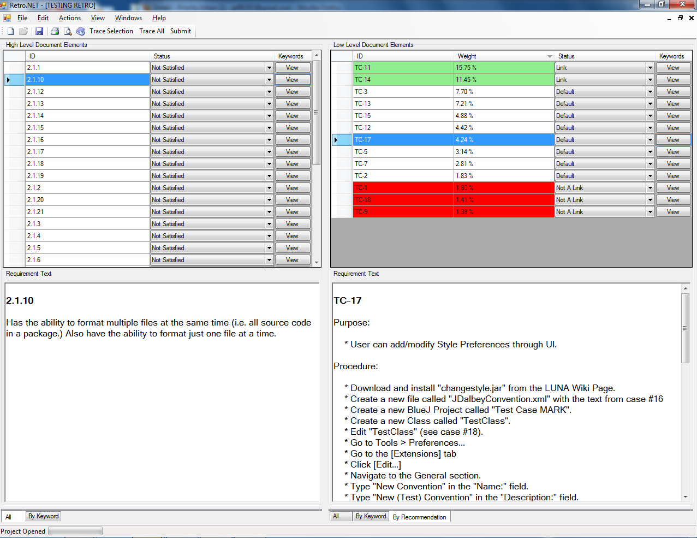
Tracing Tools

Slide 8
TraceLab- The Vision
COEST Overview
Tracing
TraceLab Overview
TraceLab Player
Demo
Questions
Build a tool, similar to MatLab, but designed specifically for the traceability community
Equip new researchers with basic algorithms and components
Make it easier to perform rigorous comparative evaluations
  Datasets
  Benchmarks
  Repeatable experiments
Permit practitioners to use “best” algorithms for specific benchmark

Slide 9
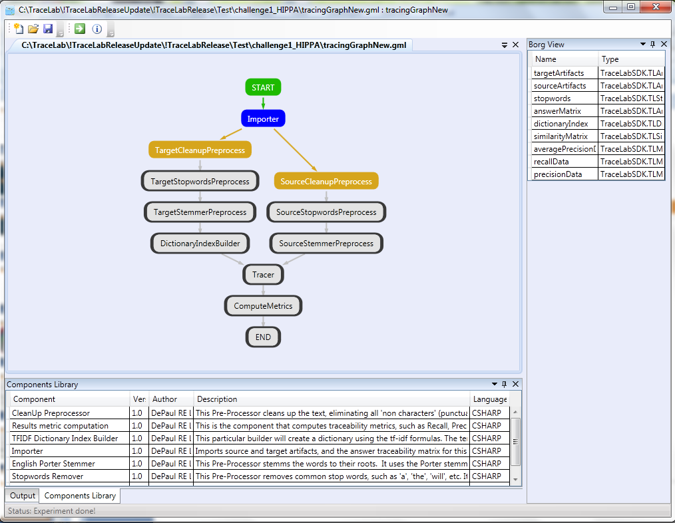
TraceLab - Major Research Instrumentation
Features:
Visual environment for designing, executing experiments
Component library
Support for writing components in C++, C#, and Java
Flexible work-flow engine
Portability across multiple operating systems
Intuitive user interface
TraceLab Version 0.4.3.0
TraceLab developers: Ed Keenan,
Adam Czauderna, and Greg Leach

Slide 10
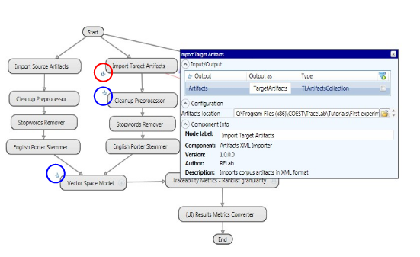
Configuration
Easy to setup, check inputs/outputs
Allows users to configure various parameters
  File path
  Multiple choices
  Numbers

Slide 11
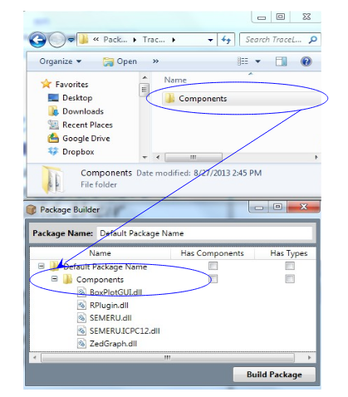
Reusability
Encourage practitioners to build own component packages
Makes it easy to reuse components, compare different algorithms

Slide 12
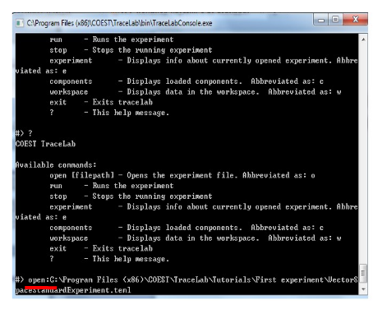
TraceLab Player
Allows users to run experiments without GUI
  open -> run
Provides efficient way to run multiple experiments, compare different methods

Slide 13
TraceLab Player
Provides all necessary information about experiment
  General experiment information
  Components
  Data values
  Outputs generated by components
Demo

Slide 14
Questions?

Slide 15
Backup

Slide 16
Challenges
2. Purposed - Traceability is fit for purpose and supports stakeholder needs.
3. Cost-Effective - The return from using traceability is adequate in relation to the outlay of establishing it.
4. Configurable - Traceability is established as specified, moment-to-moment, and the rich semantics accommodate changing stakeholder needs.
5. Trusted - All stakeholders have full confidence in the traceability, as it is created and maintained in the face of inconsistency, omissions and change; they can and do depend upon it.
6. Scalable - More and more artifacts are supported by traceability, of varying types and at variable levels of granularity, as the traceability extends through-life, and across organizational and business boundaries.
7. Portable - Traceability is exchanged, merged and reused across projects, organizations, domains, product lines and supporting tools.
8. Valued - Traceability is a strategic priority valued by all, where every stakeholder has a role to play and actively discharges his or her responsibilities.

Slide 17
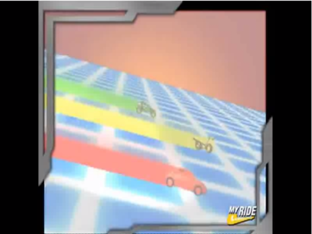
What is a grand challenge?
What makes this a good Grand Challenge?

Slide 18
Is “Traceability” a grand challenge?
Is traceability important? Why?
Is traceability difficult to achieve?
Do we have a clear vision of where we want to go?

Slide 19
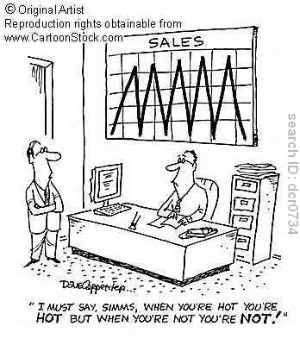
Benchmarks
Recall vs. Precision problem – small changes in thresholds can have inordinate impact upon recall vs. precision – creating zigzag graphs. For benchmarking metrics, how do we overcome this?

Slide 20
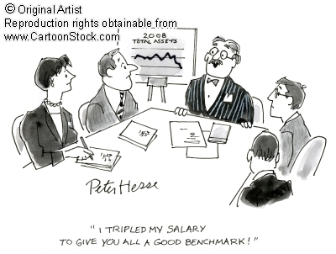
Benchmarks
High water marks–
Will high benchmarks thwart innovation?
Is this a good or bad thing?

Slide 21
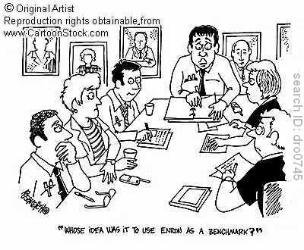
Benchmarks
Trust –
What kinds of checks and balances do we need to put into the process to make sure that benchmarks are fair?
How do we make comparisons anyway?

Slide 22
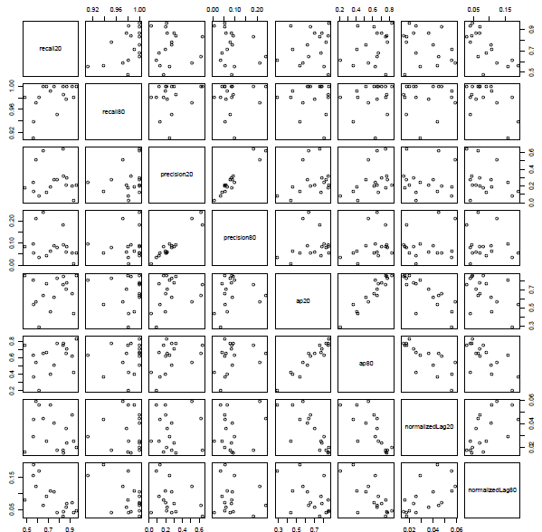
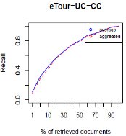
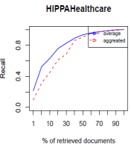
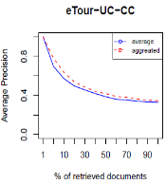
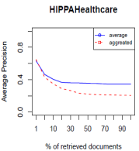
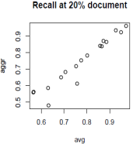
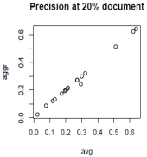
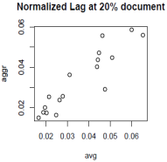
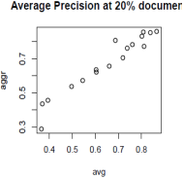
Benchmark issues
Early work
TEFSE community.
An idea.
Towards a grand challenge.
Beyond the challenges
TraceLab & Benchmarks
Yonghee’s work

Slide 23
Benchmark insights
Early work
TEFSE community.
An idea.
Towards a grand challenge.
Beyond the challenges
TraceLab & Benchmarks
What is the purpose of benchmarking our community?
  What do we hope to accomplish from benchmarking?
What are the major pitfalls of benchmarking in the traceability community?
  How can we avoid them?

Slide 24
Enter Human Analyst in Tracing – Study of Analyst
Can’t live without ‘em
Can’t live with ‘em

Slide 25
The Traceability Task
Task
Final Result
Analyst
Exact Results
Tired employees
Long waits
Wasted Effort
… but also
Manual Tracing Scenario

Slide 26

The Traceability Task
Task
Final Result
Fast answers
More efficient employees
Software
… but also
Potentially incorrect results !
(Fully) Automated Tracing Scenario

Slide 27
The Traceability Task
Task
Final Result
Analyst
Software
“Trust but Verify” Tracing Scenario

Slide 28
So, why can’t we live without humans? [TEFSE05]
Only one scenario w/o human analyst involvement:
Task
Final Result
Software
Analyst
What happens if Final Result is not accurate?

Slide 29



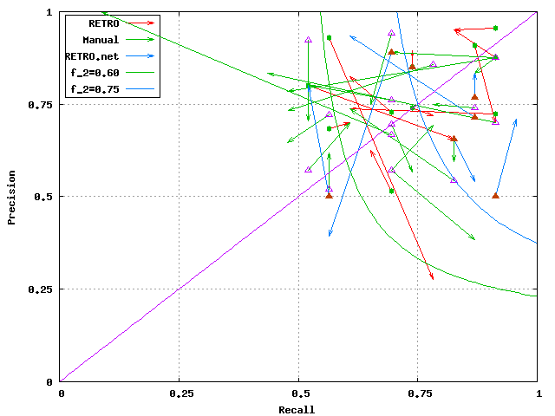
Study of Analysts - Big Picture [NIER]
Analysts are fallible
Accurate automated methods
not much help? (analyst
yields best TM from lower quality
initial TM – must account for this)
… but tracing MUST be done
Options?

Slide 30
ignore analyst,
quarantine analyst,
30
change analyst, or….
embrace the analyst
30

Slide 31
Traceability Research Timeline
Rudimentary tools
2nd Generation of Trace features in RM tools
Technology transfer pilots
What next?
The Grand Challenges provide roadmap for future research efforts and mechanism for tracking progress towards our goals; TraceLab
1995 & earlier
Seminal work in trace-ability
1995-2010
Numerous researchers work on various traceability topics receiving funding from NASA, NSF, & Industry
funded by NASA & NSF
2006/7
C
Grand Challenge Workshops held,
GCT 1.0 released
2010: MRI funded by NSF for $2M
o
E
S
T
GCT 2.0
released,
Jan. 2011

