Slide 1
Evidence-Based Assurance with the Analyst Workbench
Zachary Seamon, Donald Kranz
5th Annual IV&V International Workshop
Notes:
The Analyst Workbench is an IVV-developed Eclipse tool that interfaces with the AMF data structure to provide dynamic traceability views between requirements, design documentation, analyst assessments, and other project data. The AWB provides a powerful visual representation of project data and data relationships that other tools lack. This demonstration will provide an overview of the capabilities of the AWB, showing the tool’s ability to capture evidence for assurance cases, and enhance both the quality and quantity of work for analysts and managers. Attendees will see a general overview of the tool, and attain the knowledge necessary to assess if the AWB may be a valuable tool for their team’s analysis efforts. The AWB will become a core tool in the analysis and management efforts of NASA IV&V going forward.

Slide 2
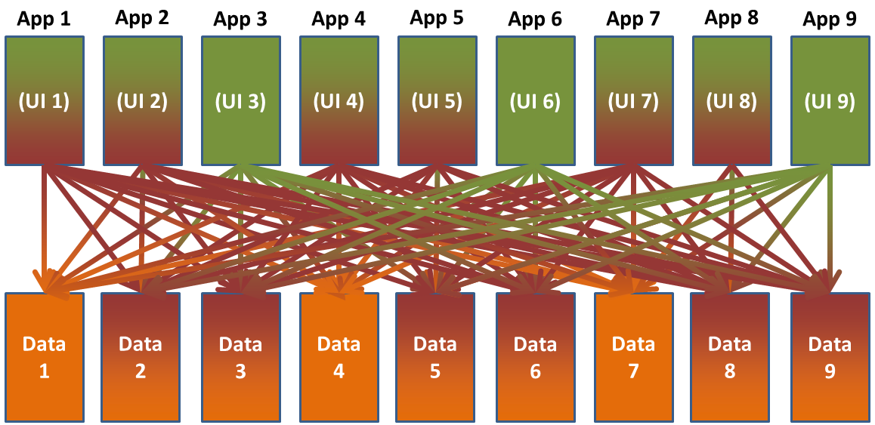
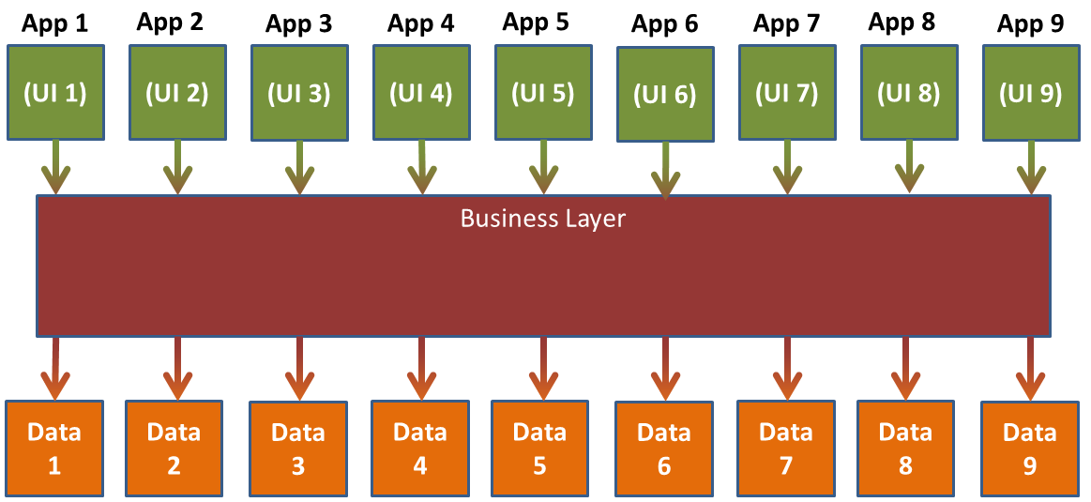
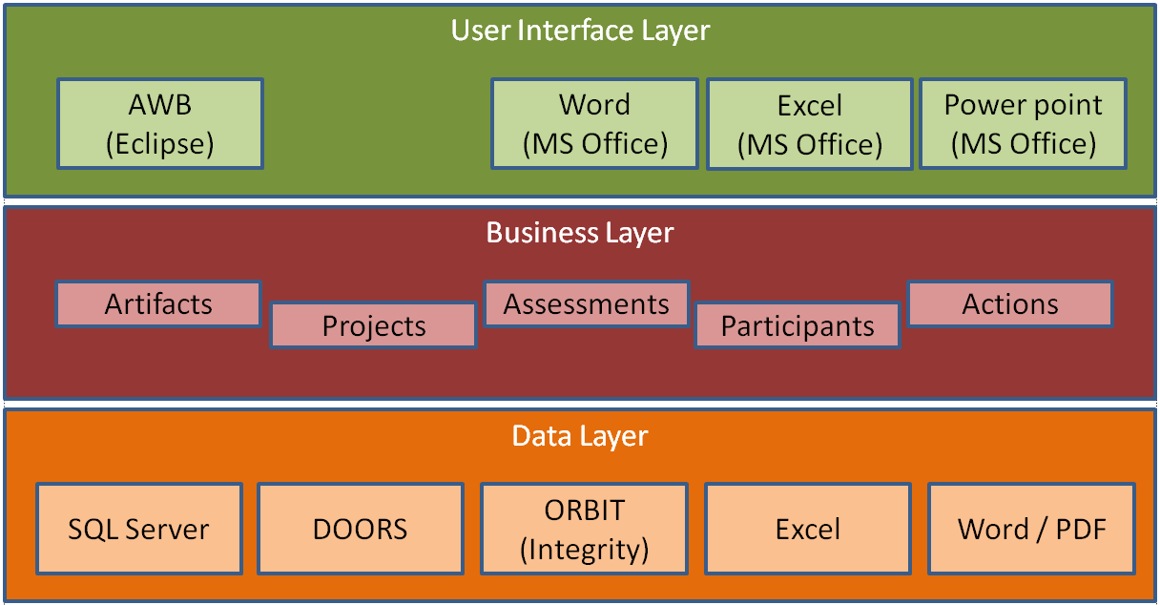
IV&V Analysis Management Framework (AMF)
Notes:
traceability views between requirements, design documentation, analyst assessments, and other project data.
visual representation of project data relationships

Slide 3
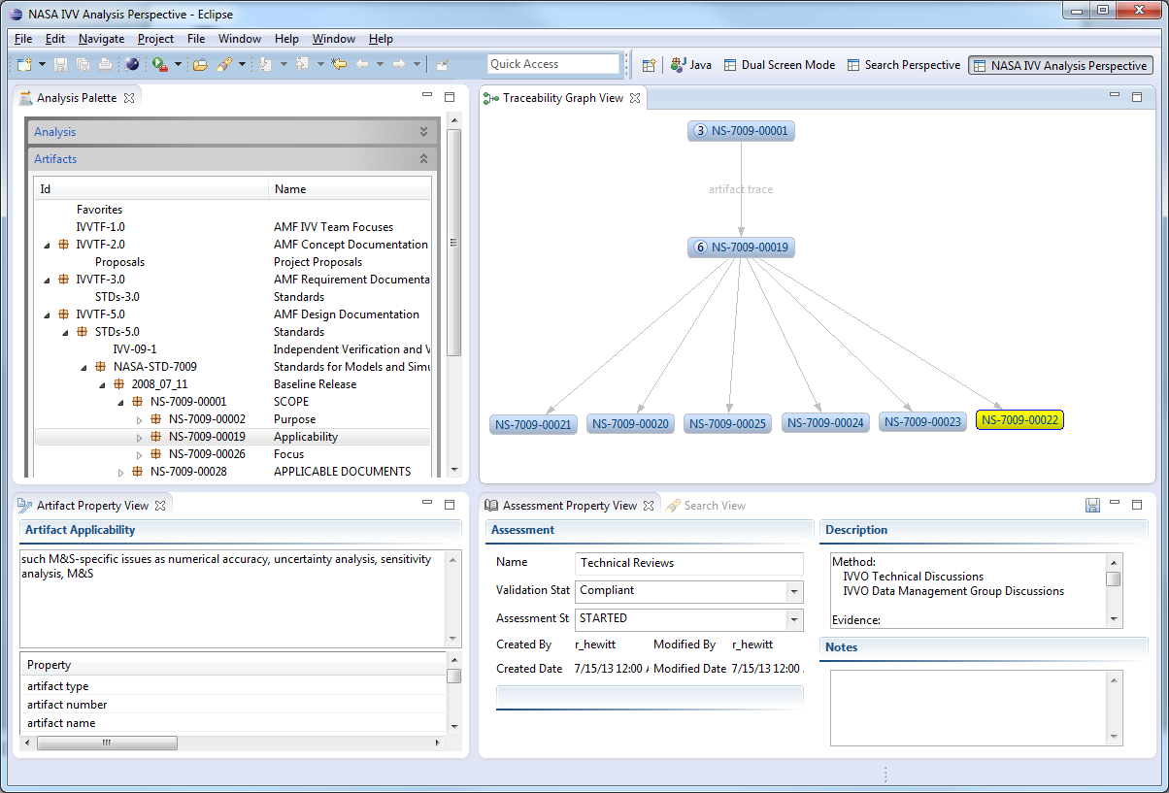
Analyst Workbench (AWB) Overview
Analysis Palette
Traceability Graph View
Artifact Property View
Assessment Property View
Search View

Slide 4
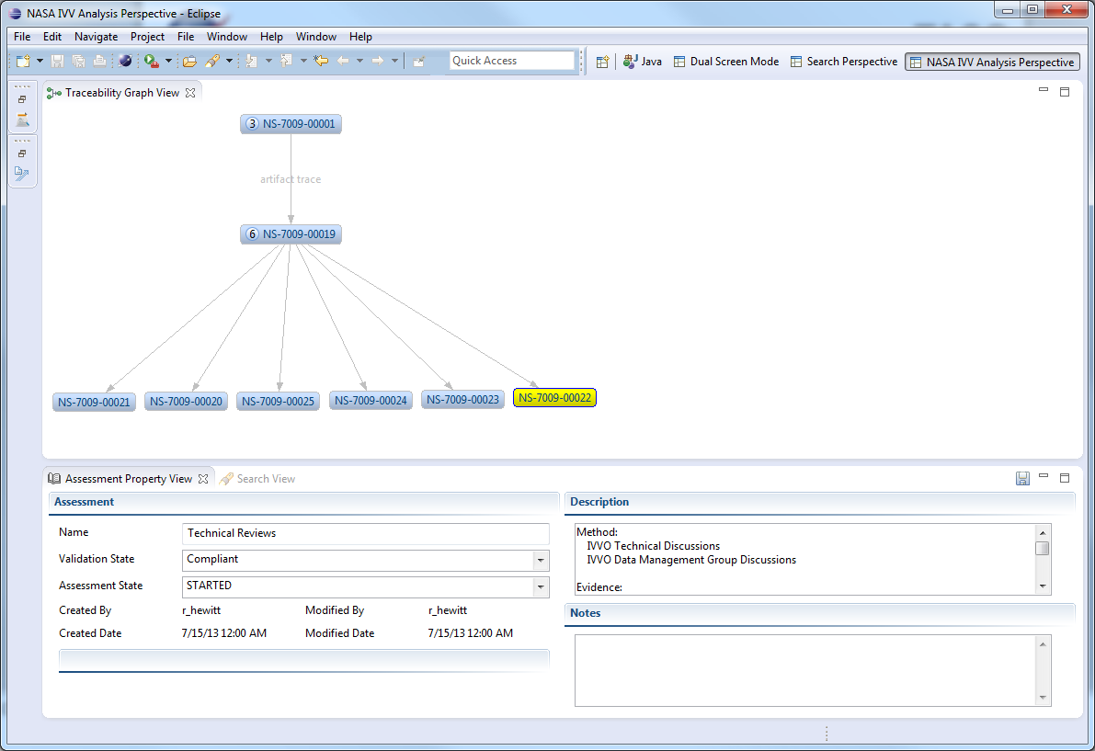
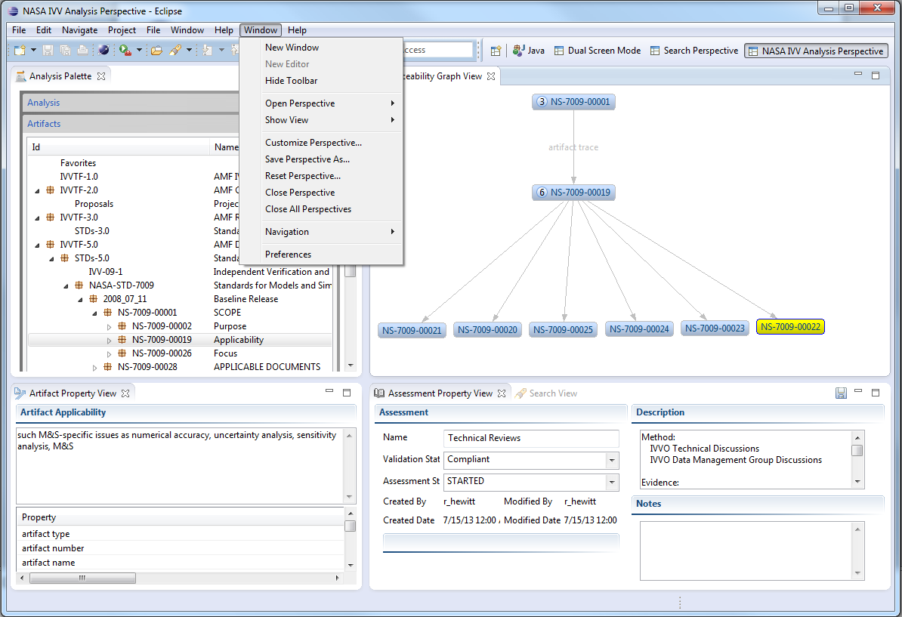
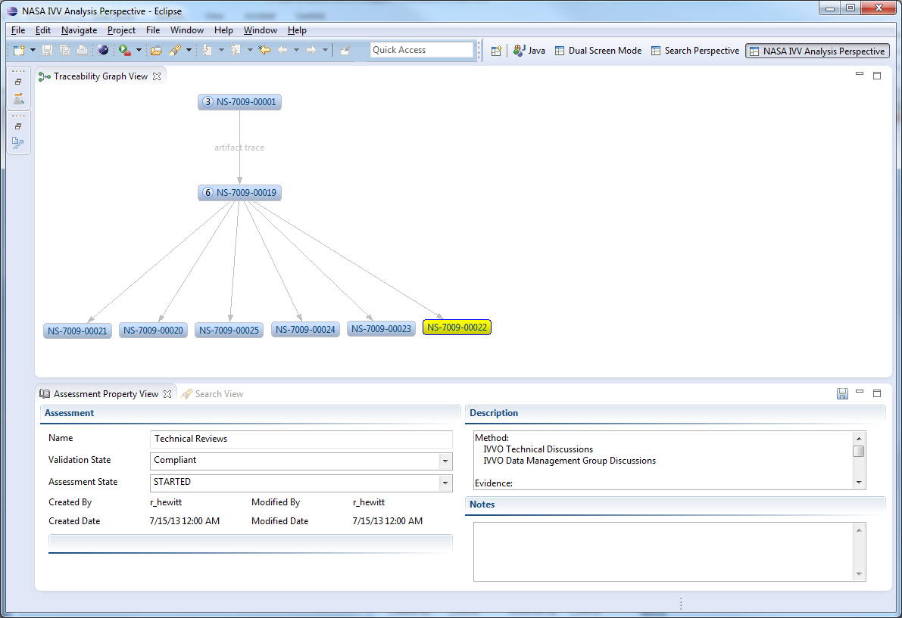
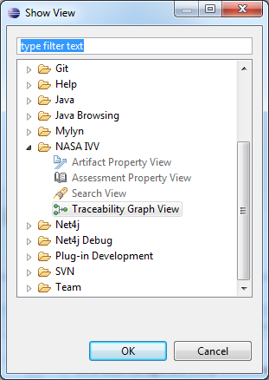
Perspectives, Views and Preferences

Slide 5
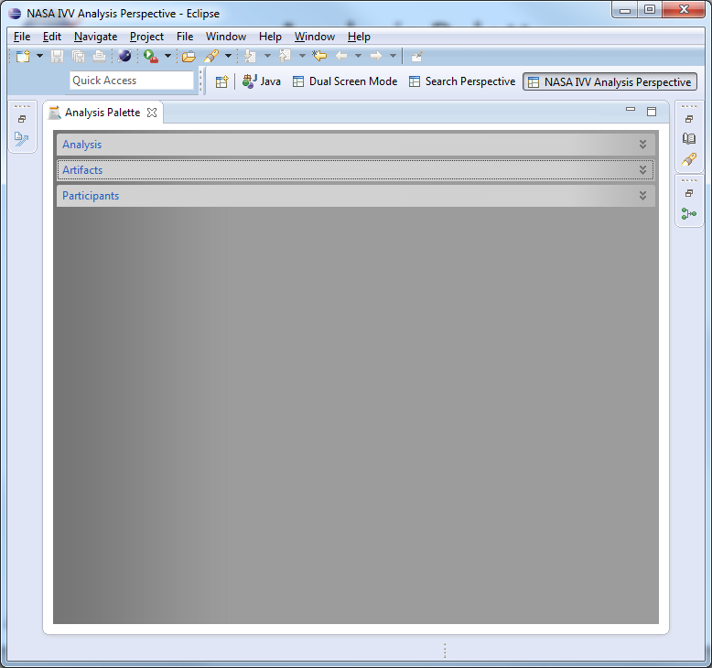
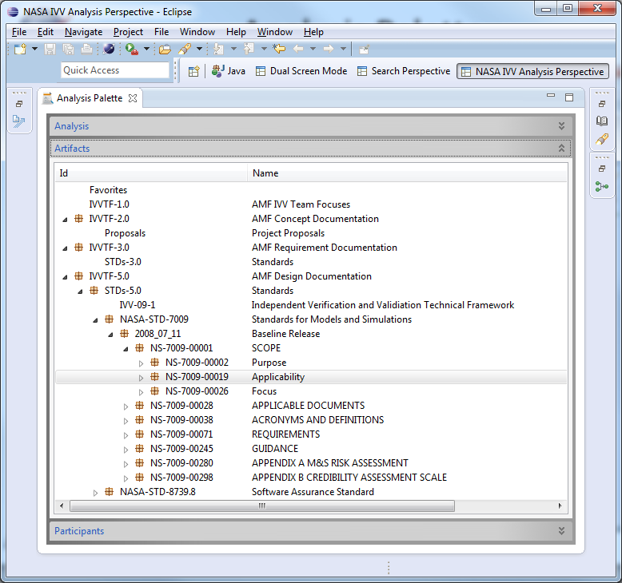
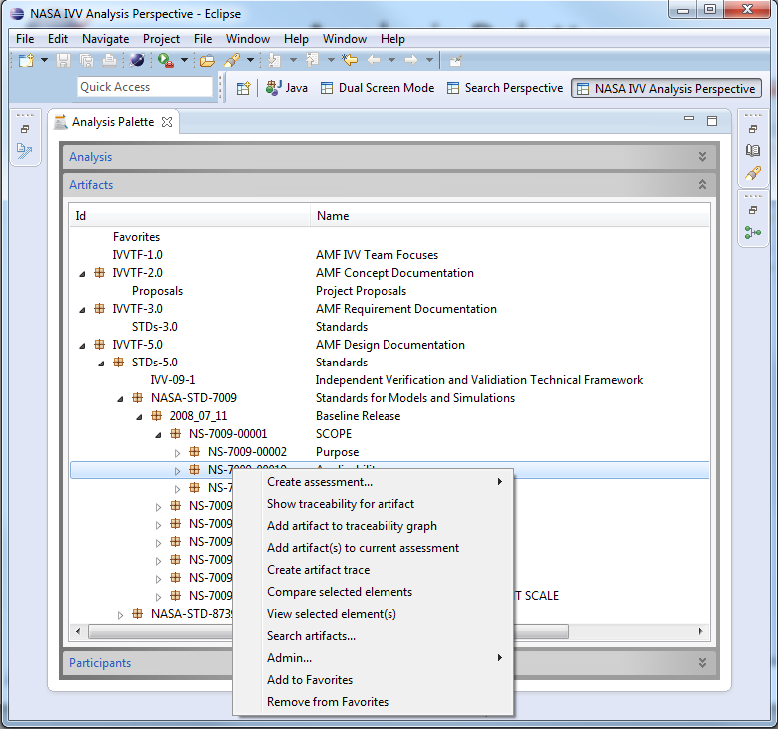
Analysis Palette

Slide 6
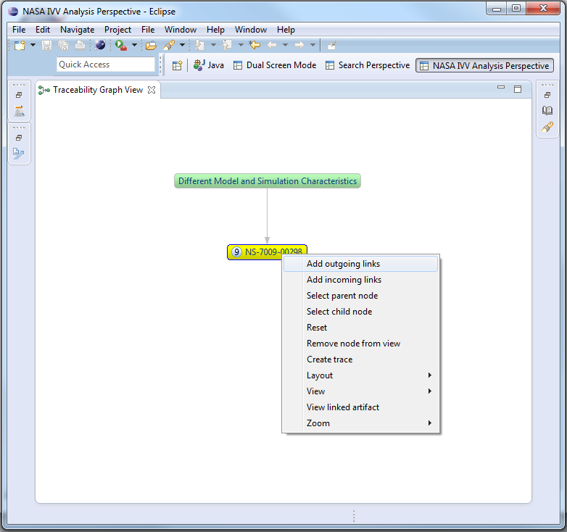
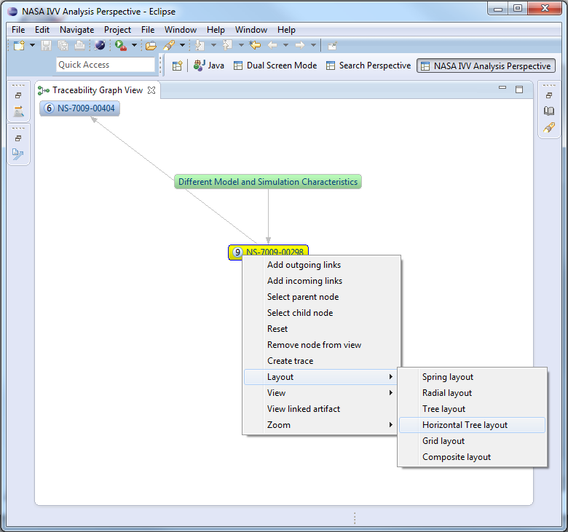
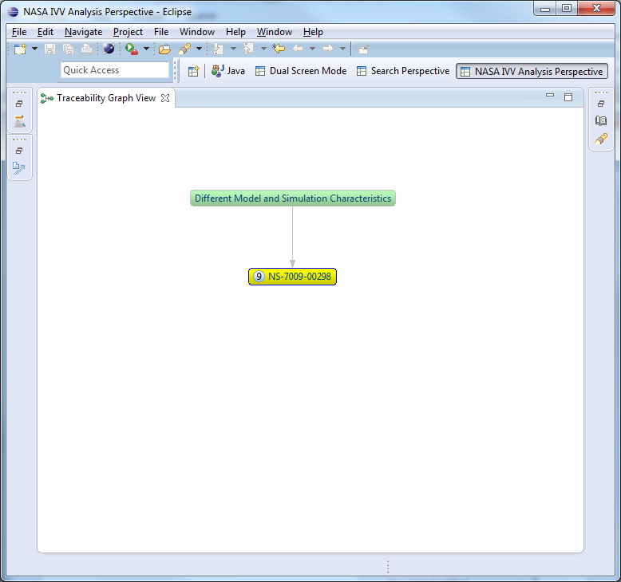
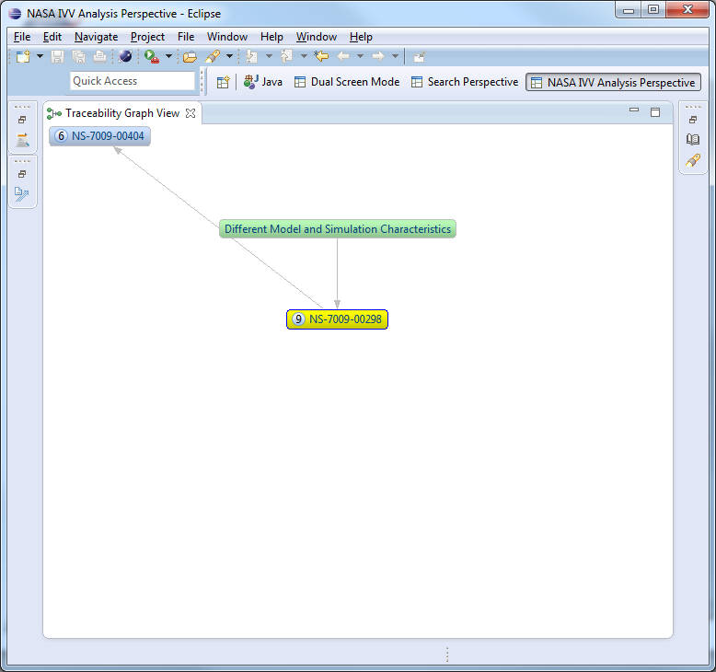
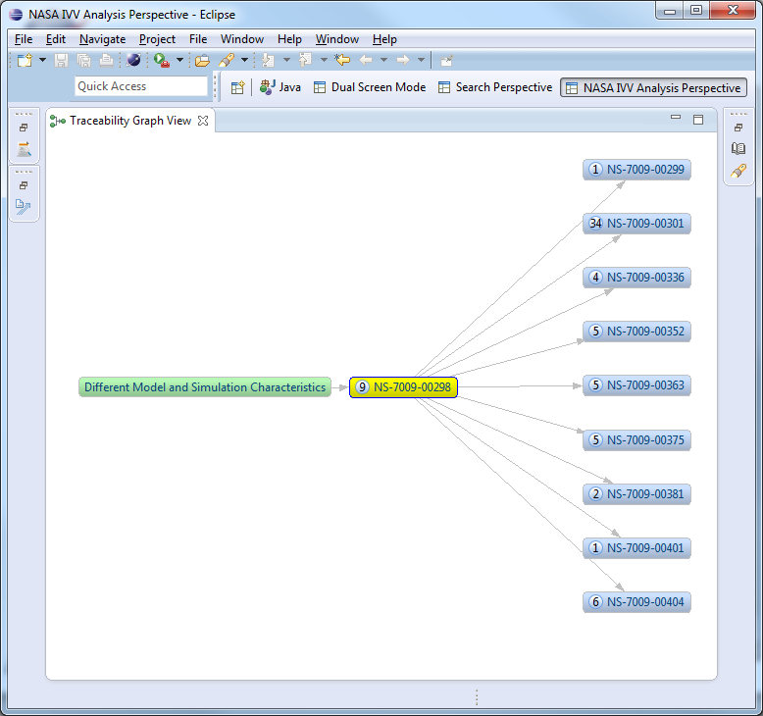
Traceability Graph View

Slide 7
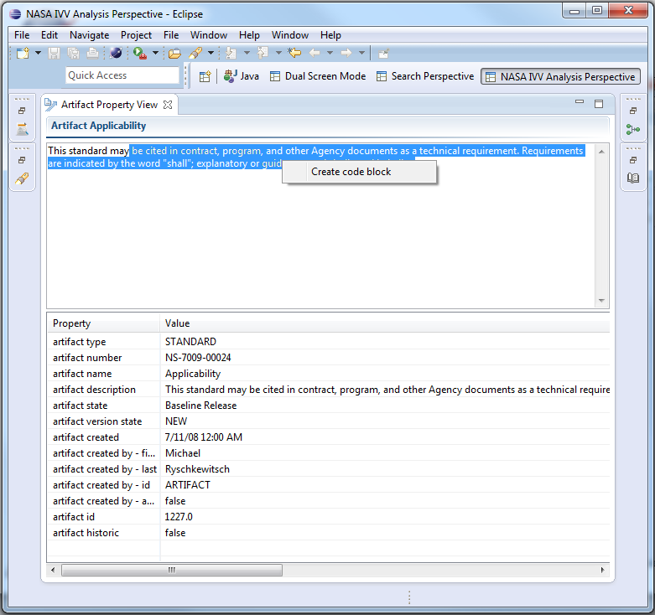
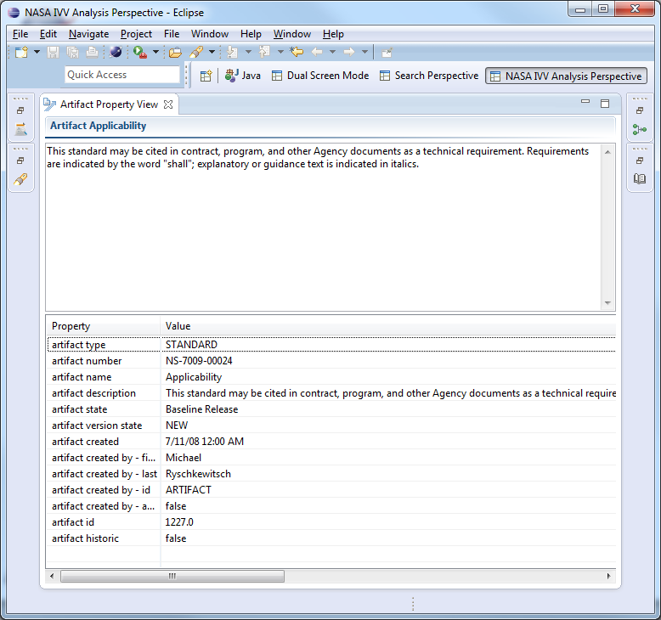
Artifact Property View

Slide 8
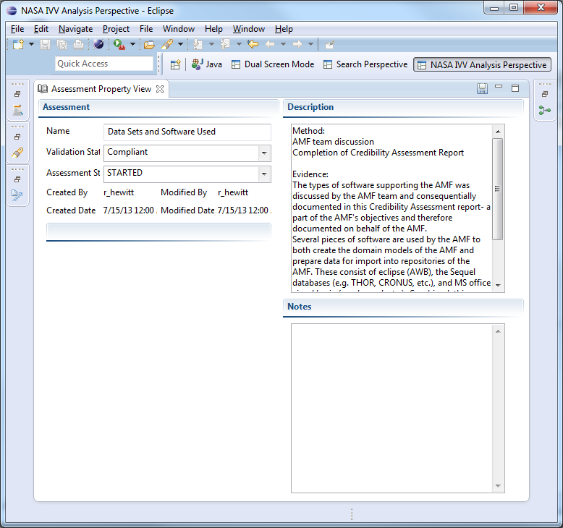
Assessment Property View

Slide 9
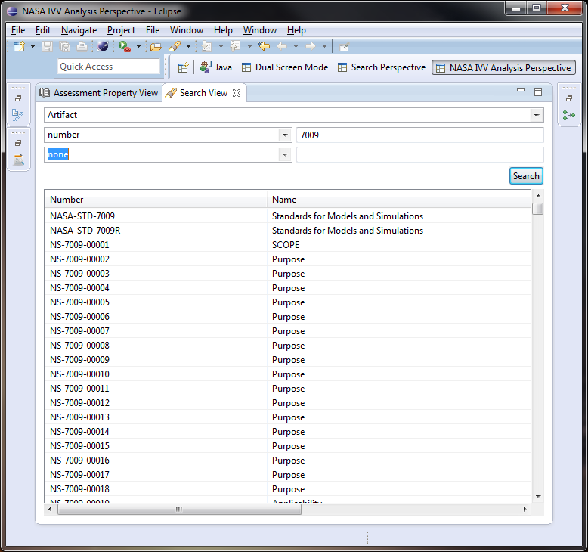
Search View

Slide 10
Evidence-Based Assurance
Other Project Artifacts
IV&V Analysis
References to project artifacts
Target Artifacts
Evidence
Technical Reference
IV&V
Sources
Supplemental Representations
Outside Sources
Criteria
Assessment Artifact Traces
Assessment Assessment Traces

Slide 11
Here’s My Claim
A Claim is a type of Assessment in AWB
Make an initial Claim by creating an assessment.
The claim can be found in the Analysis Palette
Claim details are shown in the Assessment Property View

Slide 12
Here’s My Argument & Evidence
Additional Assessment records can be made to record Arguments
Evidence can be linked to the Claim’s arguments. Evidence may be other Assessments, or Project Artifacts.

Slide 13
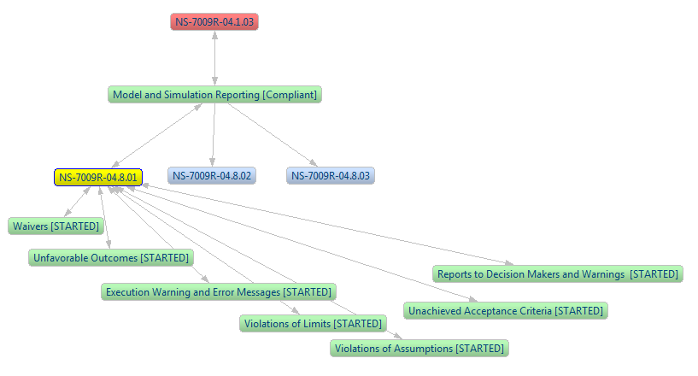
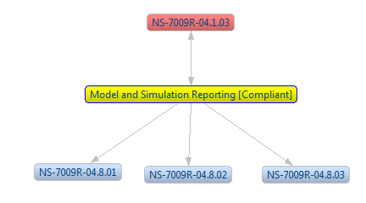
Discovery – via view traces
A completed Claim can be followed, using traces, from the top Claim Assessment.
In addition, the Claim can be seen as attached when looking at other Artifacts or Assessments.

Slide 14
Conclusion
The AWB’s robust tracing and graphing capabilities make it the ideal tool to seamlessly integrate Evidence-Based Assurance into the IV&V Program in a dynamic, useful, and easy to implement fashion.
The AWB’s advantage over other methods is its ability to create Assurance Cases and record evidence dynamically throughout the life of the project, without requiring extensive additional effort from analysts to create separate diagrams or documents to organize and illustrate their evidence.

Slide 15
AMF / AWB Core to IV&V Effort
assess AWB as a tool for team’s analysis efforts.
The AWB core tool at NASA IV&V going forward.
Requirements, Code, Design, Con Ops, Test Plans, Managing

