Slide 1
A New Method to Validate Planets and the Discovery of Kepler-10c
Francois Fressin
Harvard-Smithsonian Center for Astrophysics
ffressin@cfa.harvard.edu

Slide 2
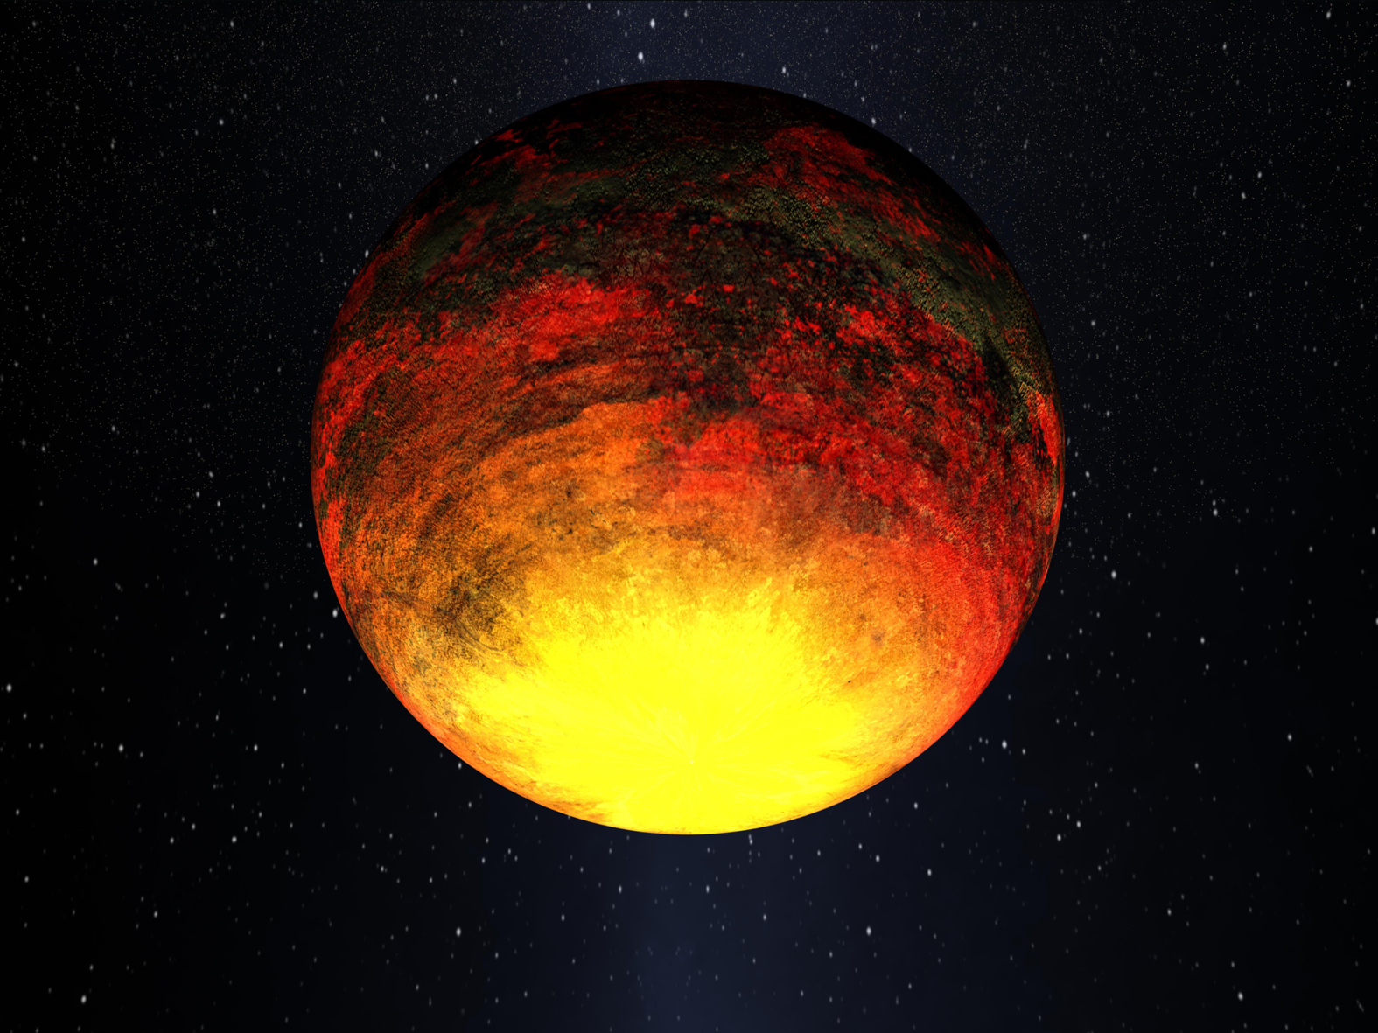
Kepler’s First Rocky Planet: Kepler-10b

Slide 3
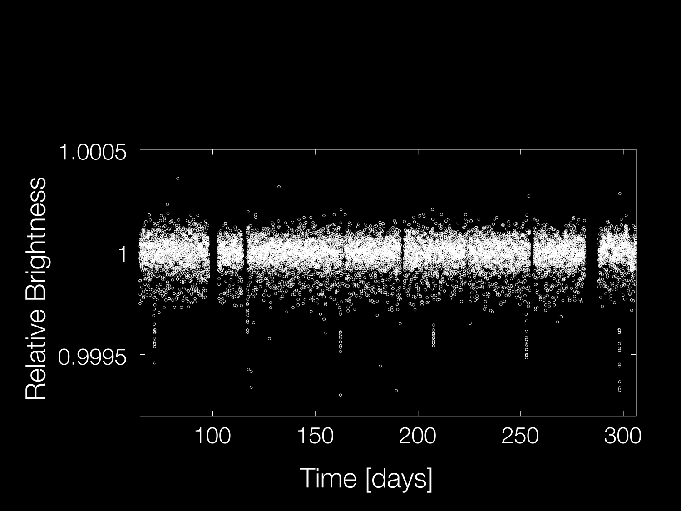
Another signal in the data
There was a longer period signal, that could not be confirmed as a planet by the Doppler method.
New technique to validate the discovery

Slide 4
Kepler-10c
Period = 45.29 days
There was a longer period signal, that could not be confirmed as a planet by the Doppler method.
New technique to validate the discovery

Slide 5
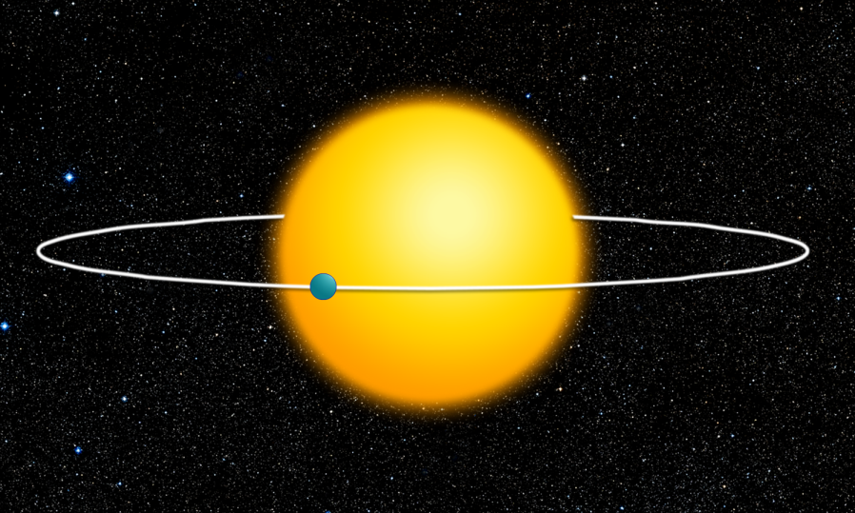
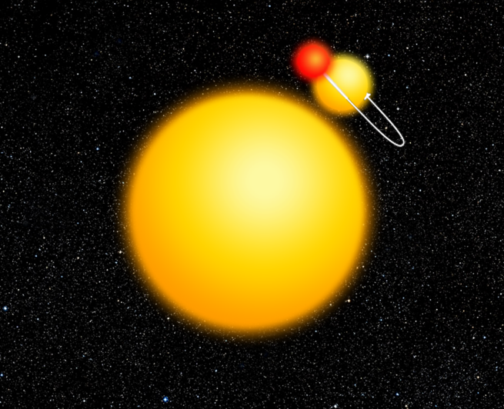
Planet or Blend?
An observed periodic transit signal could be due to:
Transiting Planet
Eclipsing Binary Stars
Blender is a light-curve fitting software
It attempts to explain Kepler candidates assuming they are the result of two background eclipsing stars.

Slide 6

Pleiades
NASA’s fastest supercomputer

Slide 7
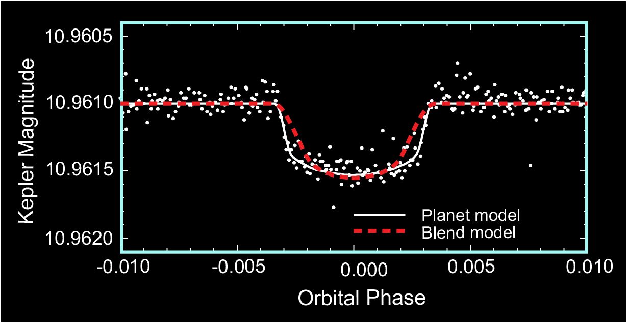
Validating Transiting Planets
A large range of Eclipsing Binary Stars could mimic the transit.
Blender results show that only a very small fraction can actually reproduce the exact transit shape

Slide 8
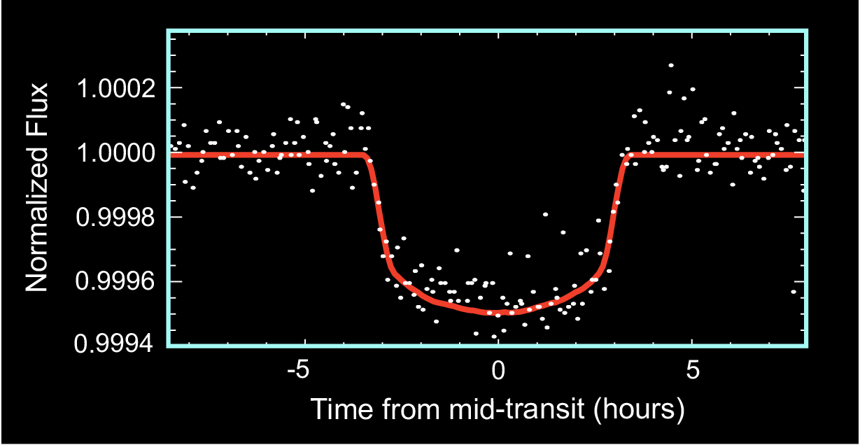
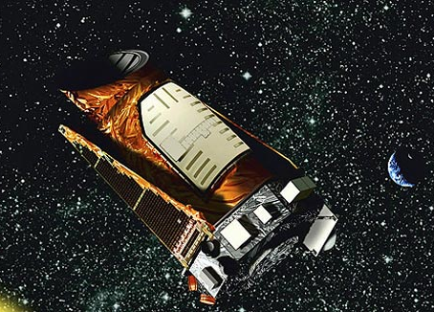

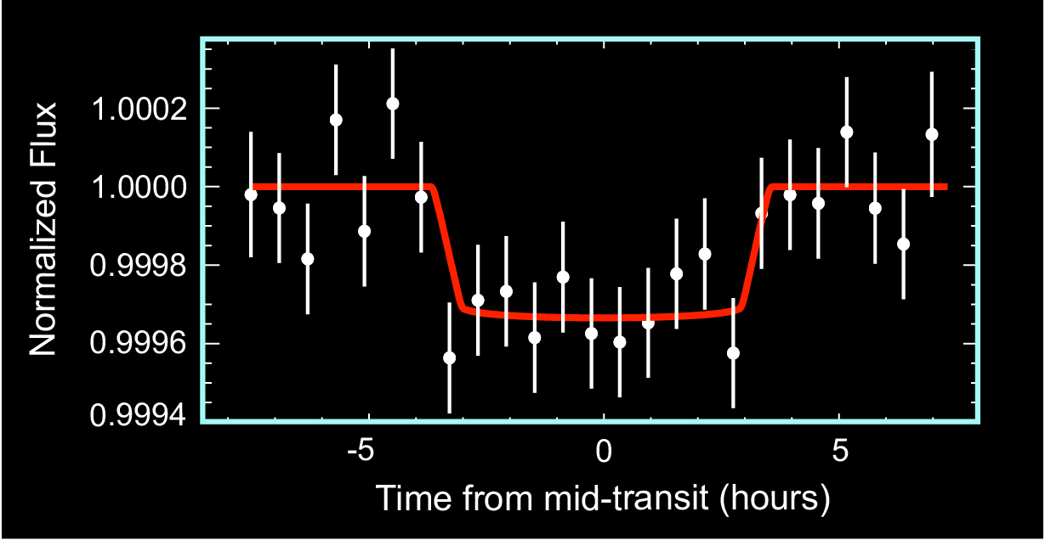
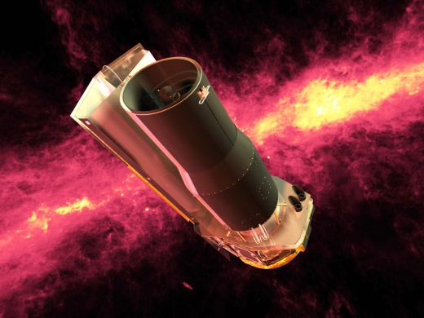

Warm Spitzer Observations
If the system is a planet, transit depth is independent of the color of light observed
In visible light
In Infrared

Slide 9
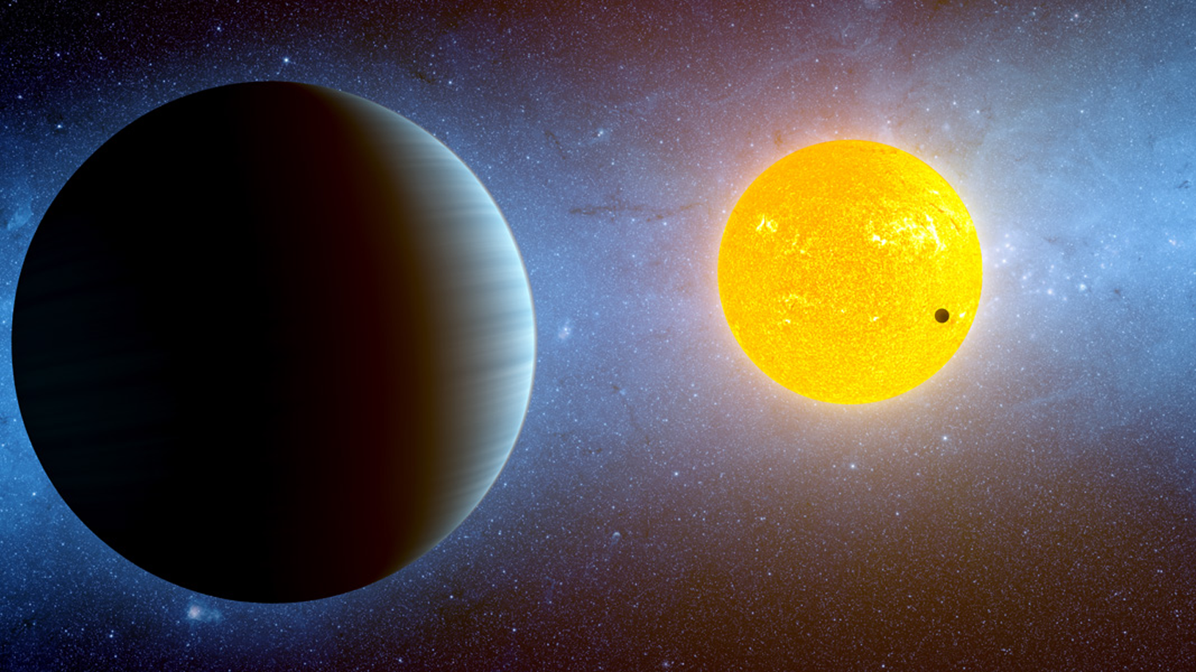
Validation of Kepler-10c
There is only 1 in 60,000 chance it’s not a planet
Period = 45.3 days
2.23 Earth Radii
< 20 Earth Masses
This technique will be used to validate planets that cannot otherwise be confirmed, like rocky planets in the habitable zone.

