Slide 1
Kepler’s Astounding Haul of Multiple-Planet Systems
David Latham
Harvard-Smithsonian Center for Astrophysics
latham@cfa.harvard.edu

Slide 2
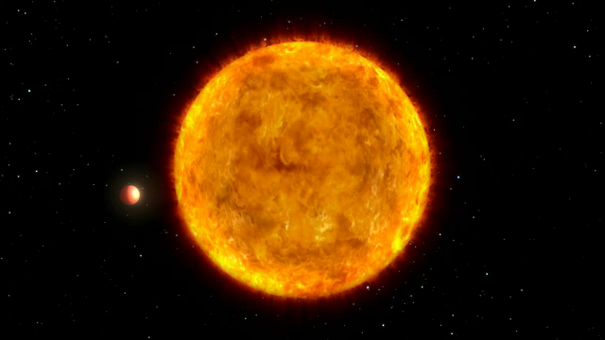
Kepler has found 1,235 planetary candidates:
  827 singles
  408 multiples in 170 planetary systems

Slide 3
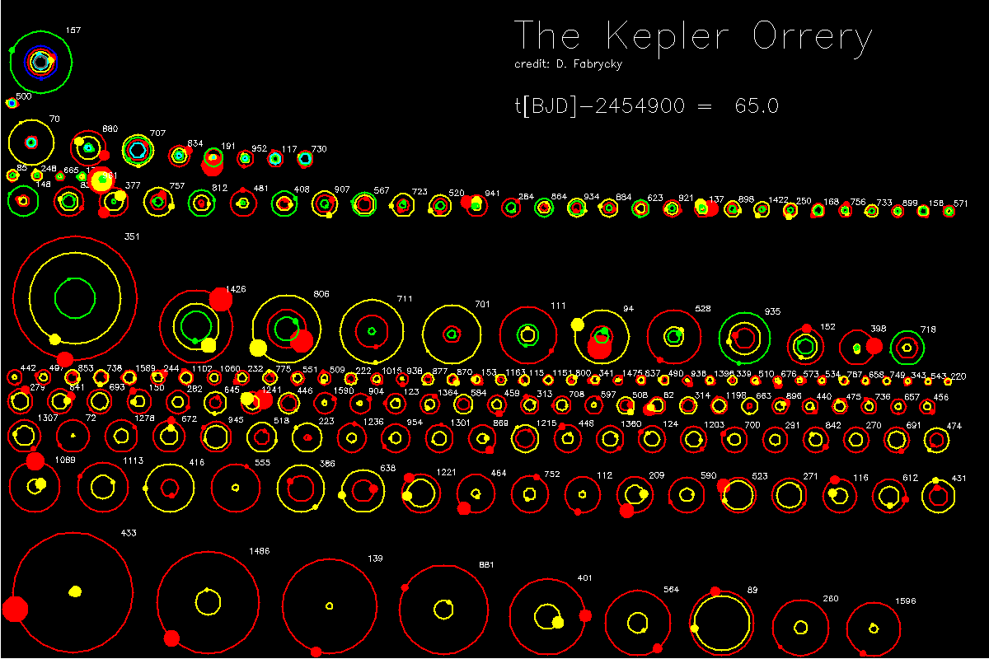

Slide 4
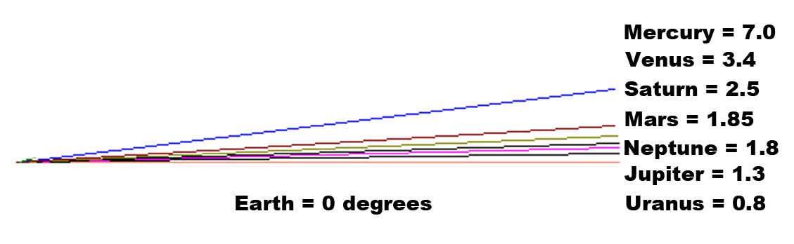
Flatter than our solar system
deg
Degrees
Can only see multiple transiting planets if all are edge-on
Kepler systems are coplanar to ~1 degree

Slide 5
827 Single Planet Systems Detected
Candidates from the first 120 days of Kepler data
Planets smaller than Neptune are more common

Slide 6
408 candidates in 170 multiple systems
Hot Jupiters are rare in flat systems
Large planets stir things up, disrupt the flatness.
Systems of small planets have more sedate histories

Slide 7
408 candidates in 170 multiple systems
Many systems show gravitational interactions (transit time variations), which can be used to constrain planet masses and bulk densities.
A way to distinguish rocky planets from water worlds

