Slide 1
Finite States: Base Elements in a Computing Orchestra
Ronald Finkbine, Ph.D. Department of Computer Science Indiana University Southeast rfinkbin@ius.edu

Slide 2
Introduction
Software Complexity
Programmer Understandability
Maintainability
Reduce by tools
Reduce by techniques

Slide 3
Definitions
Finite State Machine, any program
DFA, 4 tuple
States
Transitions
Start state
Accept states
Moore Machine
Mealy Machine

Slide 4
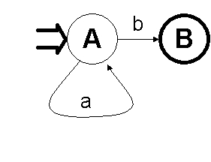
Elementary DFA
Accepts L={a*b+}
Incomplete

Slide 5
Benefits of DFAs
High-reliability
Proof or show?
Mathematics is a modeling method
Proofs are social constructs
Diagrammetics

Slide 6
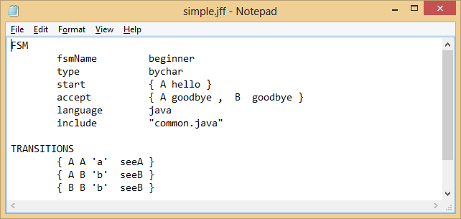
Simple FSM Specification

Slide 7
Pictures are good
Graphviz.org
dot -v -Tjpeg -o beginner.jpg beginner.dot

Slide 8
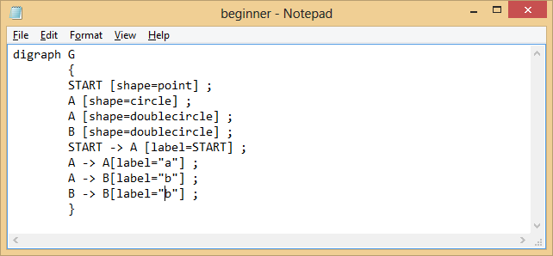
Text file output

Slide 9
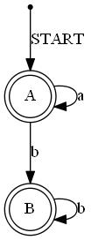
Show or proof?

Slide 10
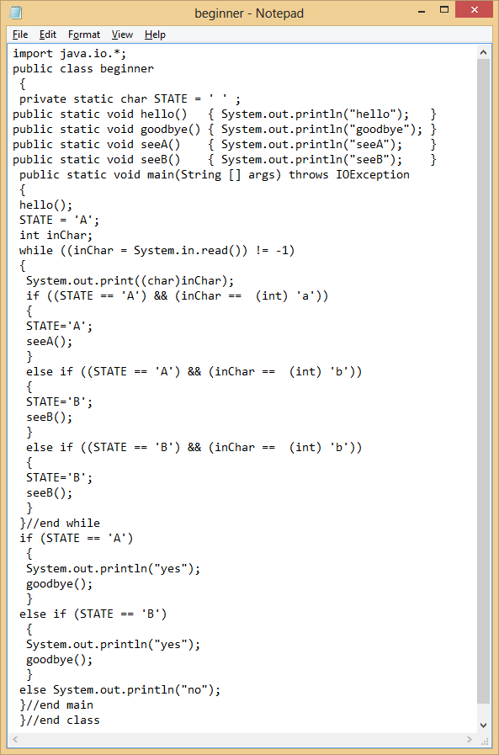
Java code produced

Slide 11
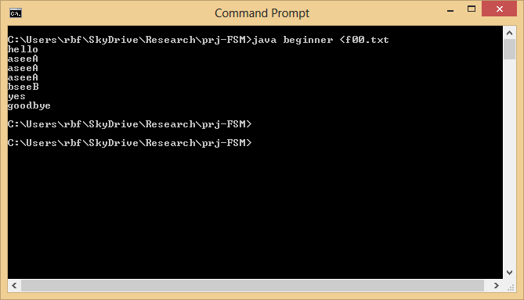

Slide 12
Fox Chicken Grain Problem
A man is crossing a river on the way to market with a chicken, a bag of grain and a fox. If left unattended the fox will eat the chicken, and the chicken will eat the grain. The boat will only hold the man and one of these at a time. Your task is to work out a sequence of crossings that will affect a safe transfer of the man, the fox, the chicken and the grain safely across the river.

Slide 13
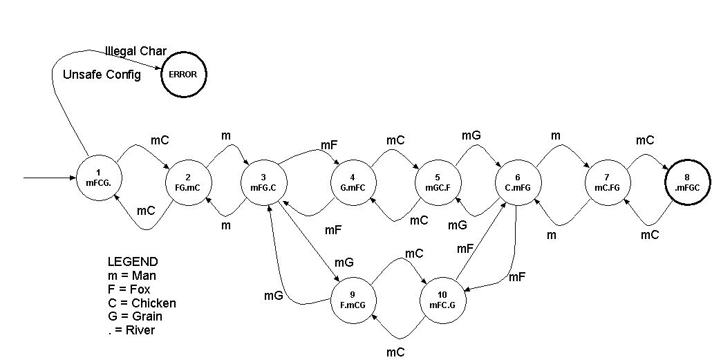
DFA

Slide 14
Text: CeFCGeC
Translating into English, the input string represents:
Man and chicken cross river
Man returns with empty boat
Man and fox cross river
Man returns with chicken
Man and grain cross river
Man returns with empty boat
Main and chicken cross river

Slide 15
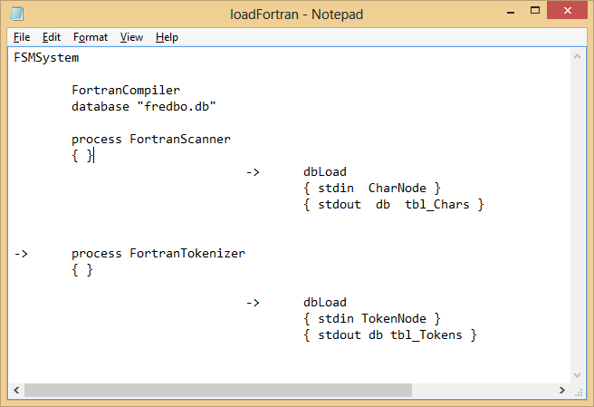
Connecting FSMs into a flow

Slide 16
Benefits
FSMs are complete programs
Lead to parallelism
Not restricted to single language
Not sharing spaces, better security
Limits programming options, reduces programming complexity, GOOD
Data in single layer, in surface pipe

Slide 17
Sample
cls
initdb.py
p0.py <input\fred.f >f1.txt
type f1.txt | indb.py NodeToken >f2.txt
type f2.txt | s3 ars.db
call s3 ars.db "select * from NodeTokens"
call s3 ars.db "select count(*) from NodeTokens"
type f1.txt | only.py NodeToken >f3.txt
outdb.py -n ars.db NodeTokens | parse.py
numdb.py ars.db NodeTokens

Slide 18
FSMs can be everywhere
Software Complexity
Programmer Understandability
Maintainability
Reduce by tools
Reduce by techniques

