Slide 1
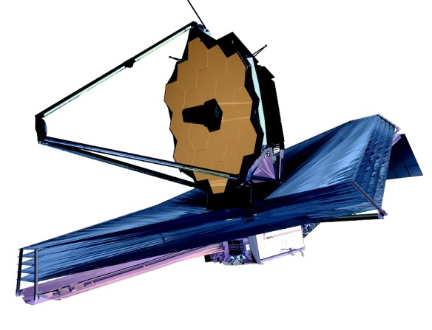
James Webb Space Telescope (JWST) Integrated Science Instrument Module (ISIM) Independent Testing
2013 NASA Annual IV&V Workshop
Chris Lescinsky IV&V Analyst, TASC
Rick Hess, IV&V Analyst, TASC

Slide 2
Agenda
JWST Overview (ORBIT and ISIM)
JWST Key Elements
ISIM Layout
JIST Test Bed
JIST Test Bed Validation
JIST Test Products
Test Case Identification (Overview, Process, and Results)
Stress Testing
Test Like You Fly (TLYF)
Technical Issue Memorandum (TIM) Mining
Source Code Metrics
Summary
Future Work
Questions?

Slide 3
JWST Overview
JWST is a large, infrared-optimized space telescope
Currently scheduled for launch in 2018
Developed to find the first galaxies that formed in the early Universe
The JWST architecture is organized into three segments
Launch
Observatory
Ground
The Observatory segment is composed of three elements
Integrated Science Instrument Module (ISIM), including Science Instruments (SI)
Optical Telescope Element (OTE)
Spacecraft Element (SCE)

Slide 4
JWST Overview
Integrated Science Instrument Module (ISIM)
Houses nine instrument support systems
Near Infrared Camera (NIRCam)
Near Infrared Spectrograph (NIRSpec)
Mid-Infrared Instrument (MIRI)
Fine Guidance Sensor/Near Infrared Imager and Slitless Spectrograph (FGS-NIRISS)
JWST URL: http://www.jwst.nasa.gov/

Slide 5
JWST Overview - Orbit

Slide 6
JWST Overview - ISIM
ISIM Flight Software (FSW)
Responsible for executing scripts that define Observatory science activities
Routes all commands and telemetry to and from SI-specific FSW, which also executes on the ISIM processor
Communicates with the Spacecraft Command and Telemetry Processor (CTP) via a 1553 Bus
Processes image data and transfers it to the Spacecraft’s Solid State Recorder (SSR) via a Spacewire Bus
Responsible for monitoring the health of SI FSW and Hardware (HW)

Slide 7
JWST Key Elements

Slide 8
ISIM Layout

Slide 9
JIST Test Bed
JWST IV&V Simulation and Test (JIST) is developed by the NASA Independent Test Capability (ITC) team
Successor of the Science Instrument Development Unit (SIDU) which was used to support test analysis of ISIM software by executing modified developer test scripts
SIDU testing focused on off-nominal test cases
Allows IV&V analysts to perform dynamic analysis on the JWST Flight ISIM FSW
Includes functionality of the Command and Telemetry Processor (CTP) computer’s Command and Data Handling (C&DH) functionality, integration of ISIM functionality, and the Northrop Grumman dynamics simulator, Software Development Verification(SDV)

Slide 10
JIST Test Bed

Slide 11
JIST Test Bed Validation
The JIST Test Bed will be validated by executing
Modified developer test scripts that were originally run on the SIDU Test Bed
A selection of developer test scripts from ISIM Builds IC1 through IC14
The JIST test bed validation results should agree with those of the SIDU and the developer
Any differences must be understood and explained
Without a validated test bed results cannot be trusted

Slide 12
JIST Test Products
Independent testing of the JWST ISIM FSW will result in the generation of the following types of IV&V developed test products
Test Plan - Maintained in Confluence and describes the scope, approach, resources, test items, testing tasks, processes, and schedule of intended testing activities
Test Cases - Maintained in JIRA and provides rationales, objectives, initial conditions, inputs, outputs, and methods
Test Procedures - Detail a series of steps to be taken by the test analyst or executed by a test script, and are maintained in SVN (Subversion)
Test Scripts - Scripts to be executed in the JIST environment and are maintained in SVN

Slide 13
Test Case Identification
ISIM JIST Test Plan has been developed
The Test Plan describes three processes and one supplemental process used to identify test cases for IV&V independent testing in the JIST environment
Stress Testing
Test Like You Fly (TLYF)
TIM Mining (additional rigor for areas of concern)
Source Code Metrics (supplemental)

Slide 14
Stress Testing Overview
Identify test cases to stress the ISIM FSW based on ISIM Level 5 performance requirements
Utilize flight software source code in conjunction with the ISIM Level 5 performance requirements when developing test cases
Identify errors in software that can remain hidden from standard or traditional unit and acceptance testing
When the system is subjected to out-of-the-ordinary conditions, errors can arise or system performance degrades below operational levels
Software should handle the degraded operation gracefully and fully recover when the unrealistic load is removed
Identify the root cause in these undesired software system behaviors

Slide 15
Stress Testing Process
Obtain the most recent ISIM Level 5 RequisitePro Requirements Export in spreadsheet format
Filter the Level 5 requirements to contain only requirements with testable quantitative performance values
Manually evaluate each Level 5 performance requirement in the spreadsheet based on the RequisitePro attributes, the benefit derived from additional independent testing rigor, feasibility to test, and the capability to test the requirement correctly, completely and accurately using the JIST environment
Select the final Level 5 requirements for stress testing

Slide 16
Stress Testing Process

Slide 17
Stress Testing Process
Identify test cases for stress testing based on requirements (grouping requirements where appropriate) that remain following manual review
Develop test cases for stress testing utilizing the ISIM Flight Software source code

Slide 18
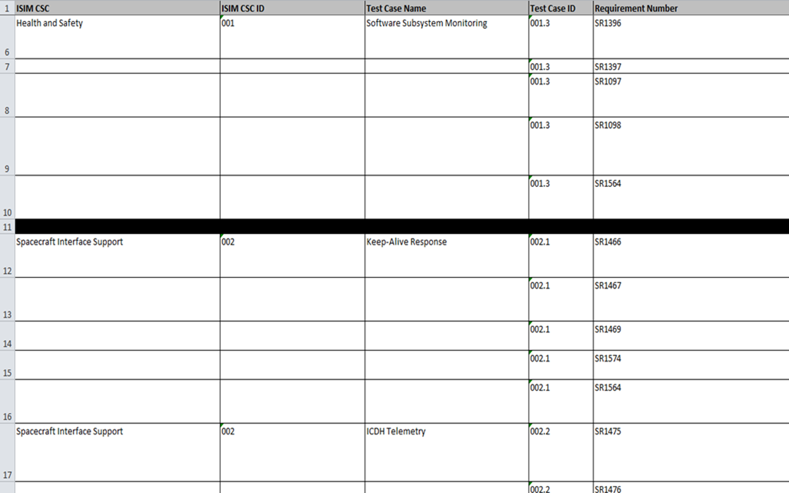
Stress Testing Results

Slide 19
Stress Testing Results
Identified 19 test cases utilizing the 67 testable performance related ISIM Level 5 requirements selected for ISIM FSW stress testing

Slide 20
Test Like You Fly (TLYF) Overview
Identify test cases to exercise the ISIM FSW based on the Test Like You Fly (TLYF) approach
IV&V TLYF process involves final software, but not flight hardware
“Mission centric” versus functional testing which is “requirements centric”
Can uncover flaws such as timing issues, memory leaks, and data errors
Not directed at requirements verification
Demonstrates that all components of the ISIM system work together which is different than demonstrating that every component item works individually
Process should perform numerous complex non-deterministic asynchronous mission tasks, Day-in-the-Life Tests, and Long Duration Tests
Test cases are derived from the JWST Mission Operations Concept Document (CONOPS) and the JWST Observatory FSW End-To-End Verification and Validation Test Plan

Slide 21
TLYF Process
Create a spreadsheet which contains normal and contingency operational scenarios involving ISIM from the JWST Mission Operations Concept Document (CONOPS) and the JWST Observatory FSW End-To-End Verification and Validation Test Plan
Identify key functionality and requirements of ISIM in selected test scenarios
Functionality includes Process Commands, Manage ISIM Telemetry, Manage ISIM Time, Manage Files, Onboard Fault Management Perform Science Operations, and Process ISIM Stored Command Sequence
Identify key CONOPS requirements of ISIM in selected test scenarios
Assess candidate scenarios for feasibility and testability using the JIST environment, identifying the types of flaws that can be found
Identify test cases for TLYF testing from test scenarios
Develop test cases for TLYF testing

Slide 22
TLYF Process

Slide 23
TLYF Results

Slide 24
TLYF Results
Identified 17 test cases from the JWST Concept of Operation Document, JWST-OPS-002018, Rev D 01-31-2011 and the JWST-PLAN-002004 OBS FSW End-To-End Verification and Validation Test Plan, Draft Rev B Jan 2013

Slide 25
TIM Mining Overview
Mine the ORBIT ISIM TIMs in order to identify areas in the software which could potentially contain additional errors, to provide validation for TIMs, and to provide evidence of and impact of existing errors specified by TIMs
Utilizes ORBIT TIMs that have been generated from the various phases of the IV&V life cycle: Requirements, Design, Testing, and Code
Requires TIMs to be analyzed manually to determine if they are candidates for test case development based on criteria (state, severity Resolution Chronology, and Impact in addition to the benefit of additional rigor via testing, and testing feasibility)
Allows for identification of areas in the software which could potentially contain additional errors since the TIMs can show areas which are error prone
Allows for validation of open TIMs where source code build artifacts are available, test artifact are available are not
Allows IV&V to provide evidence of the severity and impact of existing errors specified by TIMs
Example of TIM Mining process using Code TIMs

Slide 26
TIM Mining Process
ISIM Code TIMs
Create an Orbit query where Domain is ISIM, Defect Category is Code, and the State is one of Submitted, To Be Verified, Closed, Project Accepts Risk
Export the results of the query to an Excel spreadsheet
If the State of the TIM is PAR, the associated source code file is identified and the TIM is marked as a potential candidate for testing
If the State of the TIM is Submitted, To Be Verified, or Closed review the TIM to determine if a source code modification is/was required
The associated source code file is identified and the TIM is marked as a potential candidate for testing
Once all candidates have been identified, evaluate each candidate TIM based on state, severity, Resolution Chronology, and Impact in addition to the benefit of additional rigor via testing, testing feasibility, and the capability to test the requirement using the JIST environment
Select the final TIMs for testing

Slide 27
TIM Mining Process

Slide 28
TIM Mining Process
Identify test cases based on selected TIMs (grouping TIMs where appropriate)
Develop identified TIM based test cases

Slide 29
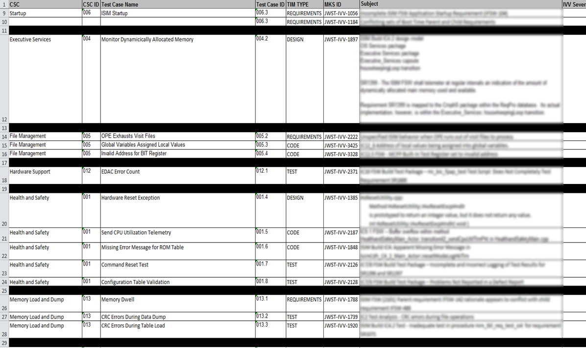
TIM Mining Results

Slide 30
TIM Mining Results
Identified 29 test cases utilizing the list of ORBIT ISIM Requirements, Code, Design, and Test TIMs that were in the Submitted, To Be Verified, Closed, and Project Accepts Risk states
The results of the filtering of the ISIM TIMs to spreadsheets were: 154 Requirements TIMs, 124 Code TIMs, 44 Design TIMs, and 49 Test TIMs

Slide 31
Source Code Metrics Overview
Utilize source code complexity metrics to identify areas in the software which are substantially complex (based on selected metrics and distribution of metrics values)
This process utilizes the Understand for C++ tool to generate metrics for the ISIM FSW
Specific metrics are selected and analyzed to identify areas of the ISIM FSW which are deemed to be substantially complex to merit additional testing by IV&V
This process will be used as a supplement to the three previous test case identification methods in this section
If an area of the ISIM source code is determined to be substantially complex and a test case is identified for the same area, then additional testing rigor can be applied to the software area by creating additional test cases

Slide 32
Source Code Metrics Process
Generate metrics using Understand for C++ on ISIM Build
Select Metrics to analyze from spreadsheet export from Understand
Cyclomatic Complexity - the number of independent, paths through a module
Sum Cyclomatic Complexity - Sum of cyclomatic complexity of all nested functions or methods
Count of Coupled Classes - The Coupling Between Object Classes (CBO) measure for a class is a count of the number of other classes to which it is coupled
Class A is coupled to class B if class A uses a type, data, or member from class B
Maximum Nesting Level of Control Constructs - Maximum nesting level of control constructs (if, while, for, switch, etc.) in the function
Maximum Cyclomatic Complexity - Maximum cyclomatic complexity of all nested functions or methods
Path Count - Number of unique paths through a body of code
Knots - Measure of overlapping jumps where the number of knots is proportional to the complexity of the control flow

Slide 33
Source Code Metrics Process
Sort Files, Classes, Structures, and Functions by selected metrics
Analyze metrics distribution of Files, Classes, Structures/Unions, and Functions
Select a cutoff point based on analysis of metrics distribution in each list based on metrics values
Create a list of target areas (Files Classes, Structures/Unions, and Functions) based on selections from each list
Assign thresholds and rules for generating a final list of target areas
Classes
Threshold for Count of Coupled Classes = 40
Maximum Cyclomatic Complexity = 80
Functions/Methods
Threshold for Path Count = 10000
Threshold for Cyclomatic Complexity = 80
Threshold for Maximum Nesting Level of Control Constructs = 6

Slide 34
Source Code Metrics Process

Slide 35
Source Code Metrics Process
If the target area is a Class and either the Count of Coupled Classes is >= to it’s Threshold OR the Maximum Cyclomatic Complexity is >= it’s Threshold
Add the Class to the list of Final Target Areas
If the target area is a Function/Method and two out of the following three metrics are >= to their Thresholds: Path Count, Cyclomatic Complexity, and Maximum Nesting Level of Control Constructs
Add the Function/Method to the list of Final Target Areas
Use metrics results as a supplement to drive development of test cases to provide additional testing rigor to the test cases identified in this section by other methods

Slide 36
Source Code Metrics Results

Slide 37
Source Code Metrics Results
Identified 22 target areas in the ISIM FSW using Understand for C++ metrics which are substantially complex and potentially error prone
IV&V will utilize metrics results as a supplement to drive development of test cases to provide additional testing rigor to the test cases identified by other methods

Slide 38
Summary
The IV&V team was able to associate Computer Software Components (CSCs) with the identified test cases from Stress Testing and TIM Mining test cases
Although TLYF involves numerous CSCs and is not a CSC by itself, each of the three TLYF areas (Event Driven Operations, Real-Time Operations, and Long Duration Normal Operations) were assigned a CSC number for ease of implementation
For each ISIM CSC, IV&V assigned a CSC number to be used in the identification of test cases
A summary of the number of ISIM test cases identified for each CSC is provided in the following table

Slide 39
Summary

Slide 40
Summary

Slide 41
Summary

Slide 42
Future Work
Prioritization of ISIM JIST Test Cases
Development of Test Procedures and Test Scripts
Delivery of JIST Build 2.0 – 4th Quarter, 2013
JIST 2.0 Implements ISIM Functionality
Execution of Test Procedures and Test Scripts to take place during FY2014
JWST Independent Test Team will present results of testing in IVVO Technical Discussion and/or 2014 Annual IV&V Workshop
Development of Spacecraft Test Plan and Identification of Test Cases currently underway
Test Case ID methods includes Risk Reduction

Slide 43
Questions?

Slide 45
Backup Slides

Slide 46
Stress Testing
Identify test cases which will stress the ISIM FSW based on ISIM Level 5 performance requirements
This process uses ISIM Level 5 performance requirements to identify test cases (aka scenarios) that will stress the system under test by exercising the boundaries and limits described by the performance requirements
Performance requirements are any requirements which are described in terms of quantity, quality, coverage, timeliness or readiness
These requirements are not limited to those listed under "Performance Requirements" in the ISIM Level 5 requirements specification
Additionally, stress tests should exercise the ISIM FSW by creating "stressful" conditions by exceeding operating constraints and design margins such as
CPU load is greater than or equal to 90%
CPU load is maximized at 100% if possible
Use maximum I/O data rates
Maximum data bus usage
Utilize all available memory

Slide 47
Stress Testing
Potential consequences of the above “stressful” conditions
Dropped commands
Tasks not running as scheduled
Tasks not prioritized correctly
Unexpected processor reset
Unexpected rejection of commands
Degraded system performance
Undesired side effects in one software area or task
Corrupt data/memory
Overflow buffers/queues
Unexpected telemetry being received/Data being received on an incorrect communication channel

Slide 48
TIM Mining Process
ISIM Requirements TIMs
Create an Orbit query where Domain is ISIM, Defect Category is Requirements, and the State is one of Submitted, To Be Verified, Closed, Project Accepts Risk (PAR)
Export the results of the query to an Excel spreadsheet
If the State of the TIM is PAR, the associated Computer Software Component is identified and the TIM is marked as a potential candidate for testing
If the State of the TIM is Submitted, To Be Verified, or Closed review the TIM to determine if a requirements or source code modification is/was required
The associated Computer Software Component is identified and the TIM is marked as a potential candidate for testing
Once all candidates have been identified, evaluate each candidate TIM based on state, severity, Resolution Chronology, and Impact in addition to the benefit of additional rigor via testing, testing feasibility, and measurability of requirement
Select the final TIMs for testing

Slide 49
TIM Mining Process

Slide 50
TIM Mining Process
ISIM Design TIMs
Create an Orbit query where Domain is ISIM, Defect Category is Design, and the State is one of Submitted, To Be Verified, Closed, Project Accepts Risk
Export the results of the query to an Excel spreadsheet
If the State of the TIM is PAR, the associated source code file is identified and the TIM is marked as a potential candidate for testing
If the State of the TIM is Submitted, To Be Verified, or Closed review the TIM to determine if a requirements or source code modification is/was required
The associated source code file is identified and the TIM is marked as a potential candidate for testing
Once all candidates have been identified, evaluate each candidate TIM based on state, severity Resolution Chronology, and Impact in addition to the benefit of additional rigor via testing, and testing feasibility
Select the final TIMs for testing

Slide 51
TIM Mining Process

Slide 52
TIM Mining Process
ISIM Test TIMs
Create an Orbit query where Domain is ISIM, Defect Category is Test, and the State is one of Submitted, To Be Verified, Closed, Project Accepts Risk
Export the results of the query to an Excel spreadsheet
If the State of the TIM is PAR, the associated source code file (if possible) and Level 5 requirement(s) are identified and the TIM is marked as a potential candidate for testing
If the State of the TIM is Submitted, To Be Verified, or Closed review the TIM to determine if a source code, requirement, or test script modification is/was required
The associated source code file (if possible) and test script(s) are identified and the TIM is marked as a potential candidate for testing
Once all candidates have been identified, evaluate each candidate TIM based on state, severity, Resolution Chronology, and Impact in addition to the benefit of additional rigor via testing, testing feasibility, and ability to test
Select the final TIMs for testing

Slide 53
TIM Mining Process

Slide 54
Test Like You Fly (TLYF)
This process is derived from the ITC Independent Testing method and the aerospace industry’s Test Like You Fly (TLYF) testing approach
The process is not directed at system requirements verification, unless the system requirement(s) is/are specifically concerned with operability under mission conditions
It shows how all parts of the ISIM system work together and complements functional and performance testing

Slide 55
Source Code Metrics
The list of available metrics is as follows
Declarations: total number of declarations
Count of Coupled Classes - The Coupling Between Object Classes (CBO) measure for a class is a count of the number of other classes to which it is coupled
Class A is coupled to class B if class A uses a type, data, or member from class B
This metric is also referred to as Efferent Coupling (Ce)
Any number of couplings to a given class counts as 1 towards the metric total
Lines: total lines (in a function or file or project)
Lines Blank: total lines without any code/comment
Lines Code: total lines that have any code on them
Lines Comment: total lines that have comments on them
Lines Declarative: total lines that have declarative code on them
Lines Executable: total lines that have executable code on them

Slide 56
Source Code Metrics
The list of available metrics is as follows
Cyclomatic: The measure of the complexity of a function's decision structure
The cyclomatic complexity is also the number of basis, or independent, paths through a module
Sometimes also called the "McCabe Complexity" after its originator
Essential Complexity: cyclomatic complexity after structured programming constructs have been removed
Knots - Measure of overlapping jumps
Maximum Cyclomatic Complexity - Maximum cyclomatic complexity of all nested functions or methods
Modified: cyclomatic except each case statement is not counted;the entire switch counts as 1
Nesting: maximum nesting level of control constructs (if, while,etc.)
Path Count: Number of unique paths through a body of code (not counting gotos or abnormal exits

Slide 57
Source Code Metrics
Ratio Comment/Code: comment lines / code lines
Strict: Cyclomatic complexity except each short-circuit operator adds 1 to the complexity
Strict Modified Essential: essential complexity except short-circuit operators add to complexity and structured case branches do not add to complexity
Statements executable: total statements in executable code
Statements declarative: total statements in declarative code
Sum Cyclomatic Complexity - Sum of cyclomatic complexity of all nested functions or methods
Units: Number of program units or functions

