Slide 1
MPCV IV&V with a Dynamic Twist
2013 Annual Workshop on Verification and Validation
September 10-12, 2013
Presenter:
Ricky Beamer
frederick.m.beamer@ivv.nasa.gov
Additional Author:
David Ho
david.ho@tasc.com

Slide 2
Agenda
Introduction
SOCRRATES
Summary
Test Case Identification
Test Procedure Definition
Test Case Example
Challenges
PLATO
Summary
Test Case Identification
Test Procedure Definition
Test Case Example
Challenges
Dynamic Testing Conclusions
Lessons Learned

Slide 3
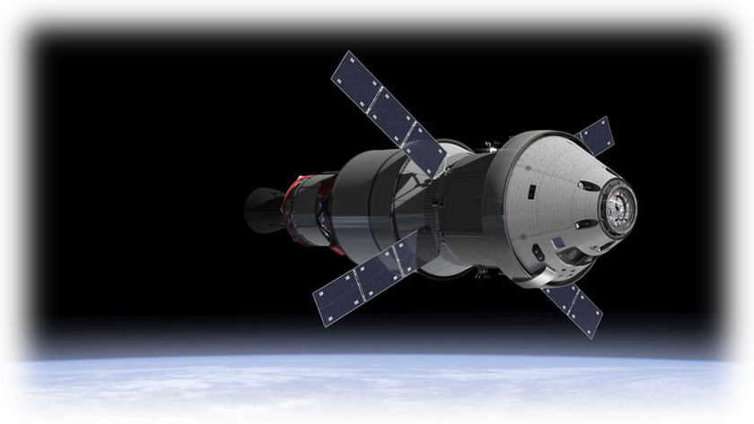
Introduction
Multi-Purpose Crew Vehicle (MPCV) is based on the Constellation program’s Orion design
Capable of conducting regular in-space operations in conjunction with payloads delivered by the Space Launch System (SLS) for missions beyond LEO
Potential backup crew transport system for the International Space Station
Image Credit: NASA.gov

Slide 4
Introduction
Expected to launch in September 2014
Image Credit: NASA.gov

Slide 5
SOCRRATES: Summary
Software Only Crew Exploration Vehicle Risk Reduction Analysis Test Environment Simulation (SOCRRATES)
Developed by Lockheed Martin (LM) for the purpose of MPCV Flight Software (FSW) development testing and verification procedure development (verification test dry runs)
SOCRRATES has three main components
SOCRRATES Controller
FSW
OrionSim

Slide 6
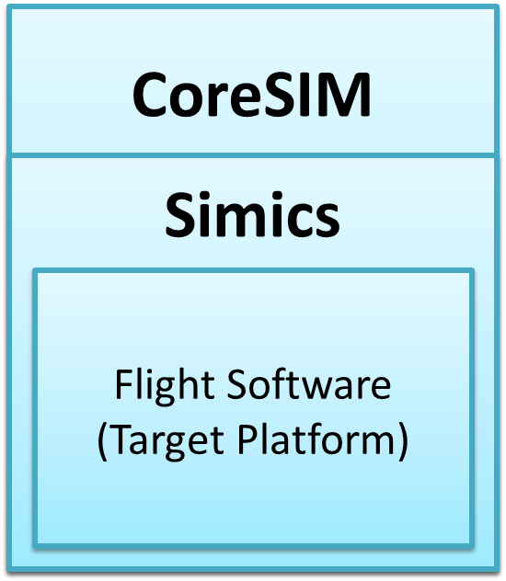
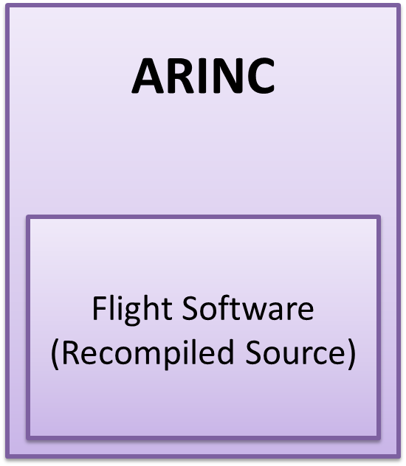
SOCRRATES: Summary
2 variants of SOCRRATES
SOCRRATES Heavy
Simulation environment that executes the unmodified MPCV FSW on an emulated Simics target
Emulates execution of the FSW on the Vehicle Management Computer (VMC)
Used for MPCV IV&V Dynamic Testing
SOCRRATES Lite
Simulation environment where the MPCV FSW is modified and compiled to run in a ARINC 653 Linux environment
Executes FSW at faster than real-time speed but does not emulate execution of the FSW on the VMC
Used for rapid MCPV IV&V Dynamic Testing script development

Slide 7
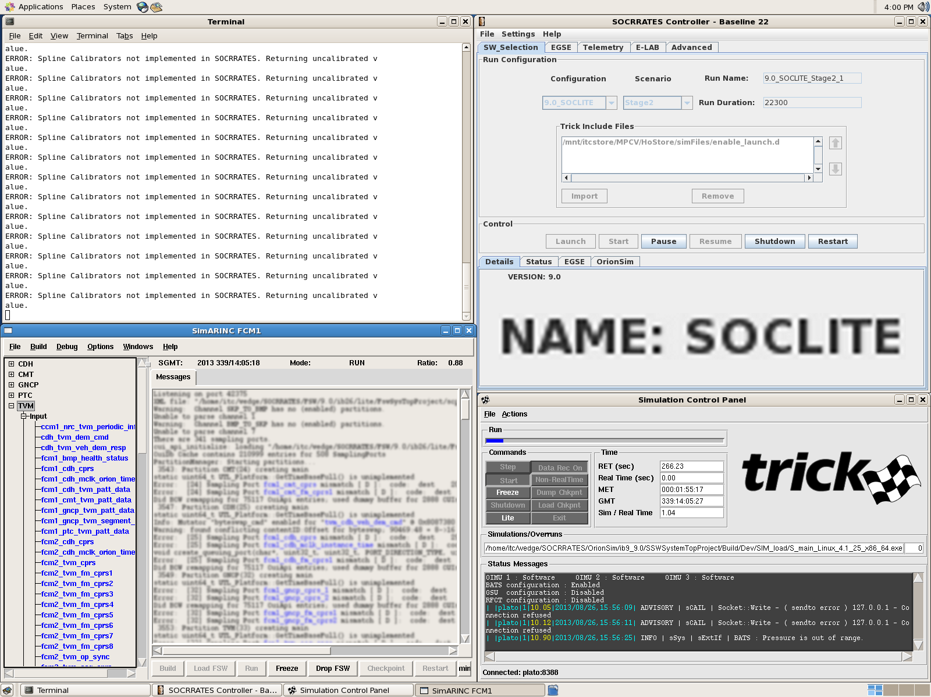
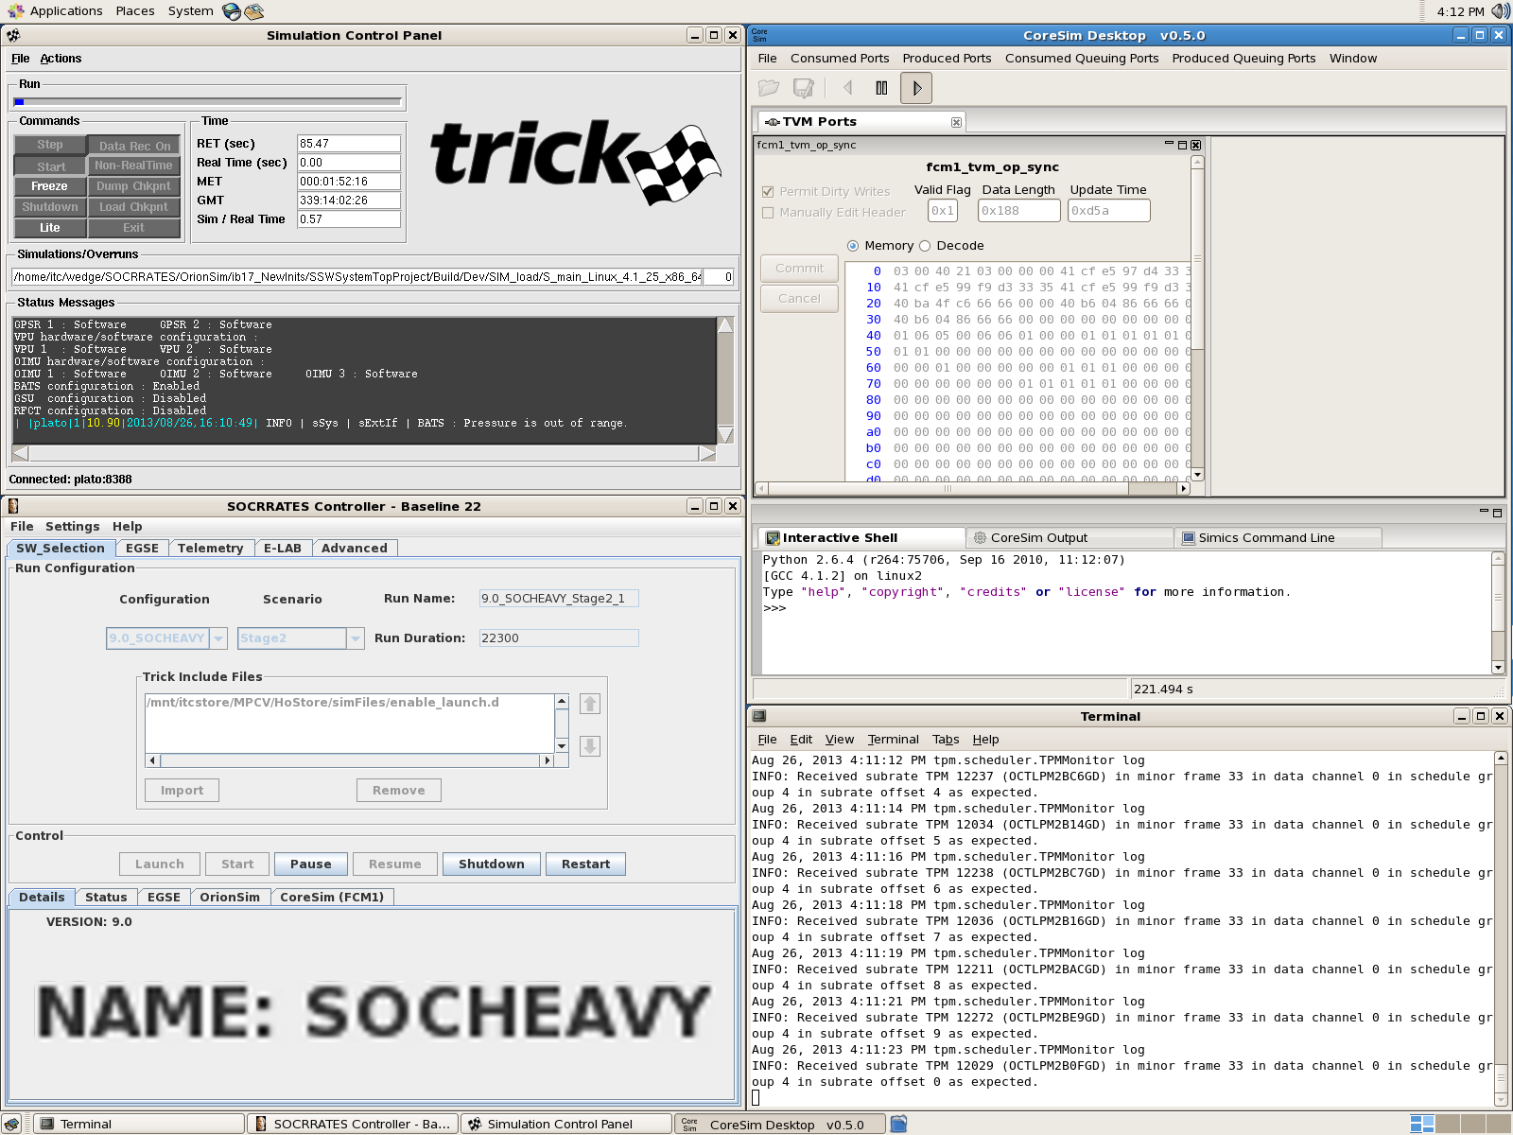
SOCRRATES: Summary

Slide 8
SOCRRATES: Test Case Identification
Identified test cases which were not emphasized in the latest release
Reviewed existing test cases
Reviewed existing Mission Design Databook (MDD) and Fault Management Design Document (FMDD) for possible off-nominal scenarios not tested
Review available Space Shuttle era anomaly data
Identified possible off-nominal situations that may apply to MPCV
Cross reference with MPCV FMDD and MDD for possible linkage

Slide 9
SOCRRATES: Test Case Identification
…
MPCV Test Cases
MPCV FMDD Inspired
…
…
Possible Shuttle Anomalies for MPCV
…
…
MPCV Existing Test Cases
Shuttle-Era Anomalies

Slide 10
SOCRRATES: Test Procedure Definition
Develop high level pseudo code script for each test case
Translate high level procedure into a SOCRRATES Comet Control Language (CCL) script
Extract command and telemetry Compact Unique Identifiers (CUIs) from MPCV’s Data Command Dictionary (DCD)

Slide 11
SOCRRATES: Test Procedure Definition
Ability to develop own/independent test cases to test different scenarios that will validate the FSW behavior in nominal and off-nominal situations
Provide more concrete assurance on analysis results

Slide 12
SOCRRATES: Test Case Example
Purpose
Monitor the Flight Software behavior during off-nominal scenarios with invalid Launch Vehicle Discrete values.
Expected Behavior
During normal flight segment transition, segment should transition upon update of valid Launch Vehicle Discrete values. If invalid Launch Vehicle Discrete values were encountered, segment transition should not occur.
Fault Condition
Inject invalid Launch Vehicle Discrete values before segment transition to occur.
Conclusion
FSW behaved as expected, no segment transition occurred when invalid Launch Vehicle Discrete values were injected

Slide 13
SOCRRATES: Challenges
Test scripts are not guaranteed to work across multiple builds due to dynamic command and telemetry CUIs
Regression test development and post-test analysis is more complex
Dynamic command and telemetry CUIs
CUIs change between builds
Identify and replace new command and/or telemetry CUIs for the obsolete CUIs
Telemetry CUIs would migrate to new Telemetry Packing Map (TPM) from major build to build
Update mapping of telemetry CUIs to TPMs
Steep learning curve

Slide 14
PLATO: Summary
Partition Level Application Test for Orion (PLATO)
Software-based execution environment that allows users to interact with the Orion FSW partitions at their sampling port boundaries
Provides displays and scripting facilities for ad-hoc and automated testing
Developed by NASA-ER6 at the Johnson Space Center
Sampling ports are communication objects allowing a partition to generate commands, statuses, and responses for an aviation or space vehicle

Slide 15
PLATO: Summary
Simulation environment that executes the unmodified MPCV FSW on an emulated Simics target
Allows for stepping through the FSW minor frames and control timing with respect to when data is received in each partition
Testing FSW at the partition level allows for:
The evaluation of partition interfaces
The isolation of partitions to focus troubleshooting efforts during software integration
Used for MPCV IV&V Dynamic Testing

Slide 16
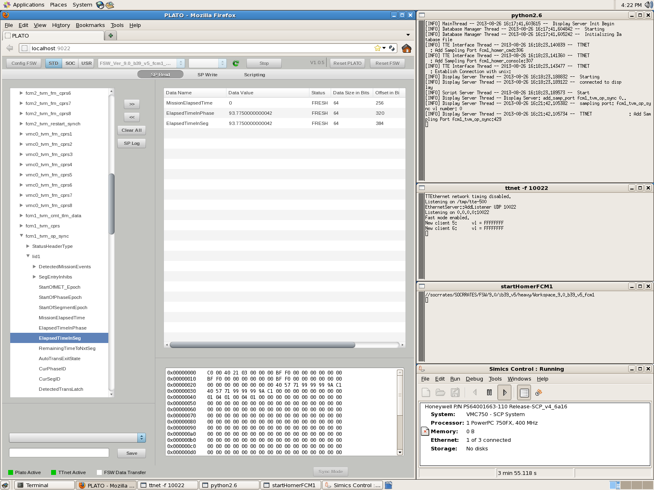
PLATO: Summary

Slide 17
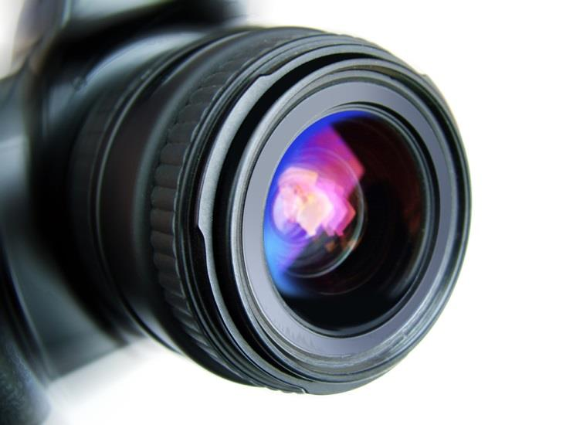
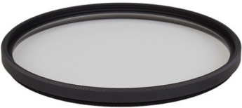
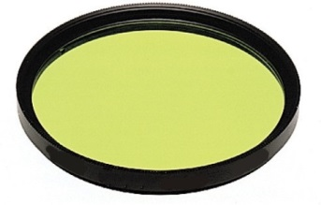
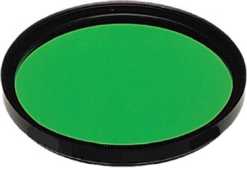
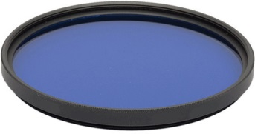
PLATO: Test Case Identification
Reviewed the Technical Memorandums (TMs) for system design patterns
Applied several different “filters”
What sticks out?
What would make for an interesting test?
What can be tested in PLATO?
Are any human-factors involved in an element of the FSW?

Slide 18
PLATO: Test Procedure Definition
When developing the initial high-level test procedures, more questions were asked about each potential test case identified
What are the “guiding ideas” behind the test case?
What is important about this test case?
Why should IV&V care?
Are there any concerns or blockages with the test case?

Slide 19
PLATO: Test Case Example
Purpose
Monitor the Flight Software behavior during nominal and off-nominal segment transition conditions triggered by event flags
Expected Behavior
Nominal transitions should be triggered by the events associated with the corresponding segment. Events not connected to the current segment should not trigger segment transitions. Upon segment transition, all event flags should be cleared.
Fault Condition
Set all event flags not linked to the current segment before setting linked event flags
Conclusion
FSW behaved as expected. Only events associated with the current segment instigated a segment transition.

Slide 20
PLATO: Challenges
Steep learning curve
Scripting API is command-line driven
Easy to inadvertently issue an incorrect command
Difficult to debug these types of errors
Creation of non-flight-like scenarios
Sampling ports are bounded by data type, not by upper/lower bounds (handled elsewhere in the data-load process)

Slide 21
Dynamic Testing Conclusions
Provide the capability to design and develop test scenarios within the NASA IV&V program independently
Can develop tests in parallel with program development. Provide any potential issue in phase with program development schedule.
Can develop tests based on NASA IV&V MPCV adverse condition list
Provide concrete evidence base for analytical results on found issues

Slide 22
Lessons Learned
Ask a lot of questions
Keep investigating until a solution is found
Document everything

Slide 23
BACKUP
IEEE 1012 Appendix C
For system tools, technical independence means that the IV&V effort uses or develops its own set of test and analysis tools separate from the developer’s tools. Sharing of tools is allowable for computer support
environments (e.g., compilers, assemblers, and utilities) or for system simulations where an independent version would be too costly. For shared tools, IV&V conducts qualification tests on tools to assure that the common tools do not contain errors that may mask errors in the system being analyzed and tested. Off-the-shelf tools that have extensive history of use do not require qualification testing. The most important aspect for the use of these tools is to verify the input data used.
Due to program schedule, conducting full qualification tests on the simulation environment was not feasible for NASA IV&V
IV&V MPCV executed supplied checkout and regression scripts to ensure that the installed simulators behave in a similar manner as the Program counterpart. This ensures that both systems behave in the same way for the same broad range of test scenarios.

